Slide 1
Respiratory Distress in Newborn

Slide 2
Learning objectives
At the end of the session the participant will be able to
Define respiratory distress/breathing difficulty
List common causes of respiratory distress in term and preterm newborns.
Identify babies with respiratory distress and assess severity of respiratory distress
Management of babies with respiratory distress
Identify neonates needing referral

Slide 3
Definition
Breathing difficulty or respiratory distress is characterized by any one of the following
Respiratory rate > 60 b/min
Severe chest indrawing
Grunting
Apnoea(not breathing) or grasping
If the baby is apnoeic or grasping, resuscitate the baby immediately

Slide 4
Common causes of respiratory distress
Preterm baby:-
Respiratory distress syndrome(RDS/HMD)
Congenital pneumonia
Miscellaneous: hypothermia, hypoglycaemia
Term baby:-
Transient tachypnea of newborn
Meconium aspiration
Pneumonia
Asphyxia

Slide 5
Cont....causes
Surgical causes:-
Diaphragmatic hernia
Tracheo oesophageal fistula
Bilateral choanal atresia
Other causes
Cardiac: congenital heart disease
Metabolic: acidosis, inborn errors of metabolism

Slide 6
Assess severity of respiratory distress
History collection includes:-
Gestational age
Onset of distress/breathing difficulty
Previous preterm babies with respiratory distress
Antenatal steroids prophylaxis if preterm delivery
Rupture of membrane >24 hours, antepartum fever, chorioamnionitis
Meconium stained amniotic fluid
Perinatal asphyxia
Maternal diabetes mellitus
Poor feeding, lethargy, convulsion
H/O excessive frothing

Slide 7
Cont...Assessment
Examination
Severity of respiratory distress is assessed by Downe’s score
Neurological status: Activity, altered sensorium
CRT(Capillary refill time)
Hepatomegaly
Central cyanosis or low oxygen saturation on pulse oximeter
Features of sepsis like umbilical sepsis, pustules
Look for evidence of malformations

Slide 8
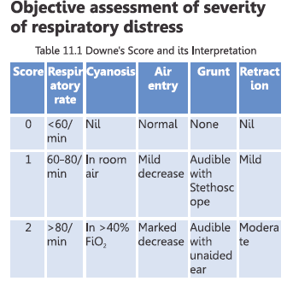
Interpretations
Score 1-6 = respiratory distress
Score >6 = impending respiratory failure
(may need CPAP or mechanical ventilation )

Slide 9
Management
Supportive management
Maintain normal body temperature
Give oxygen with oxygen hood or nasal prongs to achieve appropriate O2 saturation (90-94%)
Mild to moderate respiratory distress- EBM by tube feeding
Watch for feeding intolerance
Give IV fluids if the baby does not accept breast milk or has severe respiratory distress
Maintain blood glucose, if less treat hypoglycaemia
Treat apnoea- Stimulation, Bag &Mask, CPAP, screen for sepsis, refer if necessary.

Slide 10
Oxygen Use
Every baby with RD does not require oxygen
Every baby with RD requires pulse oximeter monitoring
Use O2 only if saturations are < 90%
Avoid saturations > 95%
Indiscrimate Oxygen use is harmful to the baby

Slide 11
Specific management
Mild breathing difficulty
Monitor respiratory distress and oxygen saturation.
Give oxygen if needed.
Allow breast feeds, if does not accept, give EBM by oro-gastric tube.
Do not require antibiotics
IF the respiratory distress persists for more than 6 hours or if there are risk factors
Take samples for screening and culture
Start antibiotics
STOP ANTIBIOTICS, once respiratory distress settles and sepsis screen and culture negative

Slide 12
Management
Moderate to severe breathing difficulty
Monitor and record the following every 1 hour till oxygen requirement then every 2-4 hours for an additional 24 hours.
Respiratory rate
Presence of chest indrawing or grunting on expiration
Episodes of apnea

Slide 13
Cont..
Monitor the baby’s response to oxygen by O2 saturation
Insert an oro-gastric tube to empty the stomach of air and secretions.
Take samples for sepsis screen and blood culture
Start antibiotics IV (Ampicillin and gentamycin)
All babies born through MSAF DO NOT require antibiotics.

Slide 14
Duration of antibiotics
Clinical improvement | Sepsis screening | Blood culture | Antibiotic duration
Baby shows improvement | Negative | Sterile | Stop antibiotics
Baby shows improvement | Positive | Negative | 5-7 days
 |  | Positive –Gram +ve cocci Positive –Gram –ve bacilli | 7-10 days 10-14 days

Slide 15
Cont...
When the baby shows clinical improvement
Give EBM by tube
Allow the baby to begin breast feeding, while on O2 by nasal cannula with continuous monitoring
If baby cannot BF, give EBM using pallada or cup/spoon.

Slide 16
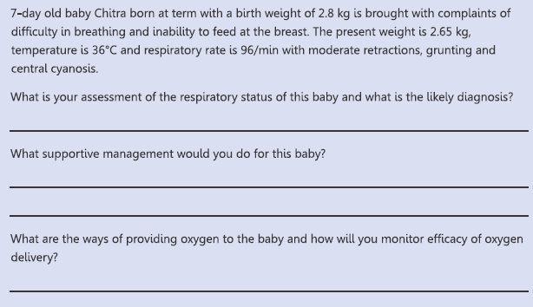
Exercise

Slide 17
Thank you

