Slide 1
NEONATAL HYPOGLYCEMIA

Slide 2
LEARNING OJECTIVES
At the end of the session, participants will be able to:
Define hypoglycemia
Identify babies at risk of hypoglycemia
Explain screening for hypoglycemia
Identify symptoms of hypoglycemia
Manage hypoglycemia

Slide 3
Definition
Hypoglycemia is defined as a blood glucose level of less than 45 mg/dl in all newborns

Slide 4
RISK FACTORS
Premature and LBW neonates especially those weighing less than 2.0kg
Infants of diabetic mother
IUGR babies
Babies on IV fluids
Sick neonates( perinatal asphyxia, hypothermia, poor and/or delayed feeding, sepsis, shock, respiratory distress and polycythemia

Slide 5
SCREENING FOR HYPOGLYCEMIA
Newborns at risk of hypoglycemia should be screened at 2 hr., 6 hr., 12 hr., 24 hr., 48 hr. and if indicated at 72 hr. of age.

Slide 6
SYMPTOMS OF HYPOGLYCEMIA
The common symptoms are:
Jitteriness, irritability
Lethargy, limpness
Weak or high-pitched cry
Poor feeding, vomiting
Tachycardia (>180/min)
Sweating
Hypothermia
Poor respiratory effort or apnea, tachypnea
Dusky color or cyanosis
Seizures, coma

Slide 7
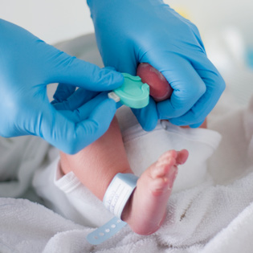
MONITORING - GRBS

Slide 8
MANAGEMENT
Hypoglycemia (blood glucose <45mg/dl by glucometer)
Asymptomatic
Symptomatic

Slide 9
ASYMPTOMATIC MANAGEMENT
BLOOD GLUCOSE > 25MG/DL
GIVE ONE BREASTFEED OR 20-30 ML EBM
BLOOD GLUCOSE <= 25MG/DL
Check blood glucose 1 hour after feeding
Follow symptomatic hypoglycemia management
<45mg/dl
>45mg/dl
Follow symptomatic hypoglycemia
Monitor blood glucose 6-8 hrly
Stop after 48 hours

Slide 10
SYMPTOMATIC MANAGEMENT
If blood glucose <= 25mg/dl then Dextrose bolus: 2ml/kg 10% dextrose over 1 min
Dextrose infusion@ 6mg/kg/min
Check blood glucose after 30 min
Blood glucose >=45mg/dl, begin oral feeding Monitor blood glucose 6 hourly
Blood glucose<45 mg/dl, Increase GIR 2mg/kg/min, as needed. Check blood glucose after 30 min and decide accordingly
GIR > 12 mg/kg/min
(Refractory hypoglycemia)
Blood glucose >=45 mg/dl for 24 hours, decrease GIR by 2mg/kg/min every 6 hr. Oral feeding and
Monitor blood glucose
Inj. Hydrocortisone 2.5 mg/kg stat and refer

Slide 11
Frequency of blood glucose measurements after blood glucose returns to normal
If the baby is receiving IV fluid for any reason, continue blood glucose measurements every 8 hours for as long as the baby requires IV fluids.
If the baby no longer requires or is not receiving IV fluid, measure blood glucose every 12 hours for 24 hours
If the blood glucose is less than 45 mg/dl, treat as per the protocol
If the blood glucose remains normal, discontinue measurements

