Slide 1
Birth Asphyxia

Slide 2
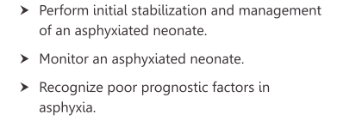
Post asphyxia Management
Learning objectives

Slide 3
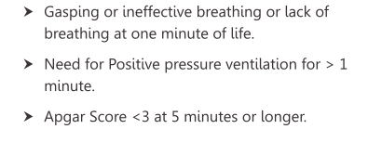
Definition of asphyxia

Slide 4
Monitoring – multi organ dysfunction
Organ | Problem | Monitor
Brain | HIE, seizures | Levene staging Q 8h
Lungs | RD | Downe score Q2 h
Heart | Shock | HR, CRT, BP, pulses
GIT | ileus | AC, BS
Kidneys | Renal failure | UO
Metabolic | Hypoglycemia Hypocalcemia | GRBS Q 6-8 h

Slide 5
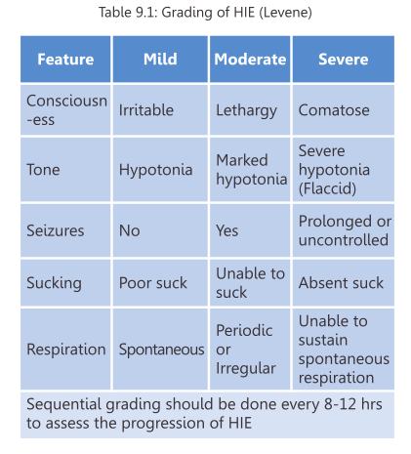
Levene staging HIE

Slide 6
Management
Normothermia -Avoid hyperthermia / uncontrolled hypothermia
Normoxemia – SaO2 90-94%
Normotension
Normoglycemia
IVF &Enteral feeds -
Assess for feeds 4-6 hrly. Abd distension, meconium. Start @ 30 ml/kg, increase by 30 ml/kg
Calcium*, Vit K
Seizures

Slide 7
Poor prognostic factors
When to Refer?
Follow up
Risk of dev. delay

Slide 8
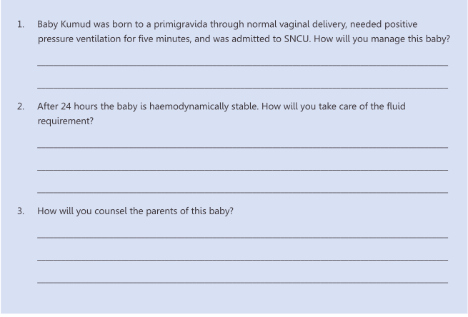
Exercise
Post asphyxia management
Monitor
30 ml/kg feeds increase by 30 ml/kg
Full feeds
Prognostic factors – PPV X 5 min
No HIE
Follow up

Slide 9
Thank you

