Slide 1
Postnatal Care

Slide 2
Postnatal care
Systematic examination of the mother and baby and appropriate advice given to the mother during postpartum period.

Slide 3
Importance of postnatal care
Chance that mother and baby develop complications
Mother: PPH, Sepsis, Depression
Baby: Infections
Identifying early and seeking treatment early can prevent deaths.
Counsel on possible danger signs, and importance of diet, rest, breast feeding and family planning methods.

Slide 4
Is it necessary for the postnatal mother to eat and drink more, why? What all she can eat?

Slide 5
Postnatal Diet
Balanced meals for adequate breast milk.
3 big meals
one small meal
8-10 glasses of liquid (water and milk).
Can eat all foods. No contraindications
No special food is required for the mother
IFA and Calcium

Slide 6
Cont...
Give cereals such as rice and wheat, milk and milk products such as curd, green leafy vegetables and other vegetables, pulses, eggs, nuts (ground nuts), jaggery and meat, including fish and poultry.
Give enough foods rich in fibre such as fruits/green leafy vegetables to avoid constipation.
Avoid tea and coffee, especially within 1 hour of a meal as they interfere with the absorption of iron.
Encourage to take IFA tablets for 3 months.

Slide 7
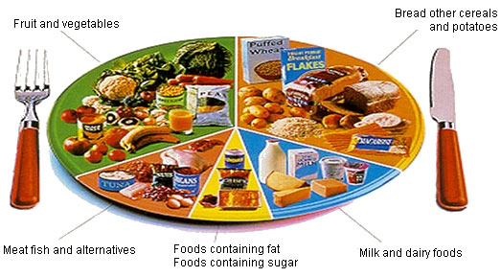
WHAT CAN HELP HAVE ENOUGH BREAST MILK?
EAT 4-5 MEALS/DAY
REST
GET HELP FROM OTHERS
STAY CALM – PRACTICE RELAXATION EXERCISES

Slide 8
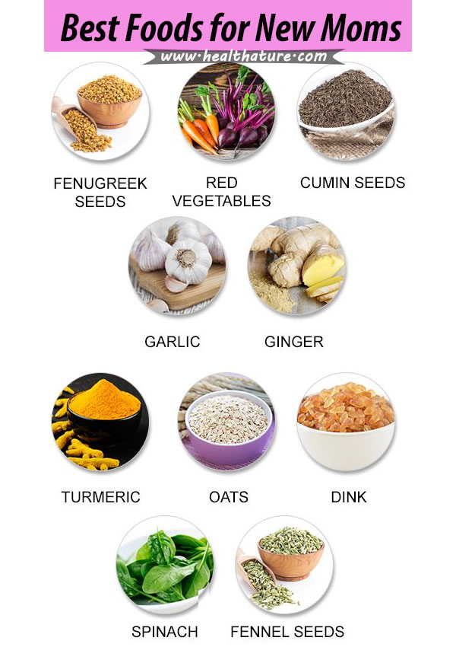
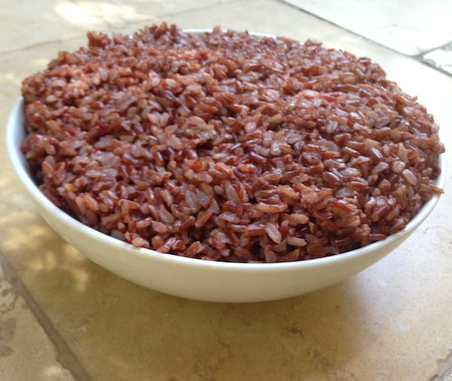
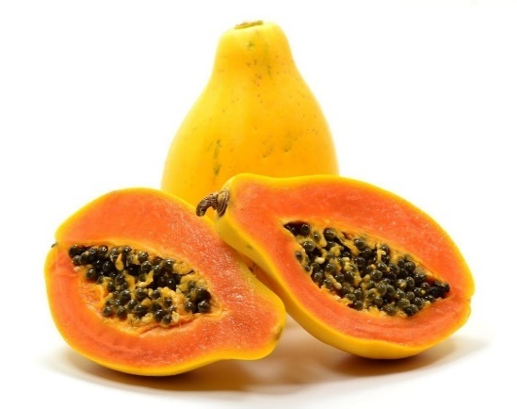
SOME FOODS THAT IMPROVE MILK
MILK OR LOTS OF FLUIDS
RED RICE
ANTINA UNDE
PAPAYA

Slide 9
Are there any special social and cultural practices concerning the diet of the mother?

Slide 10
What kind of work a mother can do after delivery?

Slide 11
Cont....
Adequate rest - 2 hours during day time.
Walk and move soon after delivery.
Can do light household work.
Avoid heavy or load bearing work in the first six weeks after delivery.
For those with Caesarean section: Follow doctors advice - rest, food, work etc.

Slide 12
What are the danger signs after delivery?

Slide 13
The danger signs in women after delivery
Heavy bleeding:
Normal: 1-2 weeks, change in colour red-brown-yellow, no foul smell
Heavy: Pads changed 2 hourly or pass blood clots of the size of a fist or foul smelling discharge
High fever,
Convulsion/fits,
Pain: Abdomen (severe) / suture site / episiotomy site

Slide 14
Advice on hygiene
Have daily bath
Clean perineum daily and after passing urine/stools.
Change pads or cloth every 4-6 hours and more often if needed.
Wash cloth pads with soap and water dry it in sun light.
Wash hands before handling baby and especially after cleaning baby or going to toilet.
Avoid sexual intercourse until the perineal wounds have healed.

Slide 15
Breast Feeding

Slide 16
Problems related to breast feeding

Slide 17
Common problems encountered by mothers during breastfeeding
Flat nipples – check at ANC
Cracked nipples
Breast engorgement
Do not stop breast-feeding in case of minor problems.

Slide 18
Inverted or Flat Nipple
proper attachment and sucking of the breast by the baby.
syringe suction method.

Slide 19
Cracked Nipples
Ensure attachment to breast is correct
Apply hind milk over the nipple.
Use mild soap for daily bath
No need to clean breast every time breast feeding is given.

Slide 20
Breast engorgement
Reasons :
Not feeding regularly
Not attached well during feeding
Mother will have pain, sometimes fever, sucking by baby difficult,
Advise
Hot fomentation
Light massage
Continue to breastfeeding or express breast and feed baby
Refer to health personnel if need

Slide 21
Family planning advice
Spacing: 3-5 years
Exclusive breast feeding - helps in spacing
Family planning methods must be used 1 month after birth.
Discuss the advantages and disadvantages of different family planning methods.
Help them to make an informed choice of contraceptive method to adopt

Slide 22
Case Study 3
Ms Suma, gravida 2 with a LBW baby who is now 2.1 kg is experiencing discharge
What advice will you give the mother?

Slide 23
Case study 1
Mrs. Vasanthy 23 years old primi delivered a female baby weight of 1900g by caesarean section due to Hypertension. She gets discharged today after 7 days of her delivery.
What advice needs to be given to this mother?

Slide 24
Case Study 2
Ms Prema Gravida 1 had a term baby weighing 2.4 kg. She says she does not produce enough milk and she has pain when feeding the baby
What will you look for?
What will you advise the mother?

Slide 25
Thank you

