Slide 1
Danger Signs in a new-born baby

Slide 2
Objectives for the session
To be able to answer the following questions
What are danger signs?
Why should one counsel about danger signs?
When should one counsel about danger signs?
How to collaborate with doctors and nurses to counsel about danger signs?

Slide 3
What are danger signs?
Indicators that baby is sick
Indicators that baby requires immediate help/attention by trained health personnel
Baby may require hospitalization or special care

Slide 4
Why should one counsel about danger signs?
All newborn babies are at risk of becoming sick
Low birth weight babies are more at risk of becoming sick
If mother is told about
danger signs,
she can identify them
and act

Slide 5
Which are the Danger signs??

Slide 6
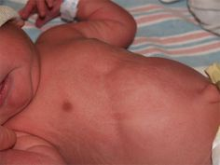
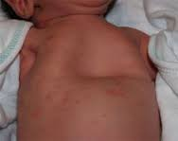
1.Chest indrawing, Increased respiratory rate, Grunting,
What does it indicate?
Life-threatening infection of lungs

Slide 7
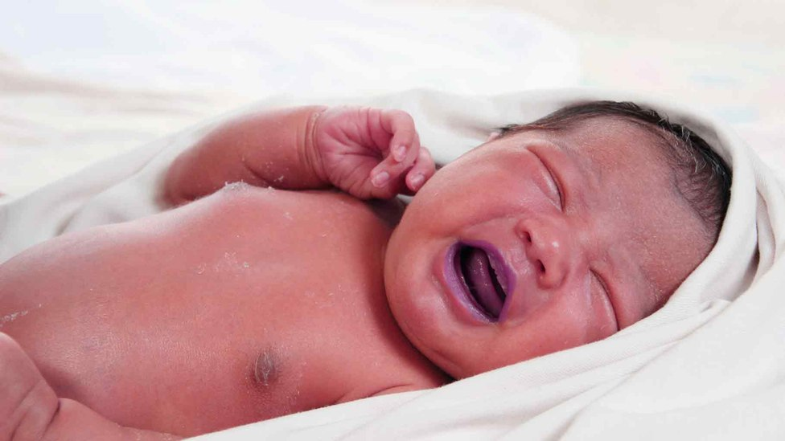
2.Bluish discoloration of face, lips
What does it indicate?
Baby may have a heart problem

Slide 8
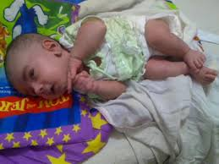
3. Seizures
What does it indicate?
Baby may have low a sugar level
Baby may have blood in brain
Baby may have brain infection

Slide 9
4.Hypothermia/Cold to touch
What does it indicate?
Baby may have lost heat
Baby may have life-threatening infection

Slide 10
5. Fever!!
What does it indicate?
Baby may have life-threatening infection

Slide 11
6.Excessive crying
>3 hours per day

Slide 12
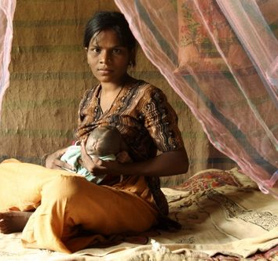
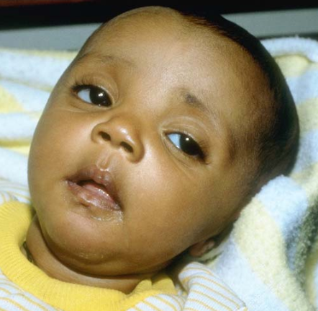
7. Poor feeding/does not eat
What does it indicate?
Baby may have life-threatening infection

Slide 13
8. Excessive sleepiness/Lethargy/poor cry
Normal, active baby
Lethargic baby
What does it indicate?
Baby may have life-threatening infection

Slide 14
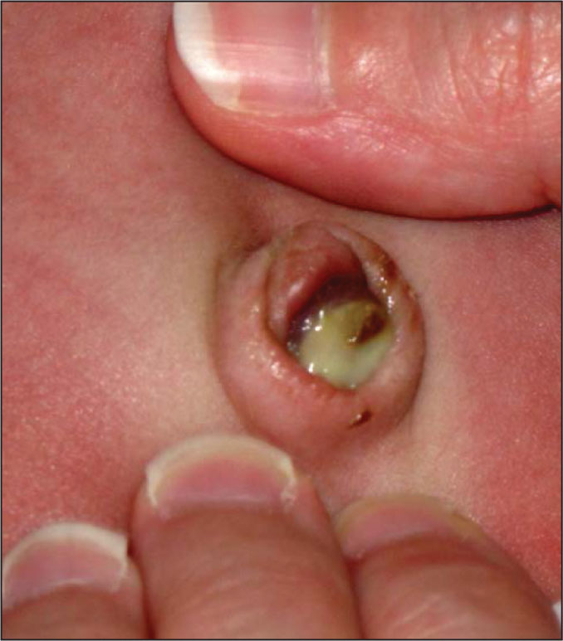
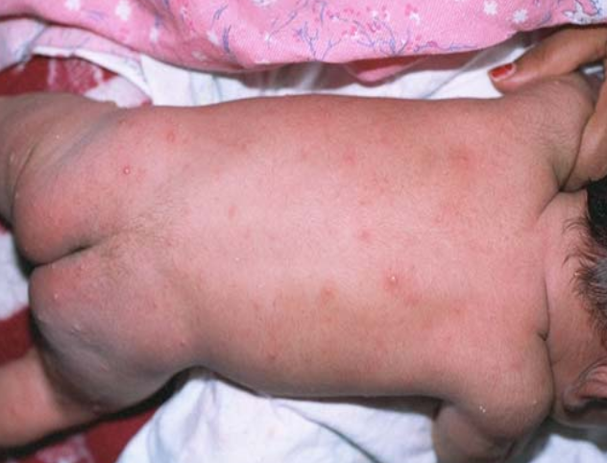
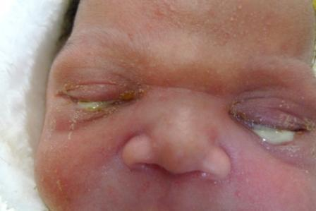
9.Skin/Eyes infection
Pus in eyes
Pus on skin
Pus on belly button

Slide 15
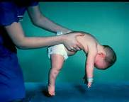
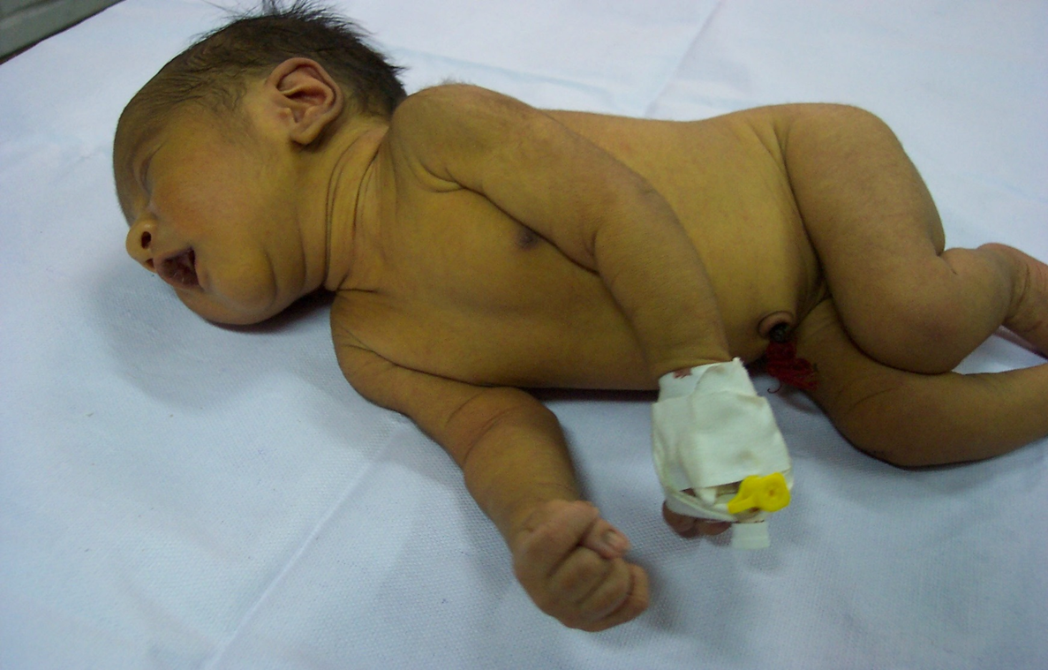
10. Hands and legs become limp or stiff
Normal
Limp
Stiff
What does it indicate?
Baby may have life-threatening infection

Slide 16
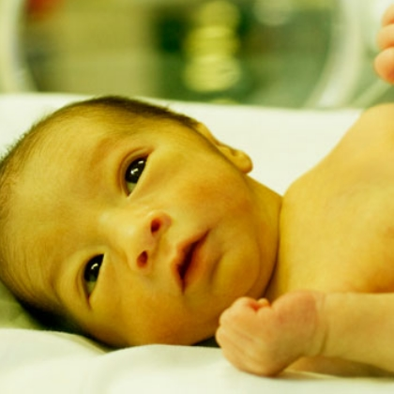
11. Jaundice beyond 14 days of life for term and 21 days for preterm babies

Slide 17
When to counsel regarding danger signs?
When baby in SNCU becomes stable
On the day or day before discharge
So when the family goes home, they are equipped with this information
Give out link card and KMC brochure at discharge

Slide 18
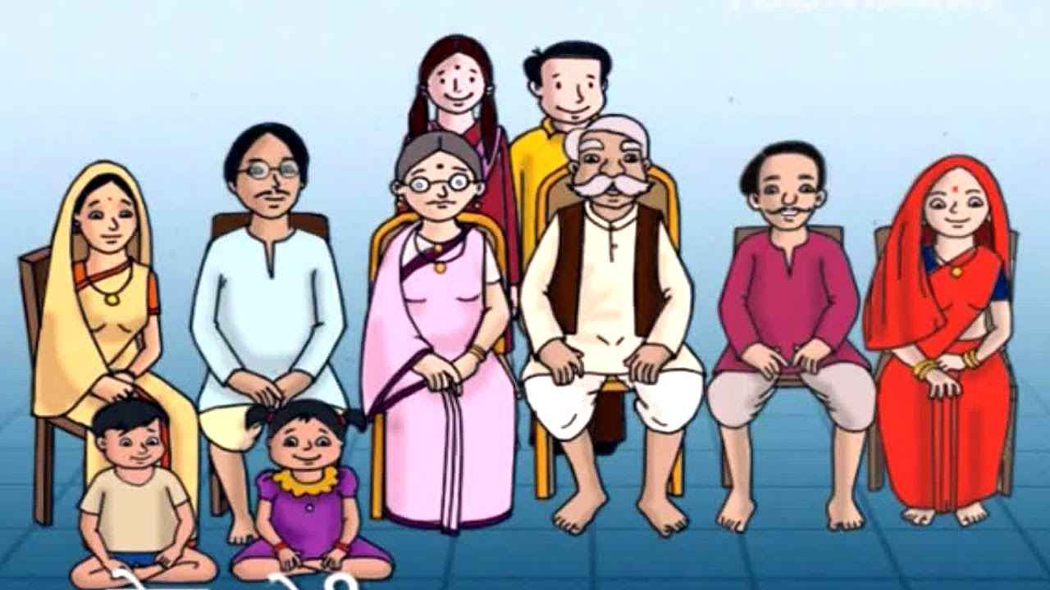
Whom to counsel?
Mother of baby
Find out who will be the person providing support to the mother:
Mother’s mother/ mother-in-law/ sister etc.
Involve baby’s father and encourage him to support his wife in caring for the newborn

Slide 19
Collaboration with the healthcare team
Counselor
Doctor
Nurse
ASHA in the community
Baby’s family

Slide 20
How to collaborate?
Attend rounds with doctors/nurses
Note babies for discharge
Ask doctor if any special messages have to be conveyed to the family
Bridge the communication gap
Inform doctor and nurse when you follow-up with discharged babies over phone
Have a list of all ASHAs and contact them regarding baby's discharge

Slide 21
Case scenario
1) Babyboy born in Koppal District hospital. Birthweight 2750 gms. Was admitted in SNCU because mother had fever just before delivery. Baby got the infection from the mother. After 7 days of treatment on antibiotics in the SNCU, baby is getting discharged tomorrow. Mother has also recovered from her illness and has now directly started breast feeding the baby since 3 days. Before that, the baby was given expressed breast milk.
Enact the discharge counselling you will provide to this mother/baby.
Tips: Use the steps of ALPAC

Slide 22
Case scenario
2) Baby girl born in Muslapur PHC. Birthweight is 1950 gms. Doctor has told that the baby's examination is normal. Mother and baby are due for discharge tomorrow (three days after birth).
Enact the discharge counselling you will provide to this baby/mother.
Tips: Use the steps of ALPAC

Slide 23
Handout
List of danger signs
Key points to counsel baby’s family at discharge

Slide 24
Summary
Chest indrawing/grunting/fast breathing
Bluish dis-coloration of lips and face
Seizures
Cold to touch/ fever
Excessive crying
Poor feeding/not eating
Lethargy
Hands and legs limp/stiff
Jaundice persisting for more than 14 days ( term) or 21 days (pre-term)

