Slide 1
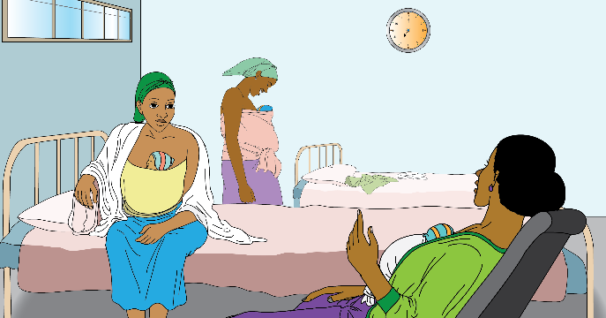
TIGRAY KMC ROOM GUIDE
TIGRAY REGIONAL HEALTH BUREAU
MEKELLE
UNIVERSITY
Prototype – R9 – 26 Oct 2018

Slide 2
PHYSICAL KMC CARE REQUIREMENTS
Mothers Area
Nurses Station
Counseling Area
Dining Area/Kitchen
Hygiene Support
1
2
3
4
5

Slide 3
OPERATIONAL KMC CARE REQUIREMENTS
Nurses General Quality Care Responsibilities
Welcoming Mother & Baby to KMC Room
Counseling on KMC Practices
Counseling on KMC Benefits
Maintain Quality of Care During Mother’s Stay
Discharge or Transfer Mother & Baby
6
7
8
9
10
11

Slide 4
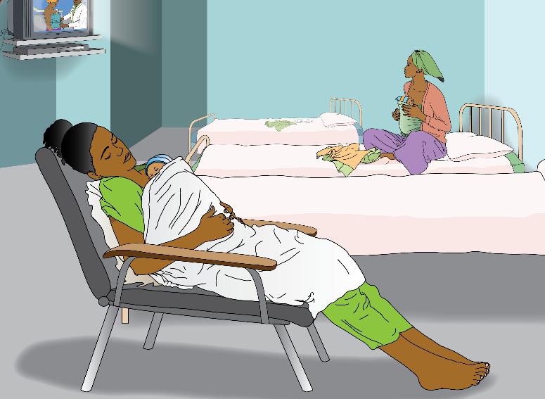

Slide 5
Mothers Area
1
240cm x 240cm minimum dedicated floor space per mother | Gives mother sense of privacy or comfort as well as the space for family to be present to provide support.
Dedicated bed & bedding per mother | Gives the mother security from contamination & some control of her private space.
Storage cupboard per mother (ideally closets for clothes too) | Mother can store valuables, clothes & maintain a clean environment. Can provide a surface to rest items on.
Dedicated KMC chair per mother | Provides skin to skin provider an important comfortable option between standing and laying down.
Hand Washing Station | Allows all an opportunity & reminder to wash hands before touching baby & reduces the chance of infection.
Family/Visitors chairs | Gives family supporters an alternative to sitting on bed or occupying KMC chair. Encourages support visits.
TV/Radio | Offers video/audio counselling, entertainment, information access to mother, father, family, & nurses.
Clock | Allows mothers & supporters to time and schedule skin to skin & breastfeeding routines.

Slide 6
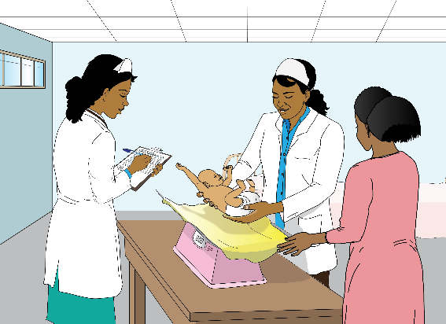

Slide 7
Nurses Station
2
Weighing scale | Allows nurses to keep daily records of changes in babies weight.
Lockable storage & shelf | Provides secure storage for charts, consumables & some medications.
Desk | Provides a place for nurses to organize their paperwork responsibilities and discuss factors with families/staff.
1 to 3 x Chairs | Allows for comfortable & formal discussion between families & nurses (esp’ if no dedicated counseling area).
Small fridge for expressed breast milk | Allows mothers to safely store expressed breast milk (requires close management by nurses).
Thermometer | Allows nurses and mothers to monitor temperature of the KMC room.
Thermostat | Allows nurse to set/automate the temperature of the KMC room.

Slide 9
Counseling Area
3
Dedicated KMC Counseling Room | Provides a space where counseling can take place in private & materials/tools can be on display.
Counseling Materials (books, posters, checklists) | Provides multiple reminders of KMC care practice and theory to mothers, fathers, families and nurses.
Training Equipment (doll, artificial breast to show how to express milk etc) | Assists in simulating & teaching KMC practice and theory alongside the counseling materials.
Table | Provides a surface to train mothers, fathers & families on, and help keep them interacting with the materials.
4+ Chairs | Provides comfortable counseling experience & encourages family members to be included.
Lockable storage & shelf | Provides secure storage for extra counseling materials & discharge kits.
Wall space | Provides a space to hang counseling posters, or mount a TV.
Discharge Kits (socks, caps, binder, KMC materials) | Provide mothers, fathers & families with knowledge and assistive items to continue KMC practice at home.

Slide 10
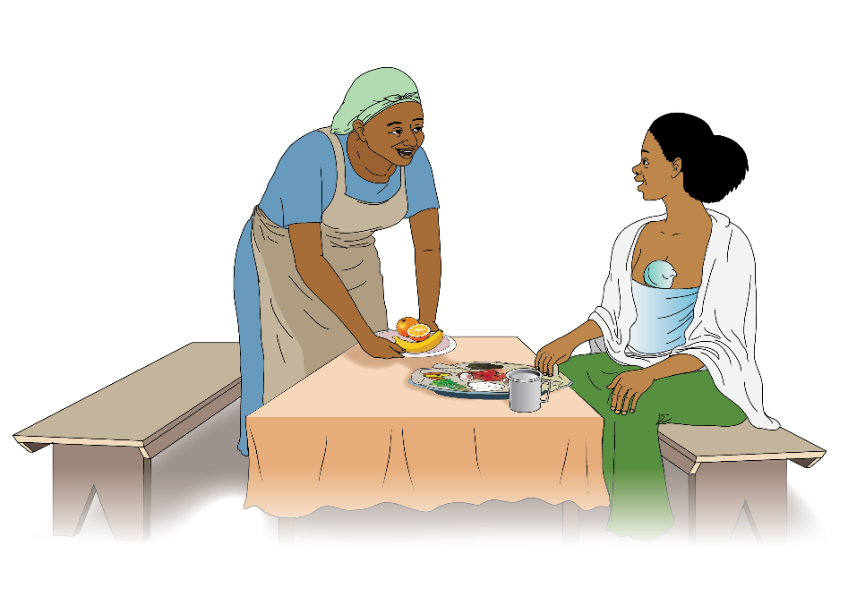

Slide 11
Dining Area / Kitchen
4
Dedicated Dining Table (foldable if space requires) | Provides a space for mothers and family members (or other mothers) to share meals and associated rituals.
4+ Chairs | Provides comfortable relaxing meal experience. Dining space can.
A functioning sink | Allows easy cleaning of dining related items.
Food Storage Lockers | Allows mothers to eat trusted and familiar food from family, also centralized food storage in the KMC space.
Small Stove(if space in HCC for kitchen or cooking area) | Allows for preparation of coffee, tea, or cooked food.
Basic cooking equipment (if space in HCC for kitchen) Pots, pans, utensils, cups,. | Allows for preparation of coffee, tea, or cooked food.
Coffee ceremony equipment | To facilitate common comfortable platform/ritual for discussion and connection with others.

Slide 12
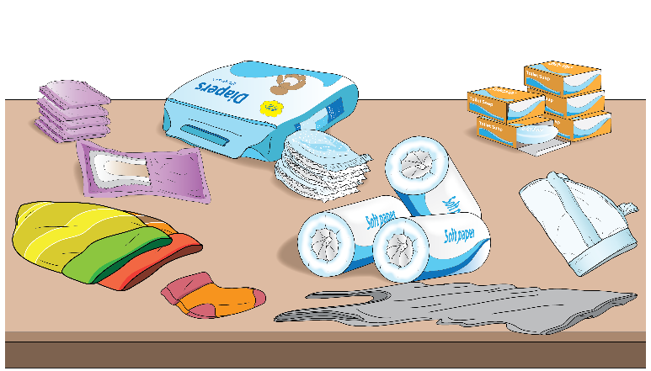

Slide 13
Hygiene Support
5
Consumables Stock Log: Soap, Diapers, Sanitary Pads, Alcohol Solution,/Antiseptics, Mothers Pyjamas | Supports basic function of the space for the mothers & nurses. Without these basic items hygiene is put at risk.
PPE for Nurses | Protects both the patient & the health care worker from potential cross contamination & infection.
Functioning Dedicated Toilet & Bathroom | Keeps KMC Room residents separated from potential cross contamination from other wards & visitors.
Cleaning Log for Bathroom/Toilet | Keeps a record of cleaning frequency, assists in hygiene management, & is an accountability tool.
Cleaning Log for KMC Room | Keeps a record of cleaning frequency, assists in hygiene management, & is an accountability tool.
Maintenance Log for Handwashing Station, Toilet, & Bathroom | Keeps a record of functioning hygiene equipment, assists in hygiene management, prompts repair.
Setup for Washing Clothes | Allows mothers, fathers or family members to keep clothes & textiles that may contact baby clean.

Slide 14
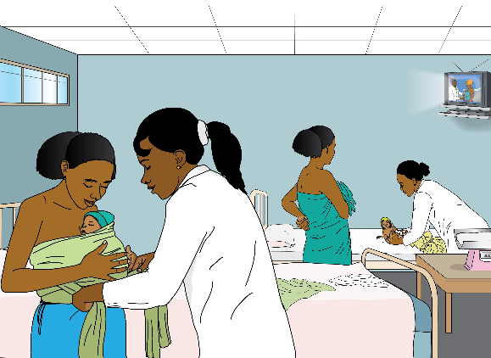

Slide 15
Nurses General Quality Care Responsibilities
6
Answer any questions mother & family may have | Encourages mother & family to increase knowledge of KMC practice and KMC room services & protocol.
Nurse Handwashing Between Patients & Between Tasks | Protects babies from cross contamination & infection
Keep KMC Room Organized, Conduct Minor Cleaning | Maintains a functional positive environment especially when it is busy/at capacity. Supports hygiene protocol.
Control/Manage Visitors & Supporting Family Members | Ensures all people in the KMC room are considerate of the protocols (especially privacy and hygiene).
Check Stock of Necessary Consumables, Enter in Log, Tell Head | Ensures stock shortages are flagged early, and that orders/requests submission is timely.
Check Function of Equipment, Enter in Log, Tell Head | Ensures malfunctioning equipment is flagged early and maintenance protocol can be prompted.
Co-ordinate with Janitors to Maintain Cleaning Logs | Ensures KMC Room & Bathroom/Toilet are kept clean. Reduces the chance of cross contamination/infection.

Slide 16
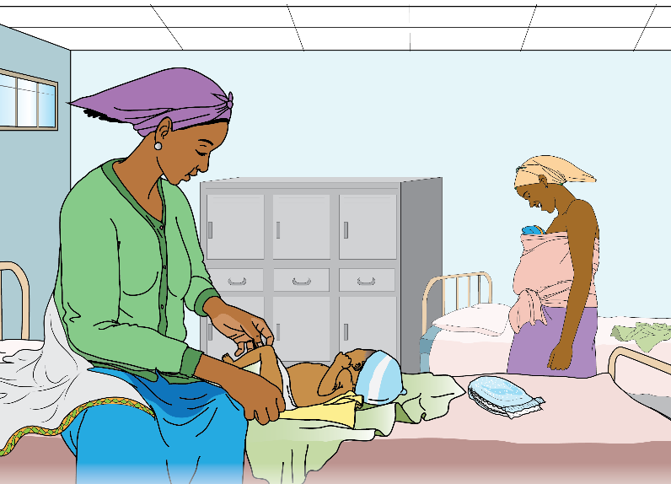

Slide 17
Welcoming Mother & Baby to KMC Room
7
Nurse Introduces Themselves & Ask Mother’s name (& babies name if it has one) | Provides a friendly & welcoming first encounter fro mother. Allows mother and nurse to gain trust.
Check & Record Newborns Condition & Vital Signs & Communicate to Mother | Identifies any problems immediately & refer back to NICU. Will begin mothers knowledge of warning signs.
Dress Baby in Hat, Nappy & Socks | Will keep baby warm and assist mothers knowledge of baby care.
Review Referral Notes & Fill in KMC Register | Keeps a record of mother babies details and allows nurse to double check them with mother.
Formally Welcome Mother & Baby to KMC Room, Show to Bed, & Introduce to Other Mothers | Helps mother feel welcome in new space, & starts relations with new KMC Room co-habitants.
Explain KMC Room Equipment & Services | Allows mother to know what to expect in the KMC Room.
Explain KMC Room Visitor & Hygiene Protocol | Encourages good hygiene practice. Prepares mother and family for being corrected or asked to comply.
Encourage Mother to Ask Questions | Reduce intimidation of new environment, further empower mother to request/ask for help or knowledge.

Slide 18
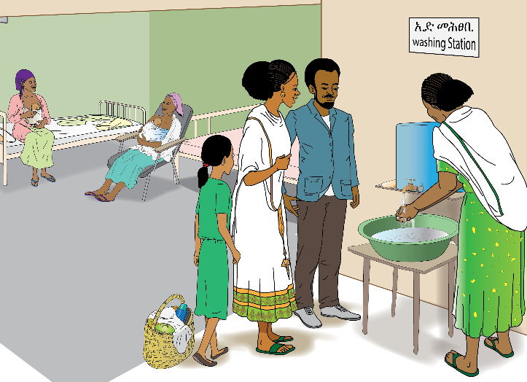

Slide 19
Counseling on KMC Practices
8
Counsel Mother, Father & Supporting Family Members on KMC Practice: | Empowers the mother, father & family with KMC theory and practice.
Skin to Skin Contact (demonstrate or ask other practicing mothers to help) | Affirms the nuances, challenges & strategies for successful skin to skin care.
Exclusive Breast Feeding & Expressing Milk | Affirms the nuances, challenges & strategies for exclusive breast feeding & pumping.
Danger Signs | Allows all to quickly identify when baby needs to return to NICU/hospital.
Family Support | Affirms importance of father and family’s role in successful KMC Care.
Infection Prevention | Affirms hygiene protocol in facility & need to wash hands between tasks and baby contact, & clothes
Follow Up | Readies the family for home visits to check on health of baby and quality of KMC care.
Continuation of KMC at home | Affirms how KMC practice extends to home environment and readies the family for associated challenges.

Slide 21
Counseling on KMC Benefits
9
Counsel Mother, Father & Supporting Family Members on KMC Benefits: | Reaffirms importance of KMC practice for babies survival.
Reaffirm Need to Monitor Heartbeat & Temperature, & that it will be Easier to do During Skin To Skin Care. | Skin to skin stabilizes babies temperature & heartbeat.
Reaffirm Need To Monitor Their Baby’s Breathing, & that it will be Easier to do During Skin To Skin Care. | Skin to skin reminds baby to breathe.
Reaffirm that Skin to Skin Care can Avoid Some of the Challenges of Getting Baby to Breastfeed. | Skin to skin encourages exclusive breastfeeding.
Encourage Parents to use Skin to Skin as a Way to Get to Know Their Baby. | Skin to skin increases bonding opportunities/intimate exchange.
Encourage Parents to use Skin to Skin as a Way to Easily Check on their Condition Regularly. | Skin to skin calms mother & baby (or father/family supporter) .
Reaffirm that Skin to Skin Care Gives Parents Increased Control of a Baby’s Survival. | Skin to skin & Exclusive Breastfeeding reduces chance of infection.

Slide 22
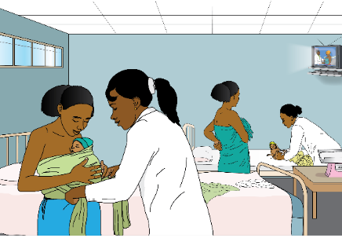
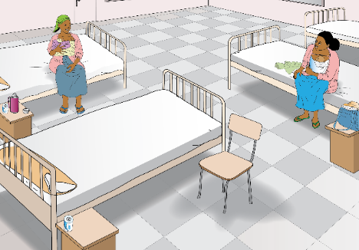
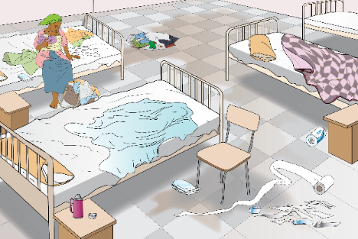

Slide 23
Maintain Quality Care During Mother’s Stay
10
Check Baby’s Condition as Frequently as Possible | Identifies problems early which can help to save baby or avoid major future health issues.
Communicate Frequently with Mothers | Offers stimulation to mother who is needing to lay/sit still for long periods of time. Encourages questions.
Communicate Baby’s Condition & Weight to Mother | Keeps mother knowledgeable/updated on baby’s condition.
Check if Mother is Content, Supported, and Visited | Can help identify problems mother may be having, or need for additional support.
Daily Group KMC Counseling with all mothers (including success stories) | Reaffirms all KMC practice, theory & benefits.
Encourage Mothers to Interact/Chat | Connects mothers and encourages them to keep each other stimulated and supported.
Document Every 6 Hours: Babies Temperature, Warning Signs, & Breastfeeding Frequency on Monitoring Sheet | Keeps detailed records on all babies conditions that can be used in data analysis and mortality analysis.

Slide 25
Discharge or Transfer Mother & Baby
11
Confirm Babies Stability for Transfer/Discharge | Makes sure a baby who may have sufficient weight also has other vital signs stabilized before leaving facility.
Ask Mother, Father & Family if they are Confident & Able to Continue KMC at home. | Reaffirms importance of KMC practice to baby’s survival.
Counsel Mother, Father & Family again on KMC Practices & Benefits | Reminds all on details of KMC practice, theory & benefits.
Confirm Mother is Accompanied & Has Transport to get Home/to Next Facility | Ensures mother feels confident about passage home/to facility.
If Transferring Communicate with Receiving HCC/Hospital and Confirm Departure & Arrival | Ensures facilities know if mother has either decided to go home against advice or has made transfer.
Complete KMC Register | Maintains detailed records of discharges.
Ensure Mother has KMC Materials/Discharge Kit to Take Home. Explain KMC Follow Up Expectations | Assists ability to practice KMC in home environment.
Wish Mother Well and Say Goodbye | Positive closure to stay in KMC room.

Slide 26
For more information or copies of this guide please contact:
TIGRAY REGIONAL HEALTH BUREAU
MEKELLE
UNIVERSITY
Prototype – R9 – 26 Oct 2018

