Slide 1
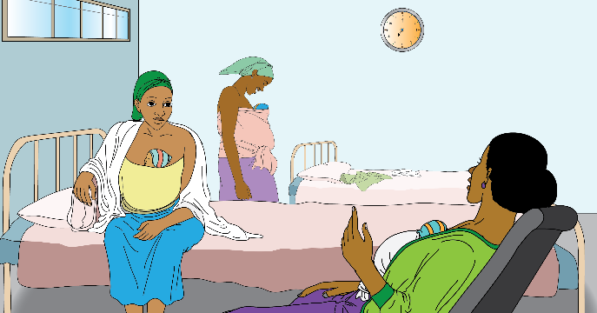
መምርሒ ክፍሊ ሕቁፈ ጓጓ/ጉለ ት
TIGRAY REGIONAL HEALTH BUREAU
MEKELLE
UNIVERSITY
Prototype – R9 – 26 Oct 2018

Slide 2
ክንክን ሕቁፈ ጓጓ/ጉለ ንክህሉ ዘድሊዩ
አዴታት መፅንሒ
መዕረፊ ነርስታት
መዉሃቢ ግልጋሎት ምኽሪ
መመገቢ ቦታ ፥ ክሽነ
ንፅሬት ዝሕግዙ
1
2
3
4
5

Slide 3
ክንክን ሕቁፈ ጓጓ/ጉለ ንክወሃብ ዘድሊዩ
ሓላፍነት ነርስ አብ ሓፈሻዊ ጽፈት ክንክን
ኣቀባበላ አደን ሕንጠን ናብ ሕቁፈ ጓጓ/ጉለ ክፍሊ
ግልጋሎት ምኽሪ አዋህባ ሕቁፈ ጓጓ/ጉለ
ግልጋሎት ምኽሪ ጥቅሚ ሕቁፈ ጓጓ/ጉለ
አብ እዋን ፃንሒት አደ ፅሬት/ጽፈት ክንክን ምሕላዉ
ካብ ትካል ምስንባት ወይ ናብ ካልዕ ትካል ምትሕልላፍ አዶን ሕንጦን
6
7
8
9
10
11

Slide 4
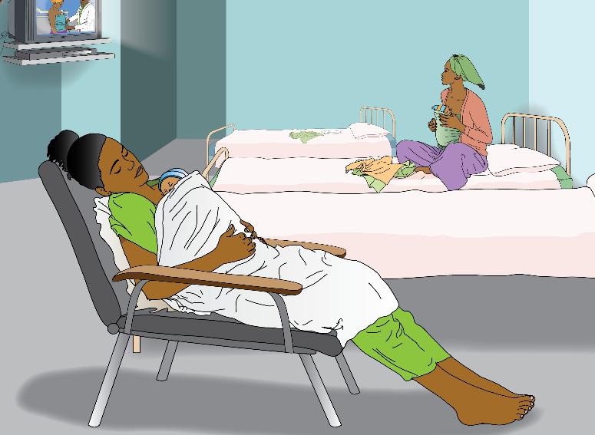

Slide 5
አዴታት መፅንሒ ፡
አደ ምቾት ተሰሚዒዋ ሕቁፈ ጓጓ/ጉለ ትገብረሉ ቦታ ክሕልውዎ ዝግብኡ ነገራት፥
1
ብዉሑዱ 240 ሴ.ሜ x 240 ሴ.ሜ ዝኾነ ቦታ (ንሓንቲ አደ ክሕዝ ዝክእል ስፍሓት | Gives mother sense of privacy or comfort as well as the space for family to be present to provide support.
ንአዶ ምችዉ መደቀሲ ዓራት | Gives the mother security from contamination & some control of her private space.
ንሕድ ሕድ አደ ሳፁን/አርማድዮ | Mother can store valuables, clothes & maintain a clean environment. Can provide a surface to rest items on.
ንሕድ ሕድ አደ ምችዉ መቀመጢ ወንበር | Provides skin to skin provider an important comfortable option between standing and laying down.
መሕፀቢ ኢድ ቦታ | Allows all an opportunity & reminder to wash hands before touching baby & reduces the chance of infection.
ንስድራቤት/በፃሕቲ ኮፍ መበሊ ወንበር | Gives family supporters an alternative to sitting on bed or occupying KMC chair. Encourages support visits.
ቴሌቪዥን/ሬድዮ | Offers video/audio counselling, entertainment, information access to mother, father, family, & nurses.
መንደቅ ሰዓት | Allows mothers & supporters to time and schedule skin to skin & breastfeeding routines.

Slide 6
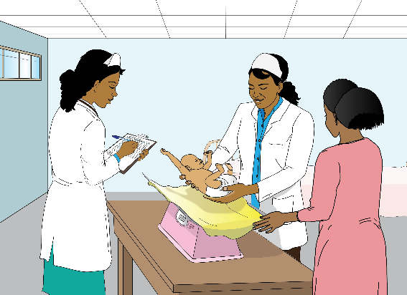

Slide 7
መዕረፊ ነርስታት፡
ናይ ክንክን ሕቁፈ ጓጓ/ጉለ ነርስታት ስራሕ ቦታ ዘተሓባብራሉን ዝኾነ ፀገም
ተሃልዩ ምስ ስድራቤት አዶን ሰራሕተኛን ዝመያየጣሉ ቦታ እዩ፡፡
2
መምዘኒ ሚዛን | Allows nurses to keep daily records of changes in babies weight.
ዝቁለፍ መቀመጥን ሸልፍን | Provides secure storage for charts, consumables & some medications.
መፅሓፊ ጠረጵዛ | Provides a place for nurses to organize their paperwork responsibilities and discuss factors with families/staff.
ወናብር | Allows for comfortable & formal discussion between families & nurses (esp’ if no dedicated counseling area).
መቀመጢ ተሓለበ ፀባ አደ ዝከውን ንእሽተይ ፍሪጅ | Allows mothers to safely store expressed breast milk (requires close management by nurses).
መለክዒ ሙቀት ቴርሞሜተር | Allows nurses and mothers to monitor temperature of the KMC room.
ሙቐት ንምምጣን ዘገልግል ብልሓት፡ ተርሞስታት | Allows nurse to set/automate the temperature of the KMC room.

Slide 9
መዉሃቢ ግልጋሎት ምኽሪ ፡
ማለት ግልጋሎት ምኽሪ ዝወሃበሉ ኮይኑ መምሃሪ ሓገዝ ናዉቲ ብቀረባ ዝረአየሉ እዩ፡፡
3
ሕቁፈ ጓጓ/ጉለ ግልጋሎት ምኽሪ መዉሃቢ ምችዉ ክፍሊ | Provides a space where counseling can take place in private & materials/tools can be on display.
መምከሪ ሓገዝ (መፃሕፍቲ፤ ምስሊታትን ቃለ መሕትትን፥ ፖስተር | Provides multiple reminders of KMC care practice and theory to mothers, fathers, families and nurses.
መሰልጠኒ ናዉቲ (ባንቡላ፤ ምስሊ/ቅርፂ ጡብ ከመይ ጌራ ፀባ ከምትሓልብ ንምርአይ | Assists in simulating & teaching KMC practice and theory alongside the counseling materials.
ጠረጼዛ | Provides a surface to train mothers, fathers & families on, and help keep them interacting with the materials.
4+ ወናብር | Provides comfortable counseling experience & encourages family members to be included.
ዝቁለፍ መቀመጥን ሸልፍን | Provides secure storage for extra counseling materials & discharge kits.
Wall space | Provides a space to hang counseling posters, or mount a TV.
ኣዶ ናብ ገዛ ሂዛቶም ትኸይድ መምሓሪ ስዕልታትን መምርሒ ወለዲን | Provide mothers, fathers & families with knowledge and assistive items to continue KMC practice at home.

Slide 10
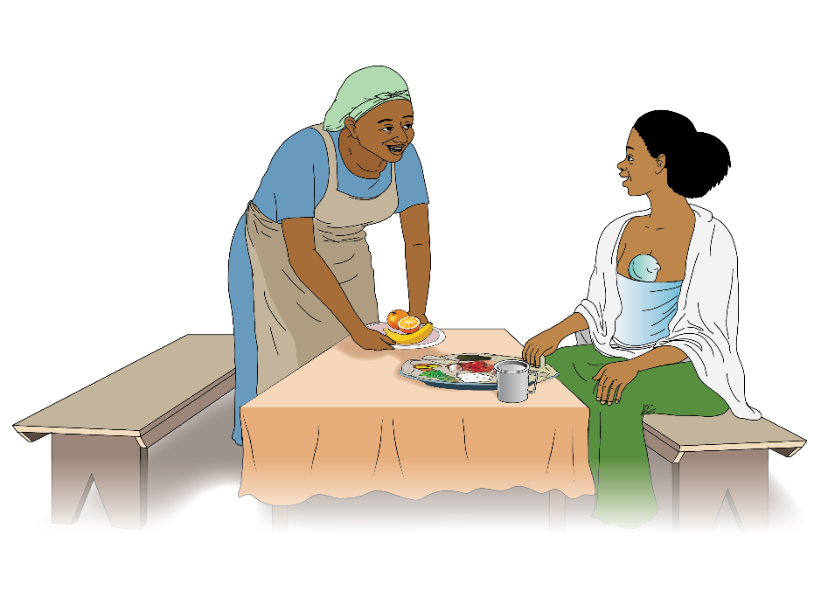

Slide 11
መመገቢ ቦታ/ ክሽነ፡
ኣደታት ክምገባሉ ዝክዕላ ተተካኢሉ ውን ምግበን ከዘጋጅዋሉ ዝክዕላ ቦታ
4
መመገቢ ጠረጴዛ (ቦታ ንከይወስድ ተዓፃፃፋይ ምግባር | Provides a space for mothers and family members (or other mothers) to share meals and associated rituals.
4+ ወናብር | Provides comfortable relaxing meal experience. Dining space can.
ዝሰርሕ መሕፀቢ ኣቁሑ ፥ ሲንክ | Allows easy cleaning of dining related items.
መቀመጢ ምግቢ ፥ ሸልፍ | Allows mothers to eat trusted and familiar food from family, also centralized food storage in the KMC space.
ንእሽተይ ምድጃ ፥ እስቶቭ | Allows for preparation of coffee, tea, or cooked food.
አድለይቲ ዝኾኑ መብሰሊ አቁሑት ( ዕትሮ፤ ባዴላ፤ ድስቲ፤ ኩባያ | Allows for preparation of coffee, tea, or cooked food.
ናይ ቡና ረኾበት/ኣቑሑት | To facilitate common comfortable platform/ritual for discussion and connection with others.

Slide 12
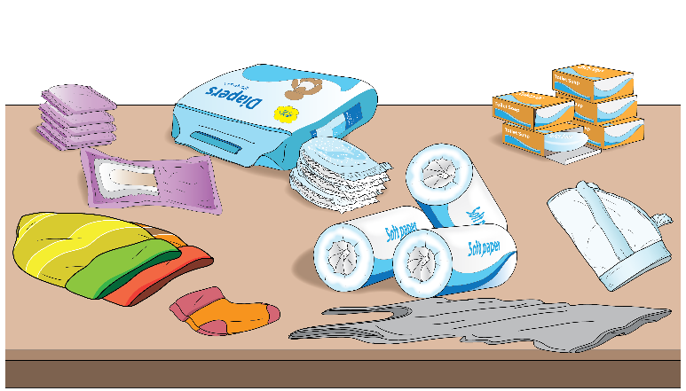

Slide 13
5
ንፅሬት ዝሕግዙ
ሓለቅቲ ናውቲ፡ ሳሙና፤ ጨርቂ ሽንቲ፤ መፀራረይ፤ አልኮል/ፀረ-ረኽሲ፤ ናይ አዴታት ቢጃማ | Supports basic function of the space for the mothers & nurses. Without these basic items hygiene is put at risk.
PPE for Nurses | Protects both the patient & the health care worker from potential cross contamination & infection.
ዝሰርሕ ሽቃቅን መሕፀቢ ሰብነትን | Keeps KMC Room residents separated from potential cross contamination from other wards & visitors.
መፀራረይ ንሽቃቅን መሕፀቢ ሰብነትን | Keeps a record of cleaning frequency, assists in hygiene management, & is an accountability tool.
Cleaning Log for KMC Room | Keeps a record of cleaning frequency, assists in hygiene management, & is an accountability tool.
መዝገብ መከታተሊ ፅሬት ሰብነት መሕጽቢን ሽቃቅን | Keeps a record of functioning hygiene equipment, assists in hygiene management, prompts repair.
መሕፀቢ ክዳውንቲ ሲንክ | Allows mothers, fathers or family members to keep clothes & textiles that may contact baby clean.

Slide 14
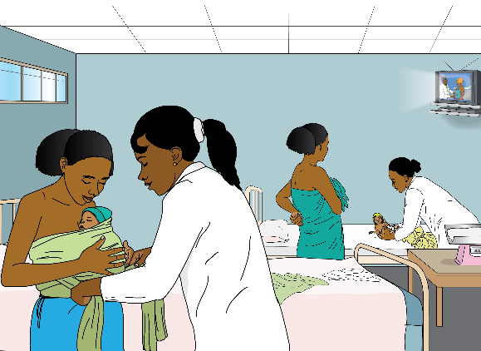

Slide 15
6
ሓላፍነት ነርስ አብ ሓፈሻዊ ጽፈት ክንክን ኣዶን ሕንጦን
ዝኾኑ ዓይነት ሕቶታት አደን ስድራን ምላሽ ምሃብ | Encourages mother & family to increase knowledge of KMC practice and KMC room services & protocol.
ኢድ ምሕፃብ ቅድሚ ሕድ ሕድ ሕሙም ምንካዕ | Protects babies from cross contamination & infection
ክፍሊ ሕቁፈ ጓጓ/ጉለ ምዑርይን ጽሩይን ምግባር | Maintains a functional positive environment especially when it is busy/at capacity. Supports hygiene protocol.
ምሕደራ በፃሕትን ሓገዝቲ ስድራ ቤት አባላትን | Ensures all people in the KMC room are considerate of the protocols (especially privacy and hygiene).
ኩሎም አድለይቲ ነገራት ምህላዎም ምርግጋጽ፤ ናብ መዝገብ ምስፋርን ንሓላፊ/ት ነርስ ምዝራብን | Ensures stock shortages are flagged early, and that orders/requests submission is timely.
ናዉቲ ዝሰርሑ ምዃኖም ምርግጋፅ፤ አብ መዝገብ ምስፋርን ንሓላፊ ምፍላጥን | Ensures malfunctioning equipment is flagged early and maintenance protocol can be prompted.
ንጽዳት ሰራሕተኛታት ምትሕብባርን ፅሬቱ ዘቕፅል መዝገብ ምምላእን | Ensures KMC Room & Bathroom/Toilet are kept clean. Reduces the chance of cross contamination/infection.

Slide 16
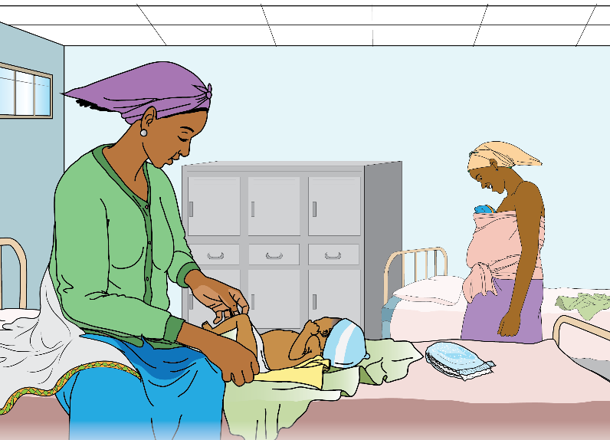

Slide 17
7
ኣቀባበላ አደን ሕንጠን ናብ ሕቁፈ ጓጓ/ጉለ ክፍሊ
ነርስ ሽማ/ሙ የ/ተፋልጥ ቀፂላ/ሉ ንአደ ሽማ ትሓታ (ሽም ሕንጠይ/ሓናጡ ምሕታት | Provides a friendly & welcoming first encounter fro mother. Allows mother and nurse to gain trust.
ምርግጋፅን ምምዝጋብን ኩነታት ሕንጠይ፤ ኩነታት እቲ ሕንጦ ንአዶ ምንጋር | Identifies any problems immediately & refer back to NICU. Will begin mothers knowledge of warning signs.
ድሕሪ ምርመራ ንሕንጦ ቆቢዕ፤ ካልስን መሕቆፊ ጨርቂን ምግባር | Will keep baby warm and assist mothers knowledge of baby care.
ሪፈር ተፃሓፈሉ ማስታወሻ ምርአይን አብ መዝገብ ሕቁፈ ጓጓ/ጉለ ምምዝጋብ | Keeps a record of mother babies details and allows nurse to double check them with mother.
ንአዶን ሕንጦን ናብ ዓራቶም ምውሳድ፤ ምስ ካልኦት አዴታት ምፍላጥ | Helps mother feel welcome in new space, & starts relations with new KMC Room co-habitants.
አብ ክፍሊ ሕቁፈ ጓጓ/ጉለ ዘለዉ ናዉትን ግልጋሎትን ገለፃ ምግባር | Allows mother to know what to expect in the KMC Room.
አብ ክፍሊ ሕቁፈ ጓጓ/ጉለ ናይ በፃሕቲ መምርሒን ፅሬት ኣተሓላለዋን ገለፃ ምግባር | Encourages good hygiene practice. Prepares mother and family for being corrected or asked to comply.
አደ ንክትሓትት ምብርትታዕን | Reduce intimidation of new environment, further empower mother to request/ask for help or knowledge.

Slide 18
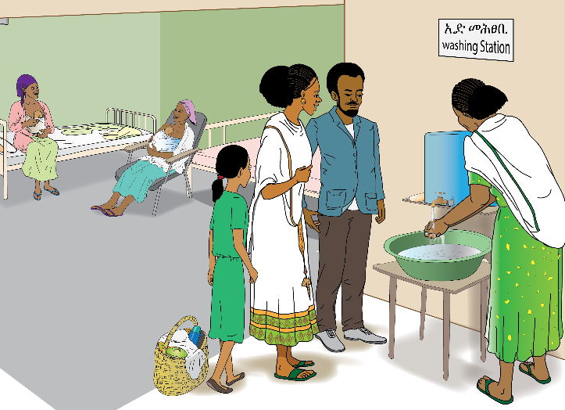

Slide 19
8
ግልጋሎት ምኽሪ አዋህባ ሕቁፈ ጓጓ/ጉለ
ግልጋሎት ምኽሪ ንአዶ፤ አቦ ፤ ንሓገዝቲ አባላት ስድራ ቤት ብዛዕባ ዕንታይነትን ትግበራን ሕቁፈ ጓጓ ክዋብ ከሎ ክግለጹ ዝግበኦም ነጥብታት፡ | Empowers the mother, father & family with KMC theory and practice.
ምንኽኻእ ቆርበት ንቆርበት (ምራይ ወይ ካልኦት ብተግባር ዝሰርሓ ኣዶታት ከርዕያ ምግባር) | Affirms the nuances, challenges & strategies for successful skin to skin care.
ፀባ ጡብ ጥራይ ምጥባይ ፀባ ጡብ ምሕላብ | Affirms the nuances, challenges & strategies for exclusive breast feeding & pumping.
ሓደገኛ ምልክታት | Allows all to quickly identify when baby needs to return to NICU/hospital.
ሓገዝ ስድራ ቤት | Affirms importance of father and family’s role in successful KMC Care.
ምክልኻል ረኽሲ | Affirms hygiene protocol in facility & need to wash hands between tasks and baby contact, & clothes
ክትትል | Readies the family for home visits to check on health of baby and quality of KMC care.
ሕቁፎ ጓጓ/ጉለ አብ ገዛ ምቅፃል | Affirms how KMC practice extends to home environment and readies the family for associated challenges.

Slide 21
9
ግልጋሎት ምኽሪ ጥቅሚ ሕቁፈ ጓጓ/ጉለ
ግልጋሎት ምኽሪ ንአዶ፤ አቦ ፤ ንሓገዝቲ ስድራቤት አባል ብዛዕባ ጥቅሚ ሕቁፈ ጓጓ/ጉለ ክዋብ ከሎ ክግለጹ ዝግበኦም ነጥብታት፡ | Reaffirms importance of KMC practice for babies survival.
አብ ዉሽጢ ቆርበት ንቆርበት ምሕቋፍ ትርግታ ልቡ፥ አተነፋፍሱን ሙቀቱን ንምክትታል ቀሊል ይገብረልኪ | Skin to skin stabilizes babies temperature & heartbeat.
Reaffirm Need To Monitor Their Baby’s Breathing, & that it will be Easier to do During Skin To Skin Care. | Skin to skin reminds baby to breathe.
ቆርበት ንቆርበት ምሕቋፍ እቲ ሕንጦ ፀባ ጡብ አደ ብደንቢ ኽወስድ ይህግዝ | Skin to skin encourages exclusive breastfeeding.
ብኡ አቢሎም ኩነታት ደቆም ይዕዘቡ ብቀሊሉን ብስሩዕን ኩነታት ደቆም የረጋግፁ | Skin to skin increases bonding opportunities/intimate exchange.
ስድራቤት ሕቁፎ ቆርበት ንቆርበት ሕንጦ ክገብሩ ምብርትታዕ | Skin to skin calms mother & baby (or father/family supporter) .
Reaffirm that Skin to Skin Care Gives Parents Increased Control of a Baby’s Survival. | Skin to skin & Exclusive Breastfeeding reduces chance of infection.

Slide 22
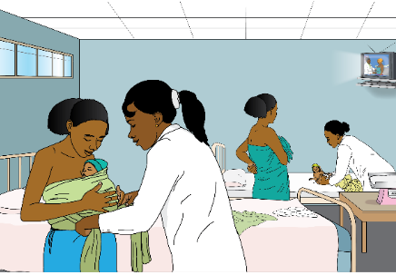
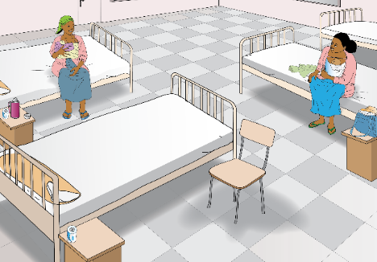
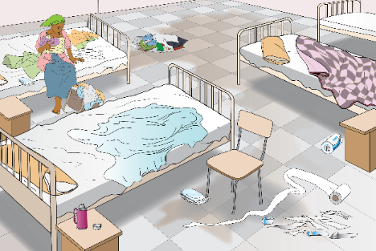

Slide 23
10
አብ እዋን ፃንሒት አደ ጽፈት ክንክን ኣዶን ሕንጦን ምሕላዉ
ኩነታት ሕንጠይ በቢ እዋኑ ምርግጋፅ | Identifies problems early which can help to save baby or avoid major future health issues.
በቢ እዋ ምስ አደ ምዝርራብ/ምርኻብ ክብደት ሕንጦ ኣብ መኣልቲ ሓደ ጊዘ ምዕቃንን ኣብ መዝገብ ምስፋር | Offers stimulation to mother who is needing to lay/sit still for long periods of time. Encourages questions.
ኩነታት ሕንጠይን ክብደቱን በቢ እዋኑ ንአዶ ምንጋር | Keeps mother knowledgeable/updated on baby’s condition.
አደ ደገፍን ክትትል ዝግበረላ ምህላዉን ፤ ሕጉስቲ ምዃና ምርግጋፅ | Can help identify problems mother may be having, or need for additional support.
መዓልታዊ ምኽሪ ግልጋት ሕቁፈ ጓጓ/ጉለ ንኩለን ኣደታት ብሓባር | Reaffirms all KMC practice, theory & benefits.
አዴታት ብሓባር ክፃወታ/ከዉግዓ ምትብባዕ | Connects mothers and encourages them to keep each other stimulated and supported.
ንዞም ዝስዕቡ መረዳእታ በቢ 6 ሰዓት ኣብ መከታተሊ ወረቀት ምምዝጋብ ፡ ሙቀት ሕንጦይ፤ ክንደይ ግዘ ፀባ ጡብ ከምዝሃበቶ፥ ንክንደይ ሰዓታት ኣብ ጓጓኣ ከምዝሃቆፈቶ | Keeps detailed records on all babies conditions that can be used in data analysis and mortality analysis.

Slide 25
11
ካብ ትካል ምስንባት ወይ ናብ ካልዕ ትካል ምትሕልላፍ አዶን ሕንጦን
ሕንጠይ ንክወፅእ/ክመሓላለፍ ጥዕንዑ/ዓ ድልው ከምዝኮነ/ት ምርግጋፅ | Makes sure a baby who may have sufficient weight also has other vital signs stabilized before leaving facility.
አደ ፤ አቦ ወይ ስድራቤት ሕቁፈ ጓጓ/ጉለ አብ ገዛ ንምቅፃል እርግፀኛታት ምዃኖም ምሕታት | Reaffirms importance of KMC practice to baby’s survival.
ንአዶ፤ አቦን ስድራቤትን ብዛዕባ ምትግባርን ጥቅሚ ሕቁፎ ጓጓ/ጉለ ምኽሪ ግልጋሎት ምሃብ | Reminds all on details of KMC practice, theory & benefits.
አደ ንገዝአ/ናብ ቀጻሊ ጥ/ትካል ንምኻድ መጓዓዝያ ምርካባ ምርግጋፅ | Ensures mother feels confident about passage home/to facility.
እንተ ድአ ናብ ካሊዕ ትኻል ተሀላሊፋ ናብ ተቀባሊ ጥ/ትካል ምብፅሓ ምርግጋፅ | Ensures facilities know if mother has either decided to go home against advice or has made transfer.
ምምላእ መዝገብ ሕቁፈ ጓጓ/ጉለ | Maintains detailed records of discharges.
አደ መምሃሪ ሓገዝ ሕቁፈ ጓጓ/ጉለ ከምዝሓዘት ምርግጋፅ | Assists ability to practice KMC in home environment.
ንአዶ ደሓን ኩኒ ምባል፡ ጽቡቕ ትምኒትና ምግላፅ | Positive closure to stay in KMC room.

Slide 26
For more information or copies of this guide please contact:
TIGRAY REGIONAL HEALTH BUREAU
MEKELLE
UNIVERSITY
Prototype – R9 – 26 Oct 2018

