Slide 1
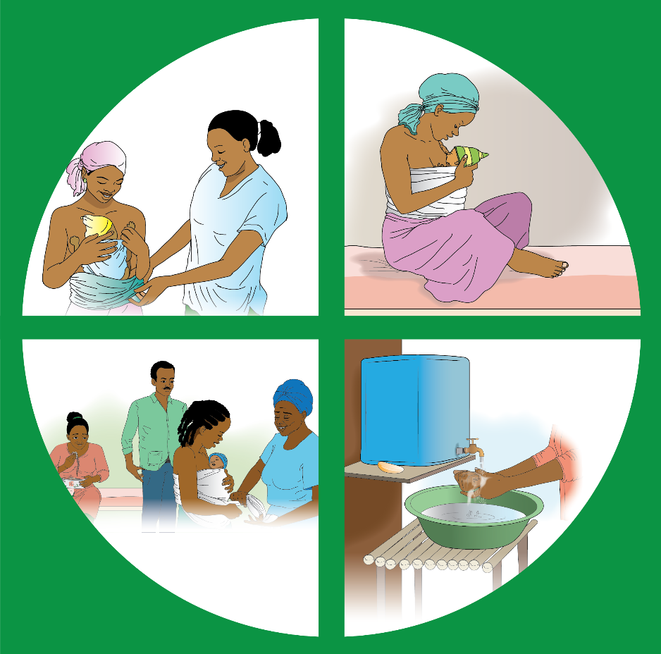
KMC FAMILY COUNSELING GUIDE

Slide 2
Instructions for Health Care Professionals
1
This guide has been created to support you in giving families appropriate and timely information on KMC.
Follow the guide as closely as possible. The illustrated pages are to show the person you are counseling.
Instructions for you to follow are in italics look like this.
Words to read out during counseling look like this or like this.

Slide 3
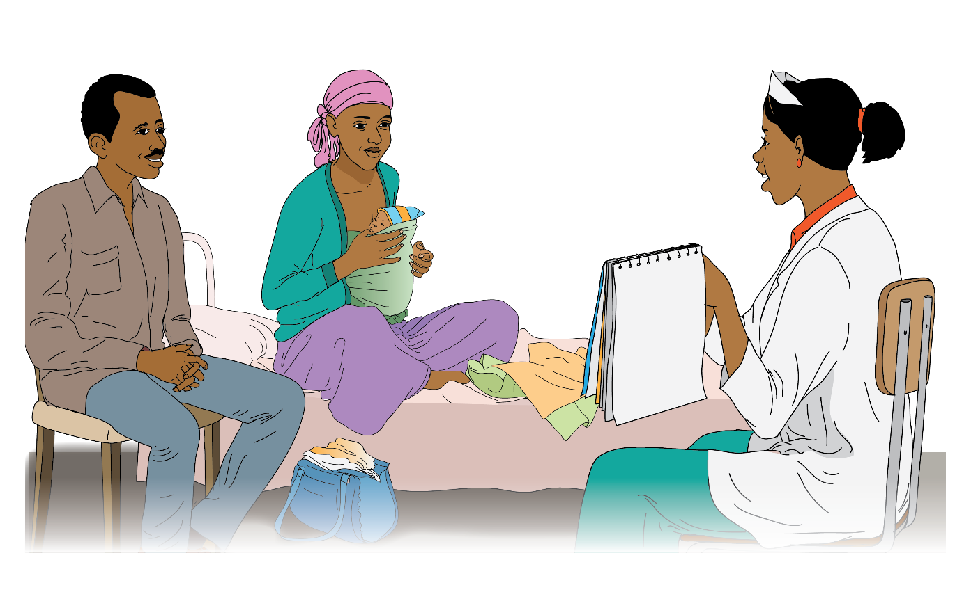

Slide 4
Introduction
2
Hello and welcome to KMC Family Counseling.
My name is _________________.
We will discuss, listen, and learn about KMC together so we can learn how to help your baby survive their first month of life.

Slide 5
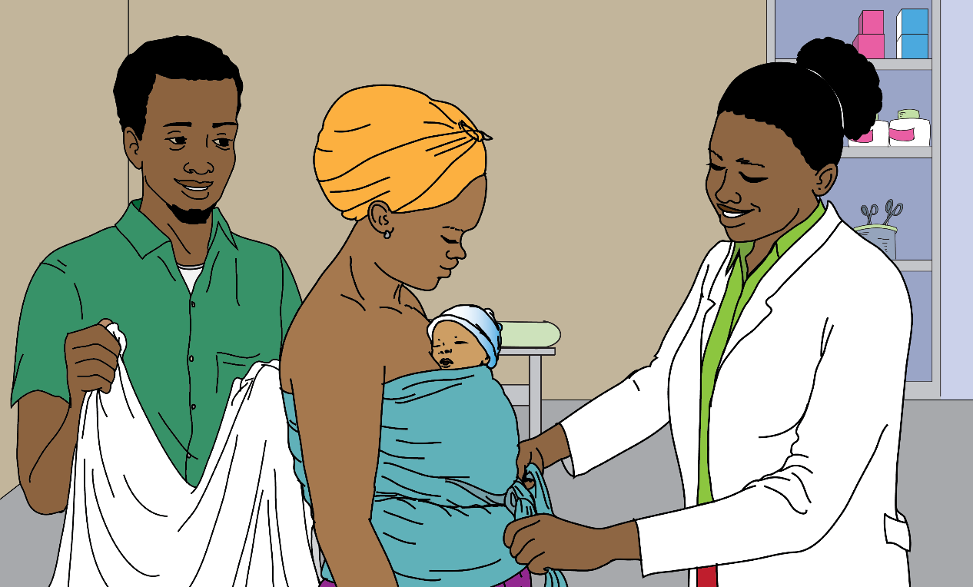

Slide 6
What is KMC?
3
KMC is a live-saving practice for small babies that has 4 main components:
Continuous Skin-to-Skin Care, where you hold your baby on your chest skin-to-skin continuously.
Exclusive Breastfeeding, where you feed only breastmilk every 2-4 hours.
Family Support, where the family supports the mother in maintaining constant skin-to-skin.
Hygiene, where you maintain good hygiene like hand washing, bathing, etc.

Slide 7
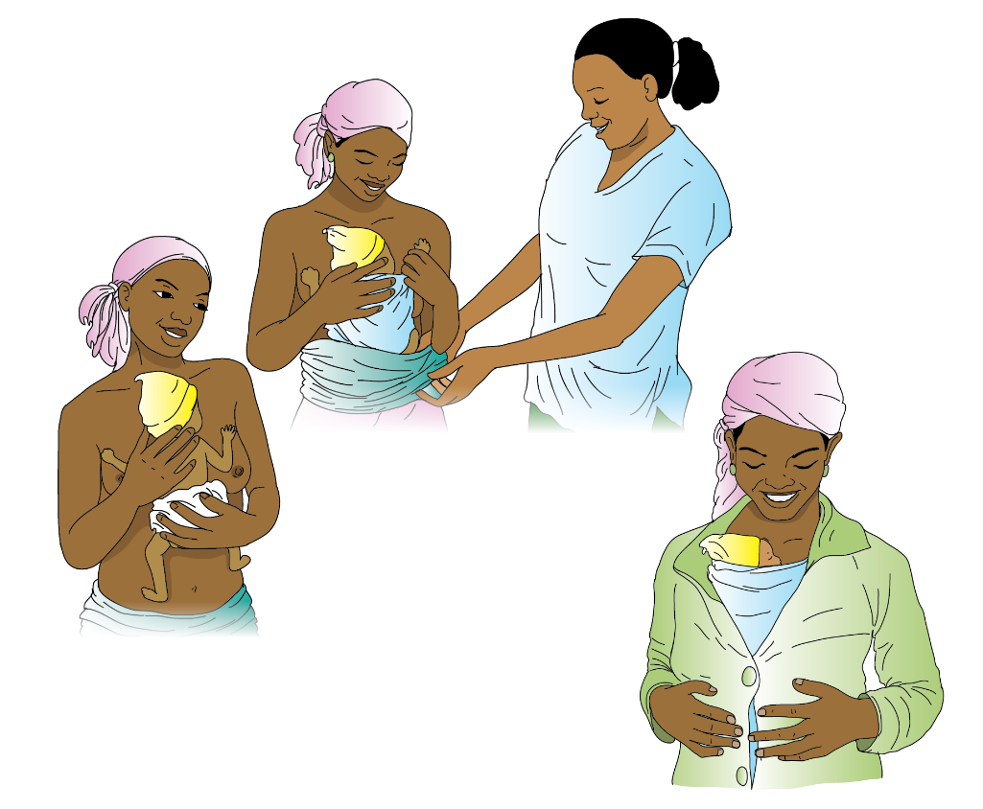

Slide 8
What does continuous skin-to-skin contact mean?
4
Continuous skin-to-skin means the baby has to be tied to be lying directly on the skin without stopping.
Put a diaper or cloth on the baby.
Position the baby between the breasts on the heart.
Tie the baby using a KMC Wrap or a traditional cloth.
The baby’s head should be to one side so that it can breathe.

Slide 9
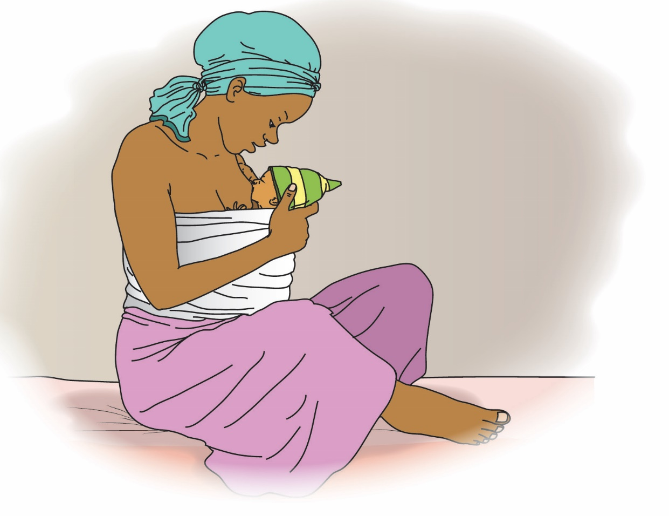

Slide 10
What does exclusive breastfeeding mean?
5
Exclusive breastfeeding means that the baby only drinks breastmilk. Usually every 2-4 hours.
A mother’s milk provides the best nutrients for the baby to grow strong and healthy.

Slide 11
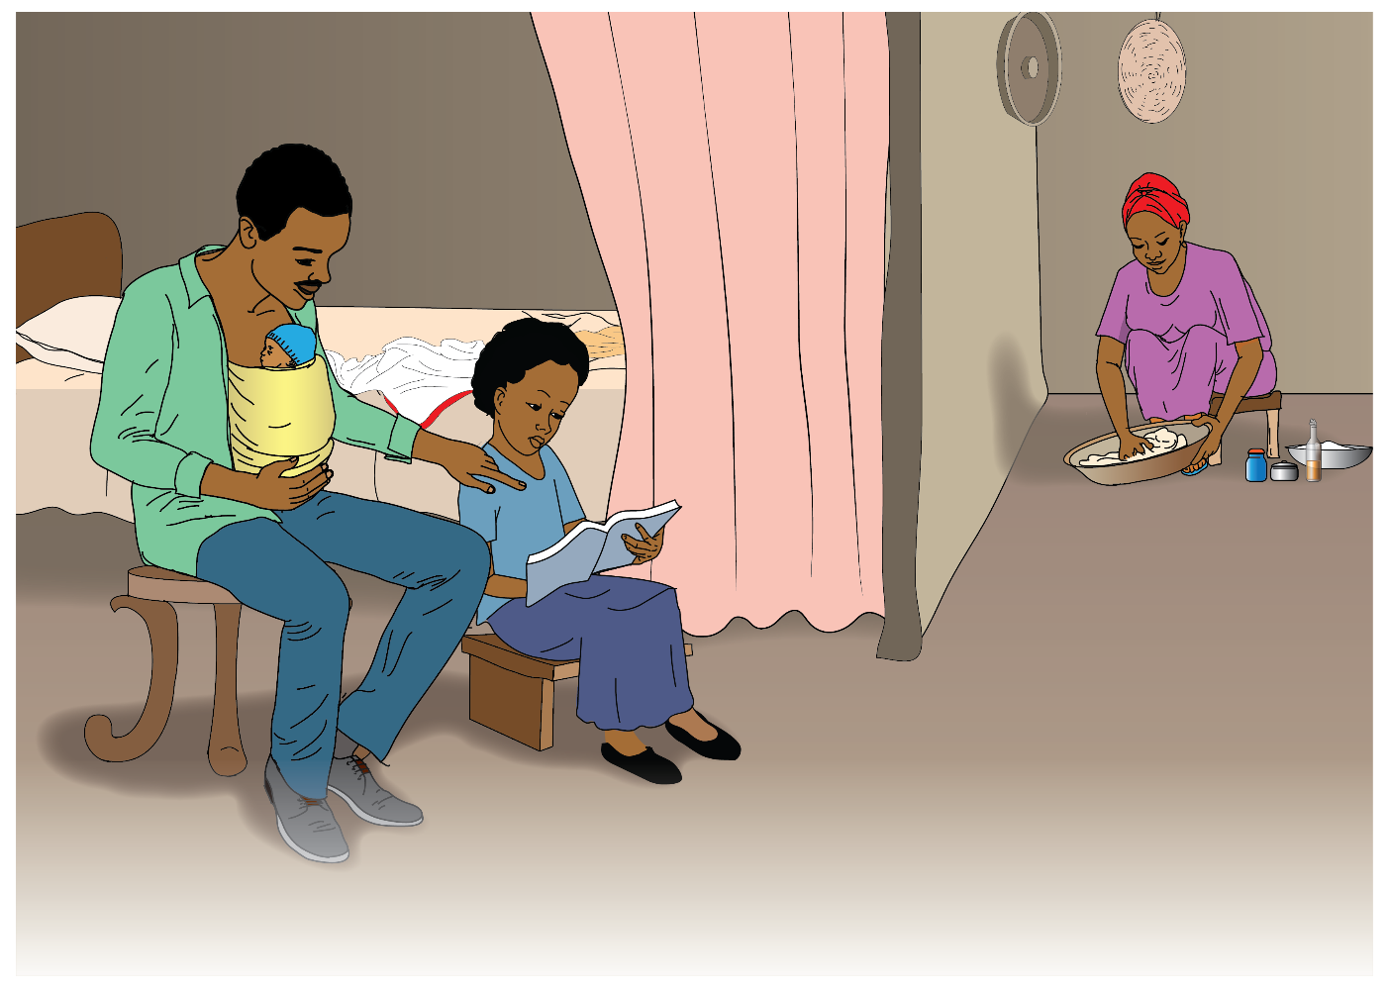

Slide 12
What does Family Support mean?
6
Family Support means the husband and the family support
the mother by practicing KMC.
It is very tiring for the mother to provide continuous support and she needs the support for her family.
Other family members can maintain the KMC position, including the father of the baby, sisters, aunties and grandmothers.
This makes it easy for the mother to get some rest while ensuring that the baby is kept in KMC position.

Slide 13
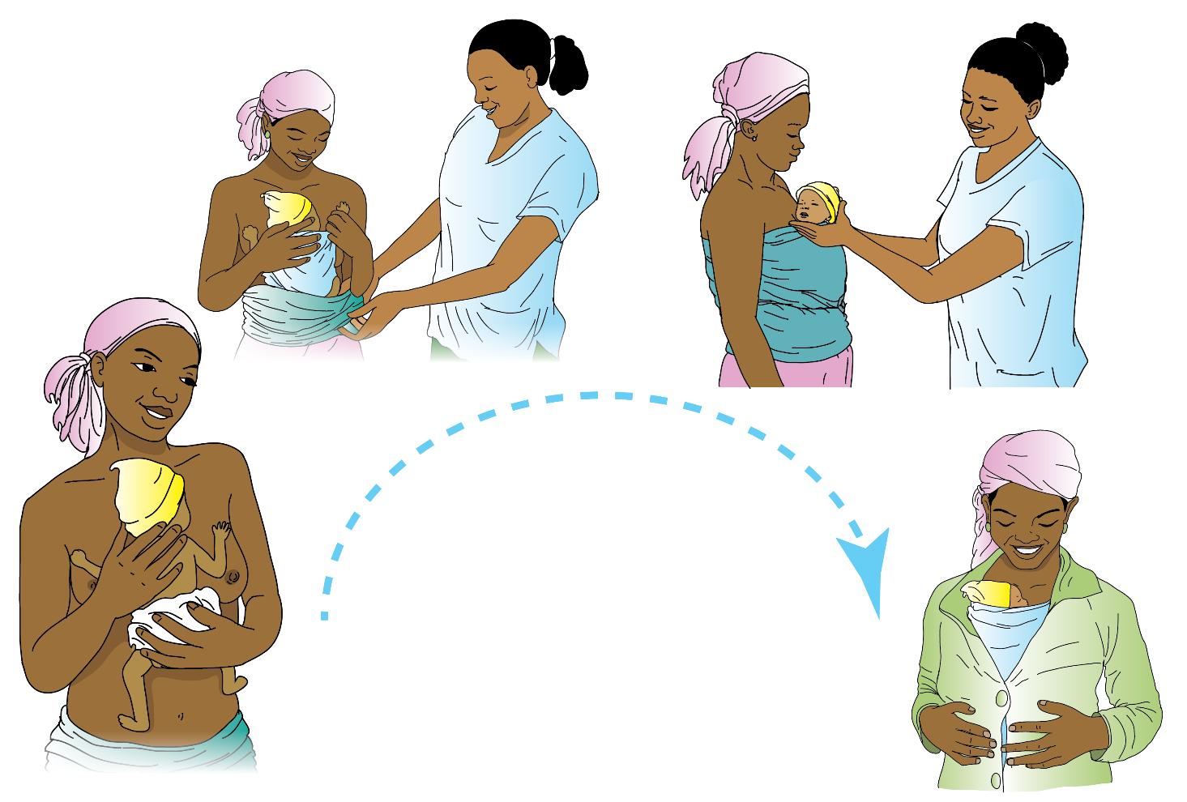

Slide 14
What are the steps of KMC positioning?
7
Describe the five steps of KMC positioning:
Step 1: Place the baby in an upright position between the mother’s breasts
Step 2: Secure the baby on to the mother’s chest with KMC sling or “netella”
Step 3: Cover the baby with a blanket or other clothes
Step 4: A mother can put on a jacket or sweeter as needed
Step 5: Breast feed the baby
Ask mother(s) to describe the five steps of KMC.

Slide 15
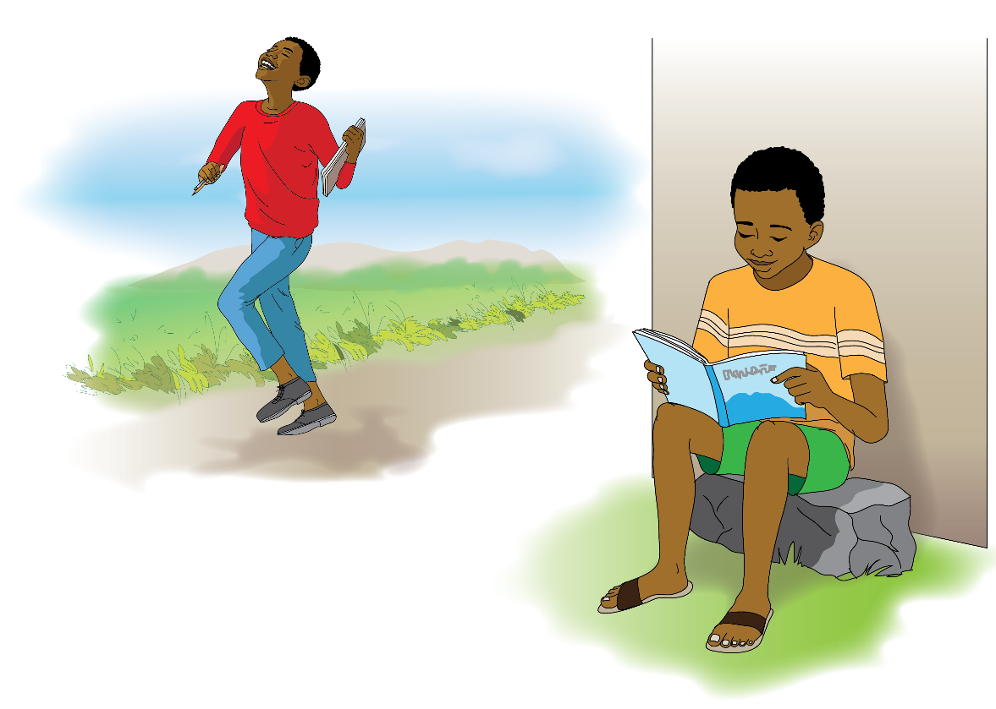

Slide 16
What are the benefits of KMC for your baby?
8
There are many benefits of KMC for your baby.
The top 3 benefits:
It reminds babies to breathe regularly.
Stabilizes heartbeat.
They develop into smart kids with good brains.

Slide 18
What are the benefits of KMC for parents?
9
Parent to child bonding is very strong.
It is inexpensive now and helps to keep your child healthy for their whole life.
You can monitor their vital signs very easily.
You feel proud that you are great parents.

Slide 19
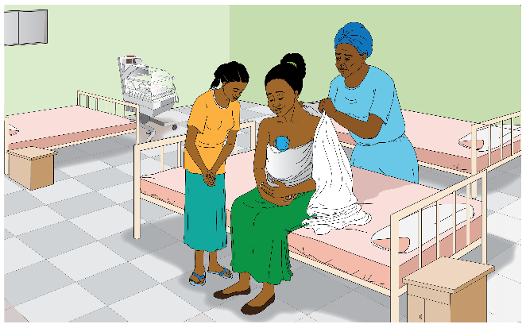
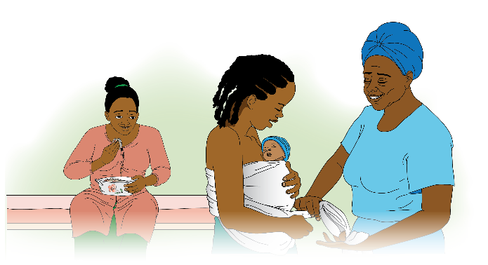

Slide 20
How will you care for your baby when you go home?
10
Continuous skin-to-skin
Breastfeed exclusively
Ask for support from the family
Maintain Hygiene

Slide 21
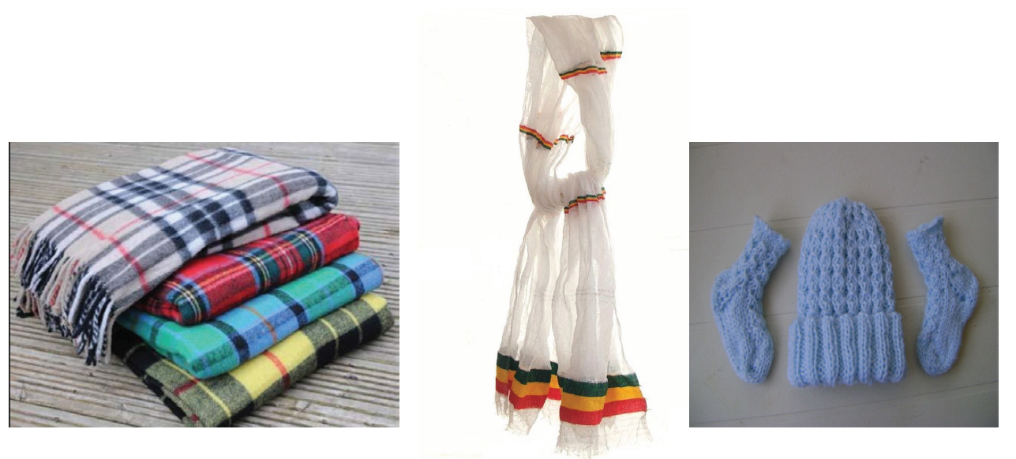
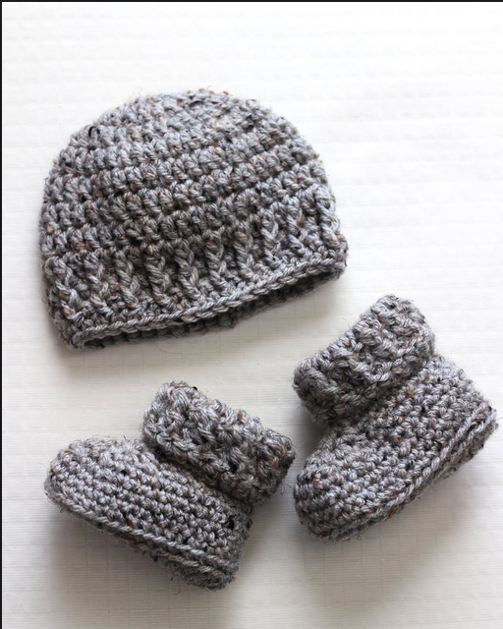

Slide 22
How can you maintain KMC at home?
11
Since you will not have the KMC Sling, you can use a netella to tie the baby and a blanket to keep them warm.
You may also need hat, socks, diaper and blanket for the baby.
Remember to maintain skin-to-skin continuously, breastfeed exclusively and to ask for support from family members.

Slide 23
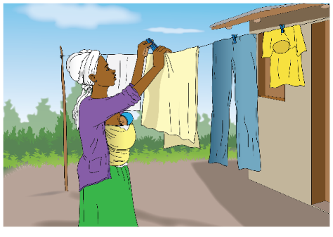
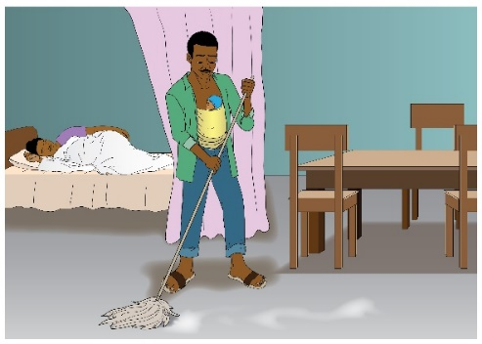
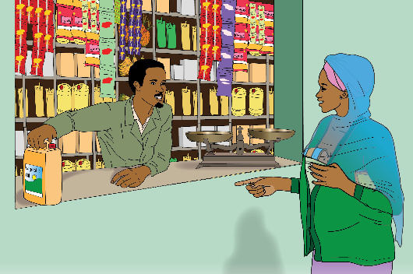

Slide 24
What activities can you do while doing skin-to-skin?
12
Simple tasks:
Cleaning the bed
Sweeping the floor
Feeding animals
Sewing
Carrying light objects

Slide 25
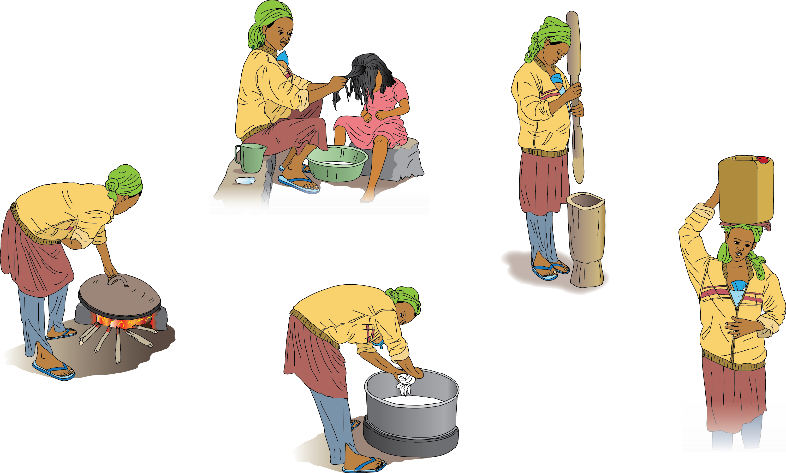
X
X
X
X
X

Slide 26
What activities can’t you do while doing skin-to-skin?
13
Heavy tasks:
Baking Injera
Washing Cloths
Washing children
Doing or attending coffee ceremony due to smoke
Carrying heavy objects like water or oil
Don’t ever leave your baby without skin-to-skin protection!

Slide 27
List of Illustrations Alex is organizing with Netsanet:
‘Father practicing KMC while mother is preparing dinner in traditional, rural home’; show socks/hat/netella in the image
‘Mother/Father ‘Yes/Can Do at Home’ Chores:
I can go shop nearby and buy something
I can make the bed
I can feed animals like chickens
I can sew
I can separate grains
I can sleep / rest
‘Mother/Father ‘No/Can’t Do at Home’ Chores:
TBD
‘Two parents with the healthy baby looking happy’ (7-01 with older child?)
Combined ‘4 KMC Actions/Pillars’ illustration: Skin to Skin - Breastfeeding - Family Support - Hygiene (for ‘Title Page’, ‘What is KMC’ page and ‘How will you care for your baby at home’ pages)
An illustration to communicate ‘Remind Baby to Breathe’ (if possible)
Addis To Do list for the Short Counceling Guide V3 and beyond:
Title Page: Add Federal Ministry of Health logo to title page
What is KMC text: Add description of definition of Hygiene relative to KMC
Add ‘What CAN’T you do while giving KMC at home’ page/spread
Review Short Counseling Guide with team, including GRID/Catapult, before 22 Aug 2018
Complete any edits from review
Determine any further necessary illustrations and/or adaptations to illustrations and let Alex know before 24 Aug 2018
Test Short Counseling Guide with HCW, film the test and share
Pilot the chosen formats to see which have best fit (discussed so far: Flip Chart, Flipbook, Cards, Poster (of 4 ‘actions’ or ‘pillars’)

