Slide 1
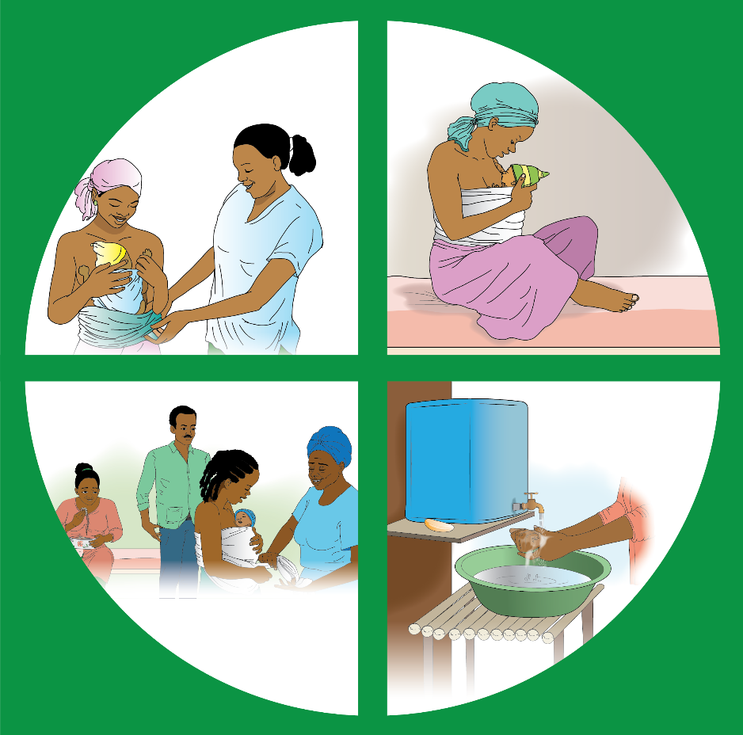
KMC FAMILY COUNSELING GUIDE

Slide 2
Instructions for Health Care Professionals
1
This guide has been created to support you in giving families appropriate and timely information on KMC.
Follow the guide as closely as possible. The illustrated pages are to show the person you are counseling.
Instructions for you to follow are in italics look like this.
Words to read out during counseling look like this or like this.

Slide 3
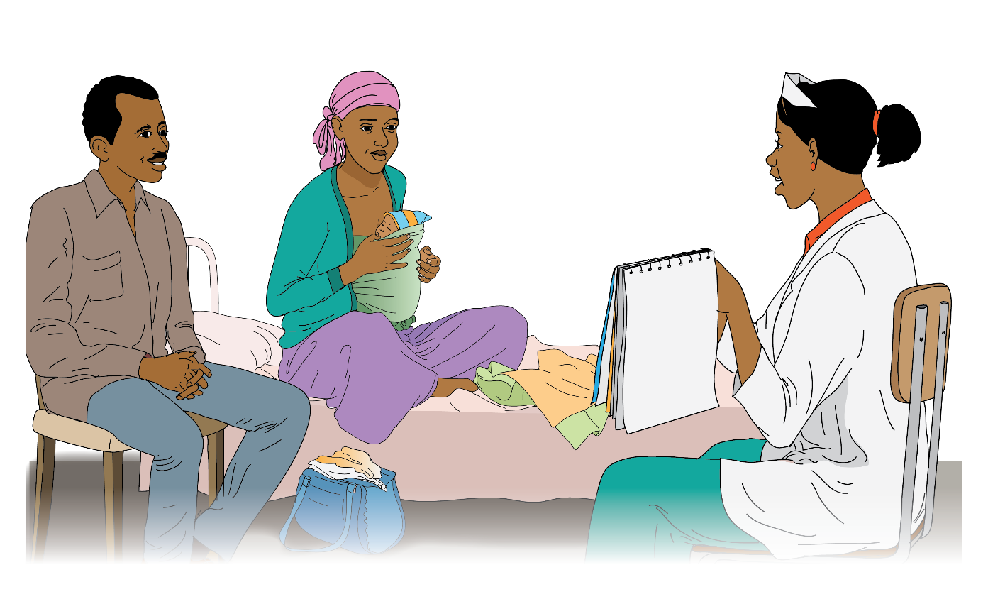

Slide 4
Introduction
2
Hello and welcome to KMC Family Counseling.
My name is _________________.
We will discuss, listen, and learn about KMC together so we can learn how to help your baby survive their first month of life.

Slide 5
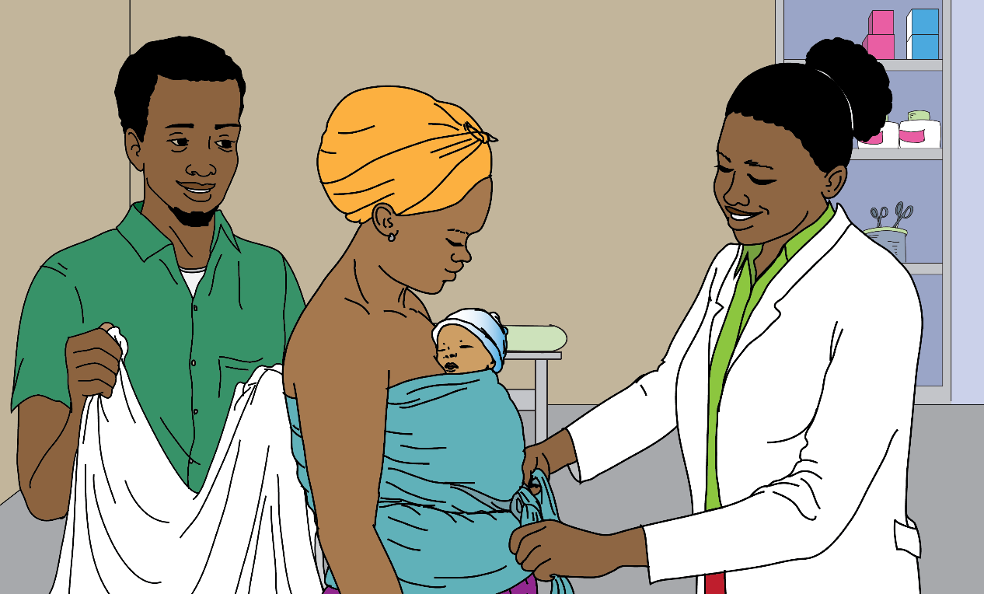

Slide 6
What is KMC?
3
KMC is a live-saving practice for small babies that has 4 main components:
Continuous Skin-to-Skin Care, where you hold your baby on your chest skin-to-skin continuously.
Exclusive Breastfeeding, where you feed only breastmilk every 2-4 hours.
Family Support, where the family supports the mother in maintaining constant skin-to-skin.
Hygiene, where you maintain good hygiene like hand washing, bathing, etc.

Slide 7
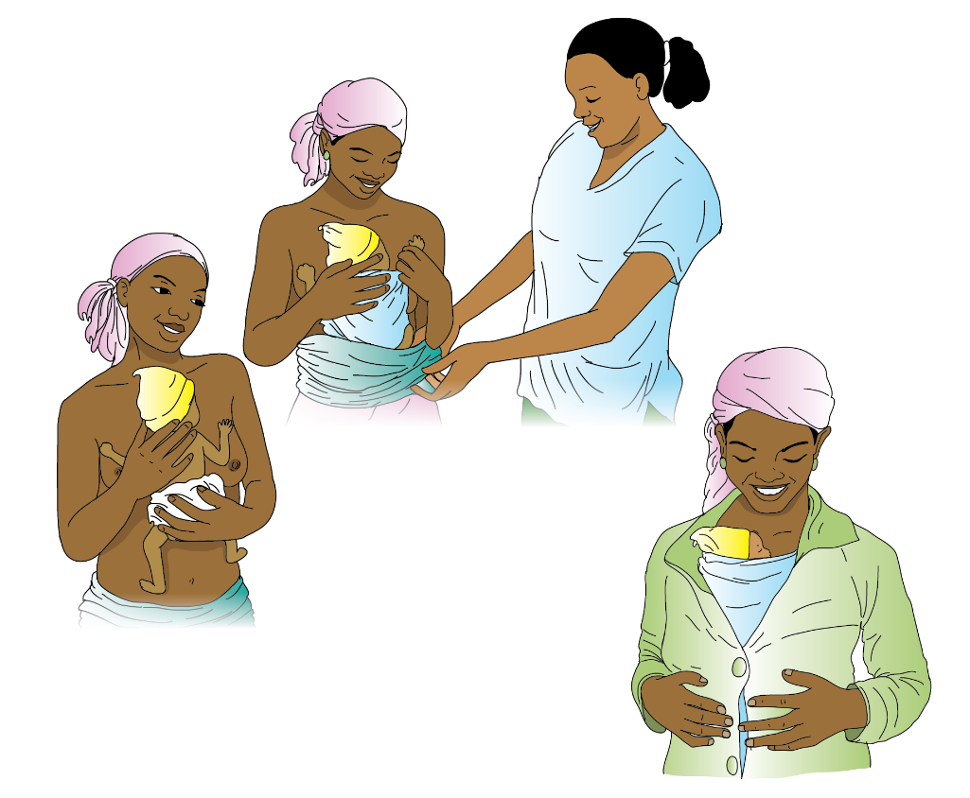

Slide 8
What does continuous skin-to-skin contact mean?
4
Continuous skin-to-skin means the baby has to be tied to be lying directly on the skin without stopping.
Put a diaper or cloth on the baby.
Position the baby between the breasts on the heart.
Tie the baby using a KMC Wrap or a traditional cloth.
The baby’s head should be to one side so that it can breathe.

Slide 9
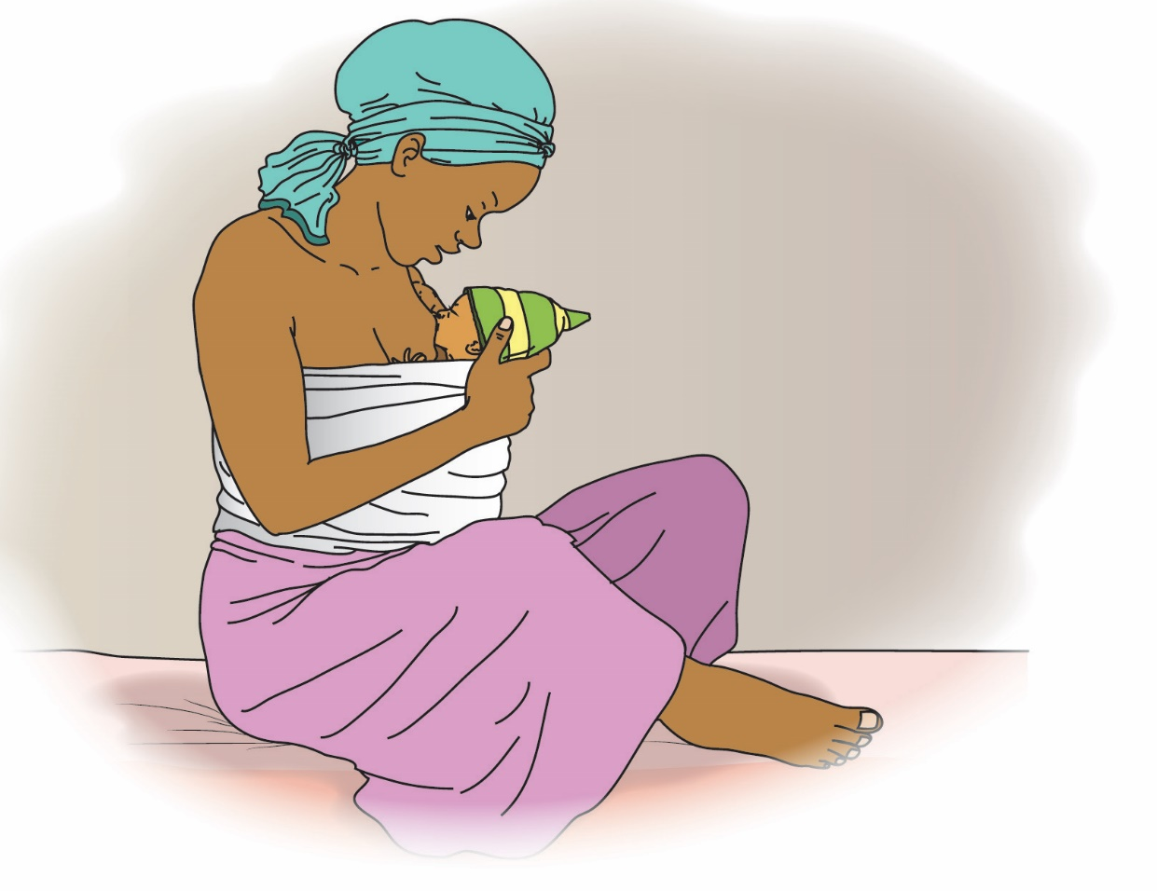

Slide 10
What does exclusive breastfeeding mean?
5
Exclusive breastfeeding means that the baby only drinks breastmilk. Usually every 2-4 hours.
A mother’s milk provides the best nutrients for the baby to grow strong and healthy.

Slide 11
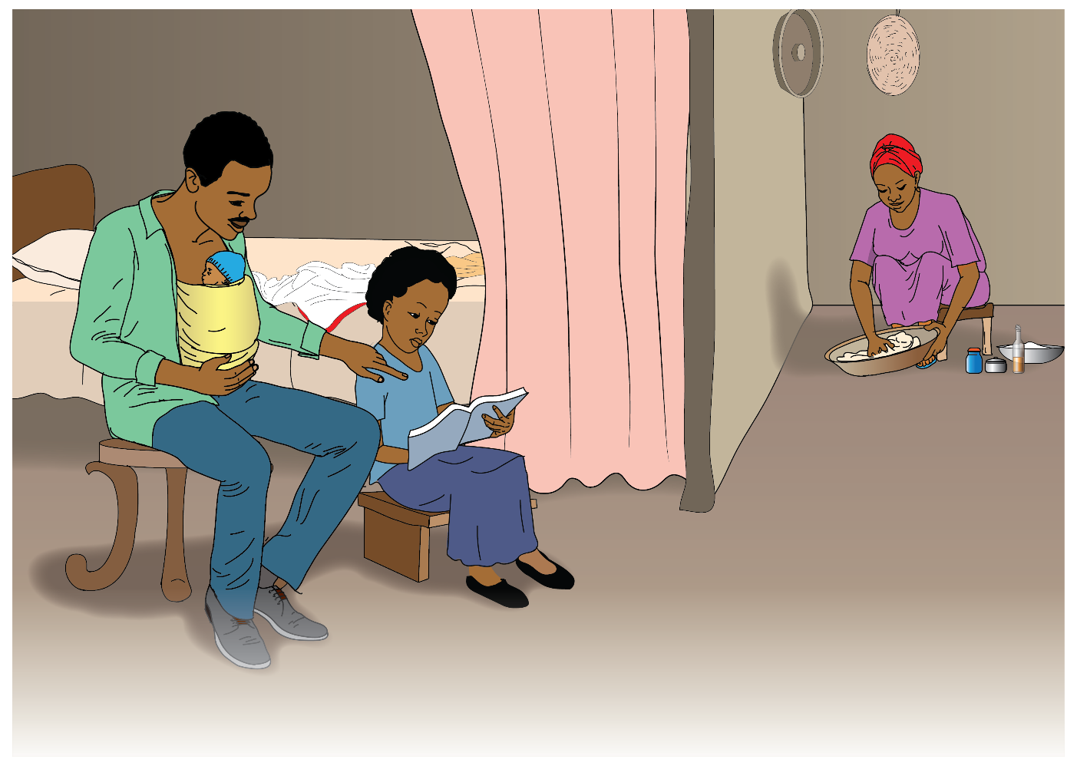

Slide 12
What does Family Support mean?
6
Family Support means the husband and the family support
the mother by practicing KMC.
It is very tiring for the mother to provide continuous support and she needs the support for her family.
Other family members can maintain the KMC position, including the father of the baby, sisters, aunties and grandmothers.
This makes it easy for the mother to get some rest while ensuring that the baby is kept in KMC position.

Slide 13
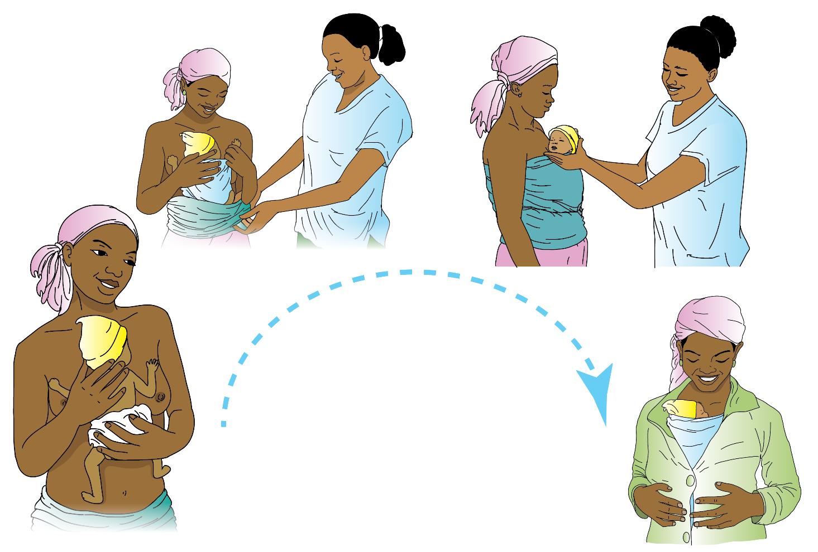

Slide 14
What are the steps of KMC positioning?
7
Describe the five steps of KMC positioning:
Step 1: Place the baby in an upright position between the mother’s breasts
Step 2: Secure the baby on to the mother’s chest with KMC sling or “netella”
Step 3: Cover the baby with a blanket or other clothes
Step 4: A mother can put on a jacket or sweeter as needed
Step 5: Breast feed the baby
Ask mother(s) to describe the five steps of KMC.

Slide 15
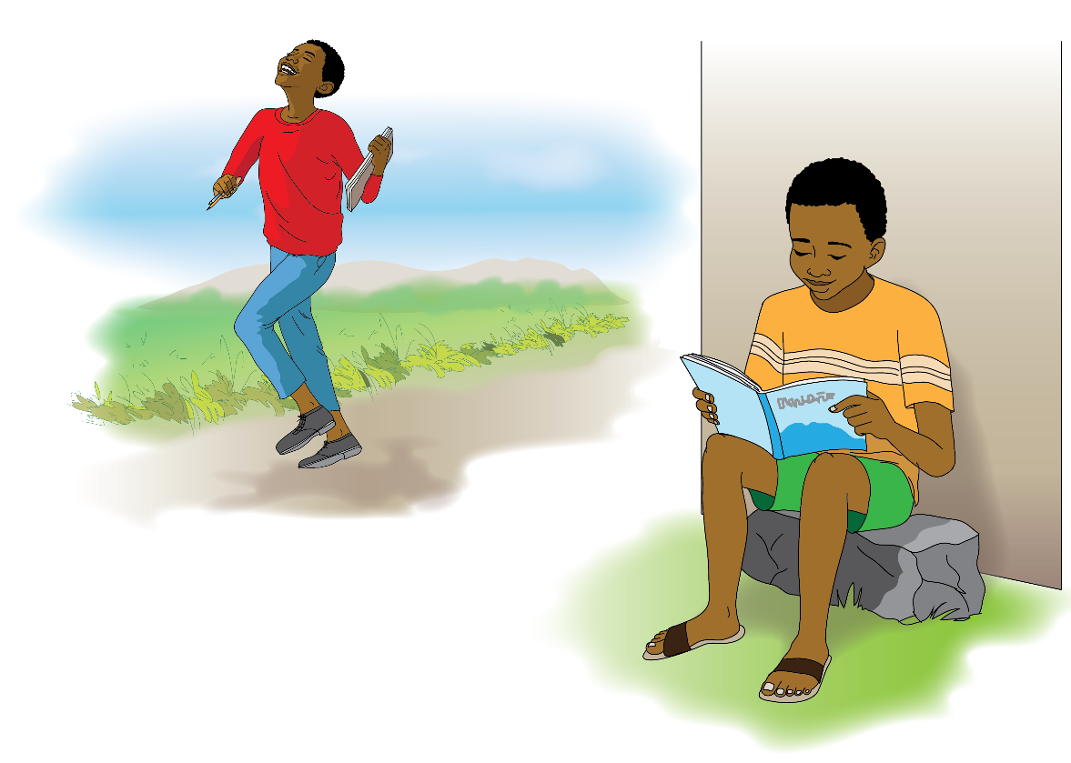

Slide 16
What are the benefits of KMC for your baby?
8
There are many benefits of KMC for your baby.
It reminds babies to breathe regularly.
Stabilizes heartbeat.
They develop into smart kids with good brains.

Slide 18
What are the benefits of KMC for parents?
9
Parent to child bonding is very strong.
It is inexpensive now and helps to keep your child healthy for their whole life.
You can monitor their vital signs very easily.
You feel proud that you are great parents.

Slide 19
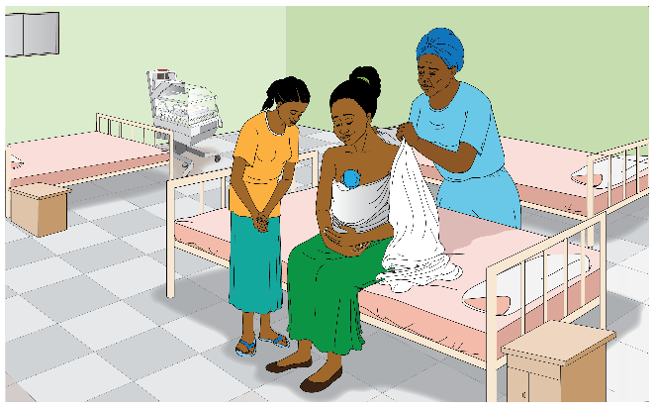
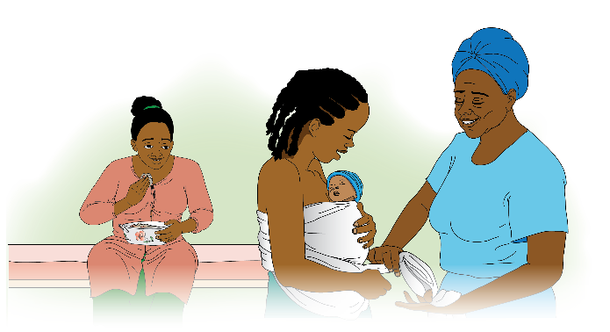

Slide 20
How will you care for your baby when you go home?
10
Continuous skin-to-skin
Breastfeed exclusively
Ask for support from the family
Maintain Hygiene

Slide 21
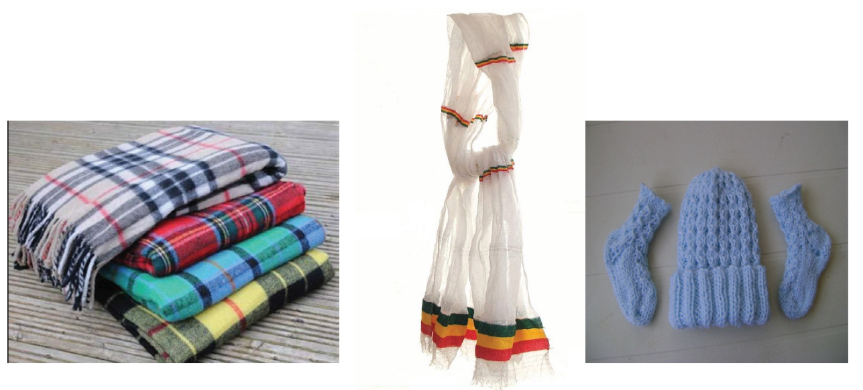

Slide 22
How can you maintain KMC at home?
11
Since you will not have the KMC Sling, you can use a netella to tie the baby and a blanket to keep them warm.
You may also need hat, socks, diaper and blanket for the baby.
Remember to maintain skin-to-skin continuously, breastfeed exclusively and to ask for support from family members.

Slide 23
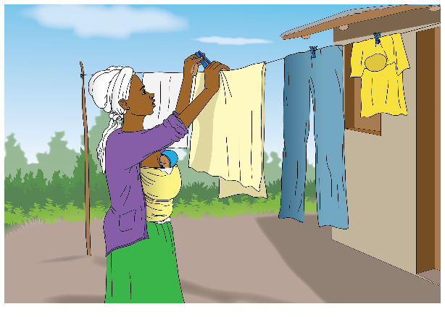
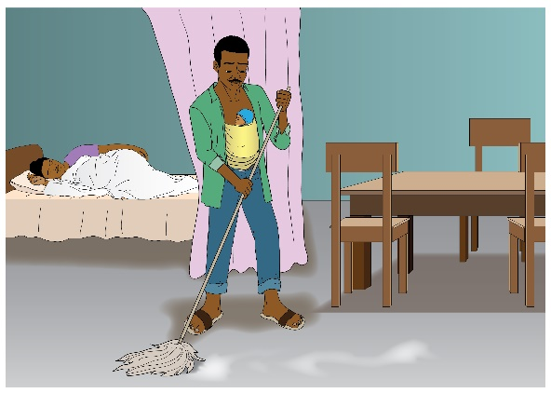

Slide 24
What activities can you do while doing skin-to-skin?
12
Simple tasks:
Cleaning the bed
Sweeping the floor
Feeding animals
Sewing
Carrying light objects

Slide 25
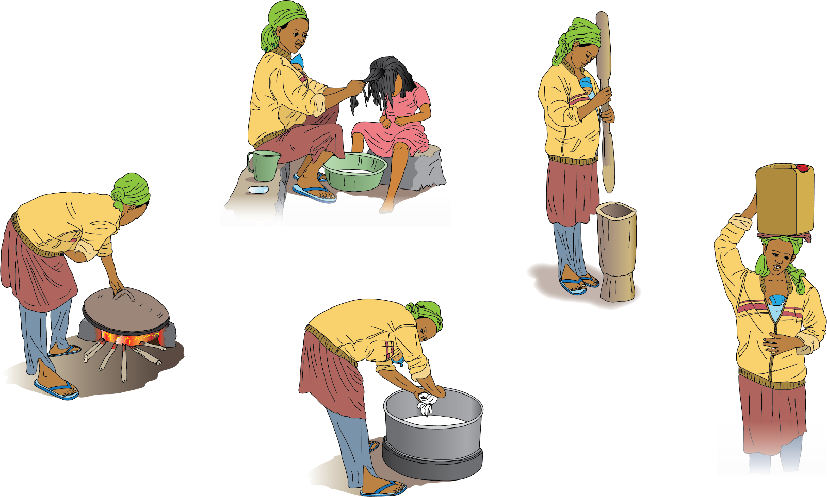
X
X
X
X
X

Slide 26
What activities can’t you do while doing skin-to-skin?
13
Heavy tasks:
Baking Injera
Washing Cloths
Washing children
Doing or attending coffee ceremony due to smoke
Carrying heavy objects like water or oil
Don’t ever leave your baby without skin-to-skin protection!

Slide 27
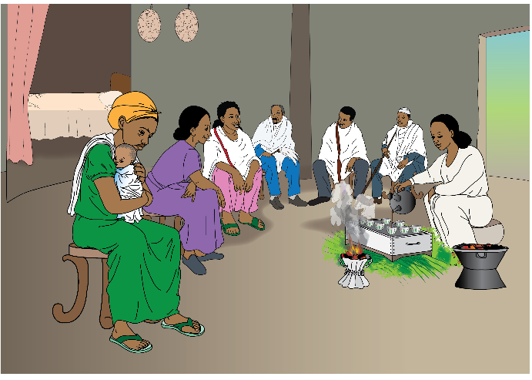
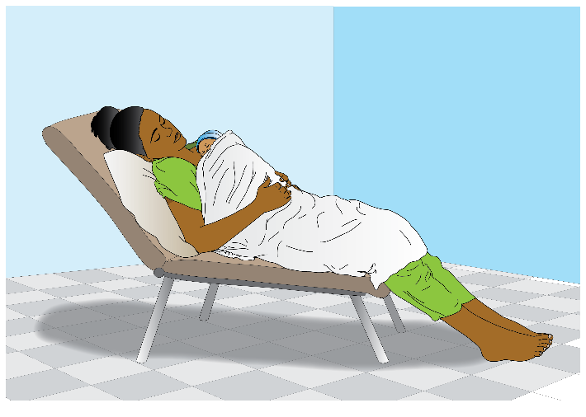

Slide 28
I will name some activities. Tell me if you can do them at home or not.
14
When you go home, can you:
Cook coffee for your family? (NO)
Lie down with your baby skin-to-skin? (YES)
Wash clothes? (NO)
Cook dinner for your husband? (NO)
Are there any activities you don’t know whether
you should do or not?

Slide 30
ROLEPLAY: Ask for Family Support
15
Roleplay 1:
Ask your sister for help. Tell her what you can and cannot do and how she can help you. Show her the KMC position.
Roleplay 2:
Select one of the mothers to play herself (mother) and another one to play the sister. Alternatively, you can also just ask the mother to pretend you are the sister.

Slide 32
Who can do skin-to-skin besides the mother?
16
Family members or friends can all help in providing skin-to-skin to the baby.
It is especially good for the baby’s father to help to increase the bonding between the child and parent. But grandparents, aunties, uncles and friends can help the mother in providing continuous 24-hr skin-to-skin.

Slide 34
How does breastfeeding help the baby?
17
Breastfeeding helps the baby to grow fat and healthy. Breast milk has every nutrient a baby needs to be the best they can be. It is natural and the mother’s body creates it in order to provide the nutritious meal for the baby. You do not need to add anything to breast milk or feed the baby formula.
You should breastfeed while keeping the baby in the skin-to-skin position!

Slide 36
Let me demonstrate the KMC position.
18
*Choose one mother with whom to demonstrate the KMC position. Use a netella to help them see how to tie the traditional cloth. Do the demonstration with all mothers if possible.
*Ask the mother to stand up and move around freely.
SAY: You don’t need to lie down when doing KMC, you can walk around and be free.

Slide 37
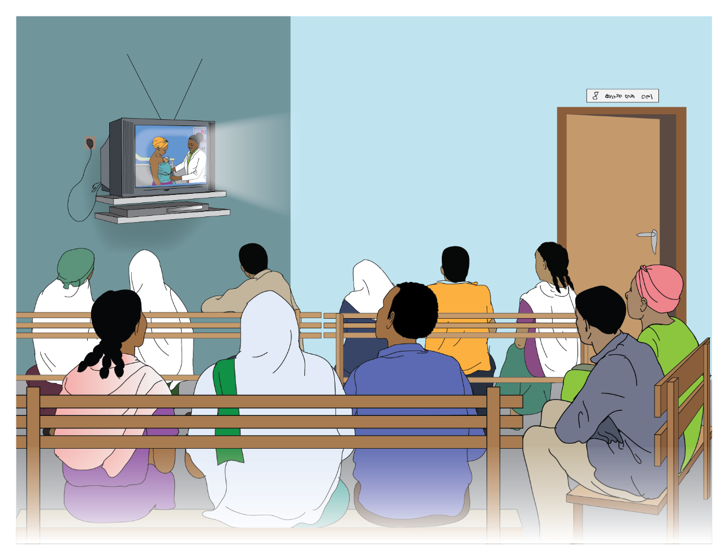

Slide 38
Now let me show you a video
19
*Show KMC video. After video, ask comprehension questions.
What are the 3 main actions you must take for KMC?
What is a benefit of KMC for the baby?
What materials do you need to do KMC at home?

Slide 40
Use the reminder chart
20
*Show them the reminder chart*
This is a reminder chart. It will help you keep track of KMC. Let me show you how to use it.
Every time you do skin-to-skin or breastfeed, you put a check in the box. Let’s fill out an example together. *Show example*

Slide 41
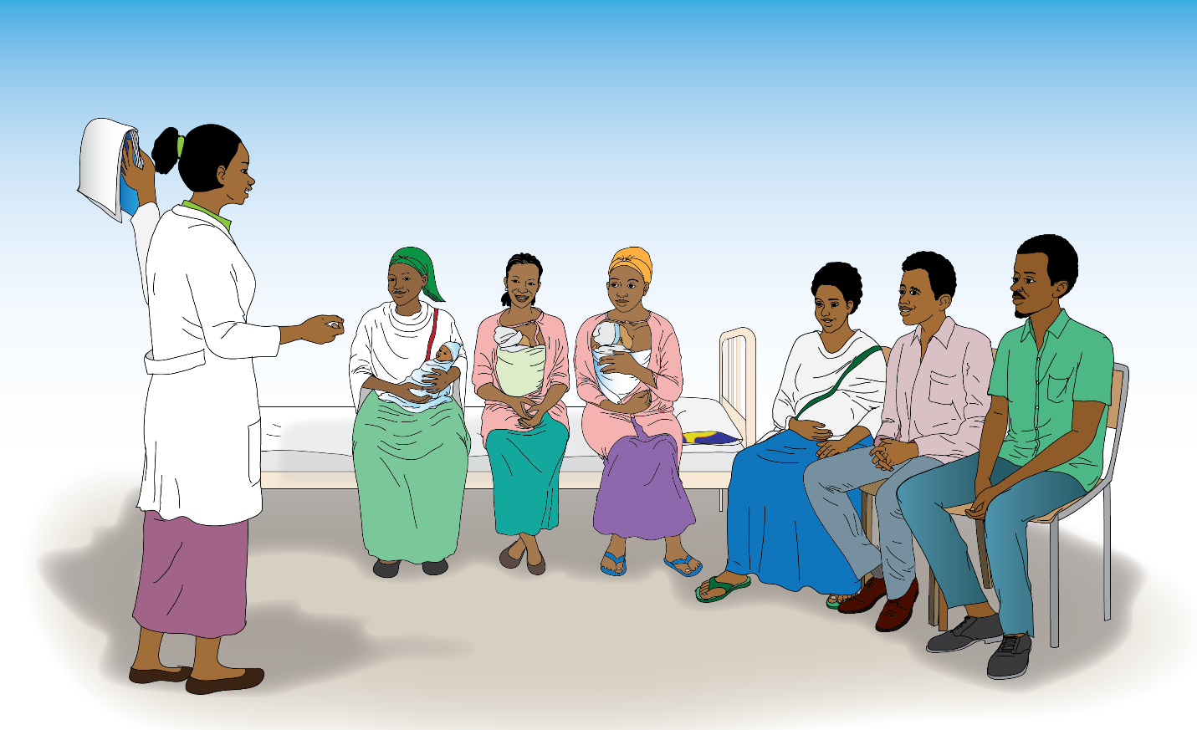
Any questions?

Slide 42
Do you have any questions?
21
Some questions that other mothers have had:
When can I put my baby down?
Will my child grow up to be smart and strong?
When should I stop KMC?
How can I breastfeed using a cup?

Slide 43
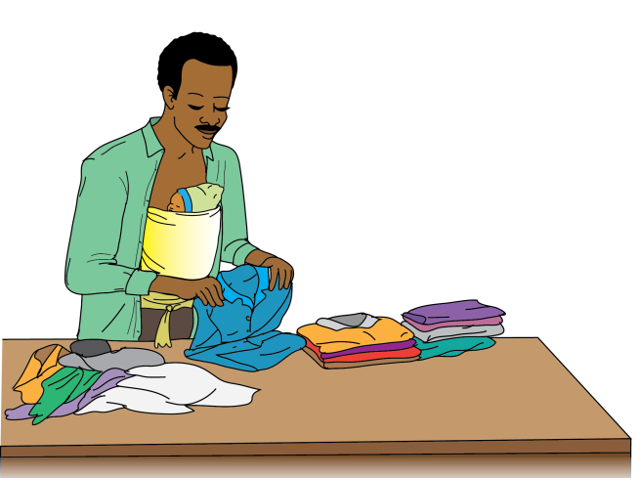
1. ገላ ለገላ ማቀፍ
2. ጡት ማጥባት
4. ንፅህና፣
3. የቤተሰብ እገዛ

Slide 44
Remember the 4 KMC Actions
22
Continuous Skin-to-Skin Care
Exclusive Breastfeeding
Family Support
Maintain Hygiene

Slide 45
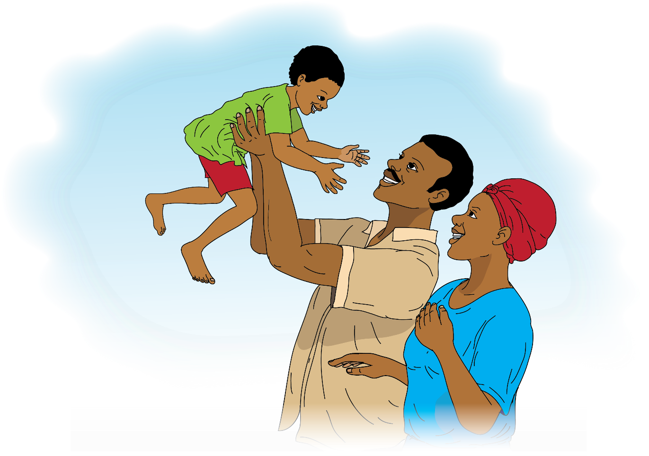

Slide 46
23
THIS IS THE END OF THE KMC COUNSELLING GUIDE.
IF TIME ALLOWS, YOU CAN HAVE MOTHERS AND FAMILIES
DO EXTENDED ACTIVITIES TO FURTHER RE-INFORCE KMC
BEHAVIOR.

