Slide 1
Infection control measures

Slide 2
Infection control measures
Learning Objectives
By the end of the session participants will
Enumerate the steps of hand hygiene.
Know about cleaning and disinfecting newborn care equipment.
Review the infection control recommendations of newborn procedures.

Slide 3
Hand hygiene
It is the single most important means of preventing nosocomial infections. It is very simple and cheap.
Notes:
Mechanically remove Organic material or dirt

Slide 4
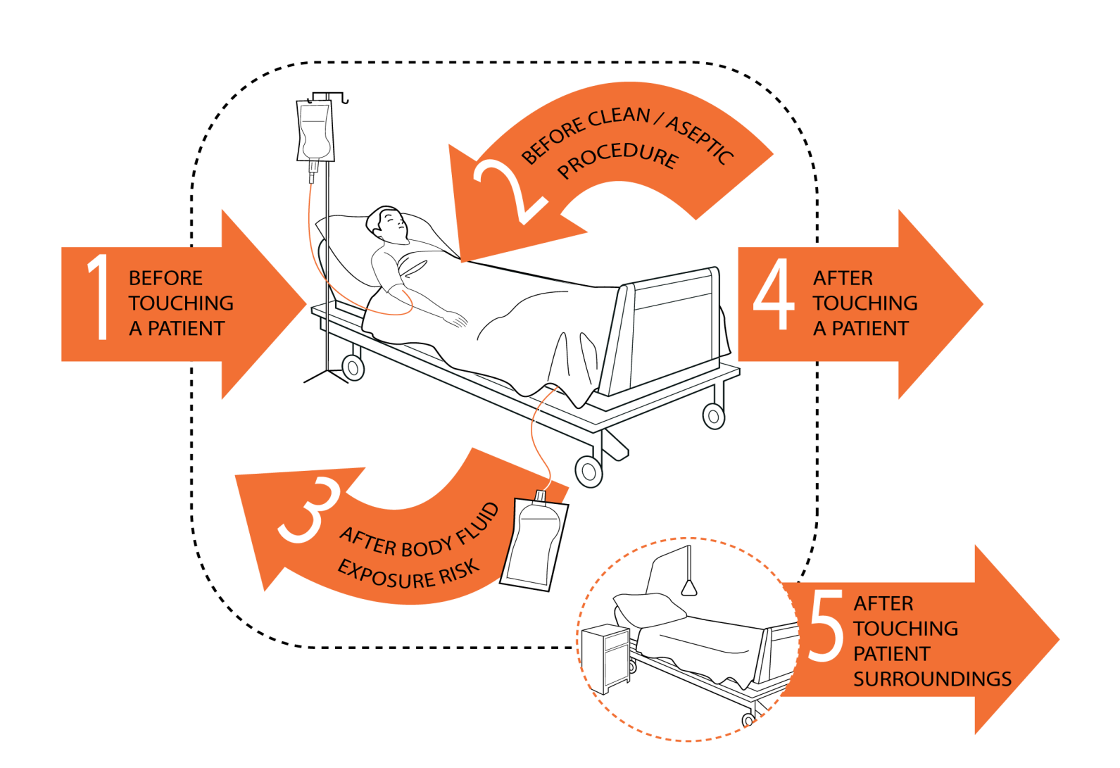
WHO “My 5 Moments for Hand Hygiene” approach
Notes:
Wash hands with soap and water when
visibly dirty or
visibly soiled with blood or other body fluids (IB) or
after using the toilet (II)
Before invasive procedures (with CHG )
If exposure to potential spore-forming pathogens eg outbreaks of Clostridium difficile, hand washing soap water preferred (IB)
Before handling medication or preparing food perform hand hygiene using an alcohol-based handrub or wash hands

Slide 5
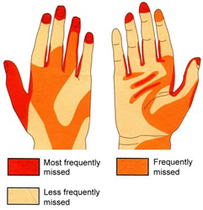
How?

Slide 6
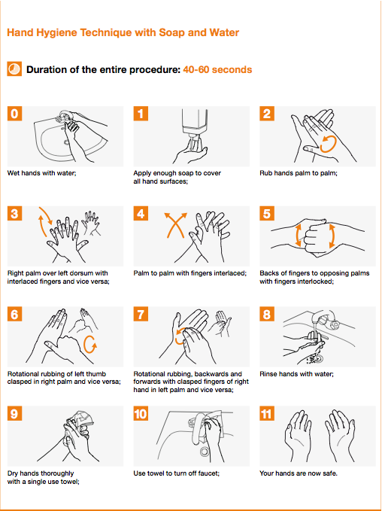
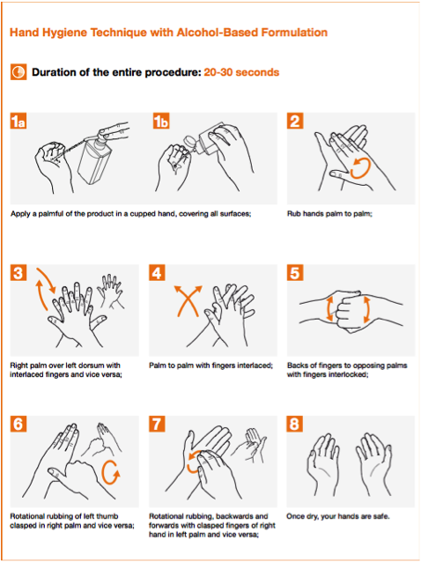
How?

Slide 7
Cleaning and disinfecting newborn care equipment and environment
Daily, clean the following equipment with soap and water
Resuscitation bag and mask
Radiant warmer bassinet
Oxygen hood
Phototherapy
Infusion pump

Slide 8
Cont..
Daily, clean the following articles with alcohol swap
Thermometer
Radiant warmer probe
Pulse oximeter sensor
All individual items like stethoscope, measuring tape and probe tips should be cleaned with 70% isopropyl alcohol daily or when used for another baby.

Slide 9
Cleaning of feeding articles
Feeding articles (cup, spoon and pallada) should be cleaned with soap and water and then boiled for 15 minutes.

Slide 10
SKIN PREPARATION FOR VENEPUNCTURE AND OTHER PROCEDURES
Steps of venepuncture
Wash and dry hands.
Wear sterile gloves.
Prepare skin site, confine to smallest possible area of skin.
Swab with alcohol/chlorhexidine 2% first, allow it to dry.
Swab iodine on site and allow it to dry.
Swab again with alcohol to wipe off iodine, allow it to dry.
Skin is now ready for puncture of prick.

Slide 11
Care of lines
Perform hand hygiene before touching IV lines.
Clean the hub of IV line with spirit.
DO NOT place the cap on an unsterile surface.
DO NOT re-use disposables.
Maintain closed circuit.

Slide 12
Other recommendations
Never use stock IV fluids. Do not use a single dextrose/saline bottle for >24 hours.
There should be a separate IV fluid bottle for each baby.
Label the bottle with date and time of opening.
Open the top surface of the bottle, keeping the seal intact.
First clean with spirit swabs, then use povidone iodine soaked sterile cotton to cover the top surface of the bottle.
Change the burette set every 24 hours.
Use syrups within 1 week of opening, note down the opening date.
Antibiotic vials should be changed after 24 hrs. e.g. injections ampicillin and cefotaxime.
There is no need for flushing with heparinized saline to keep the IV line patent.
Use separate IV line for giving antibiotics (do not open the IV fluid line for giving injections).

Slide 13
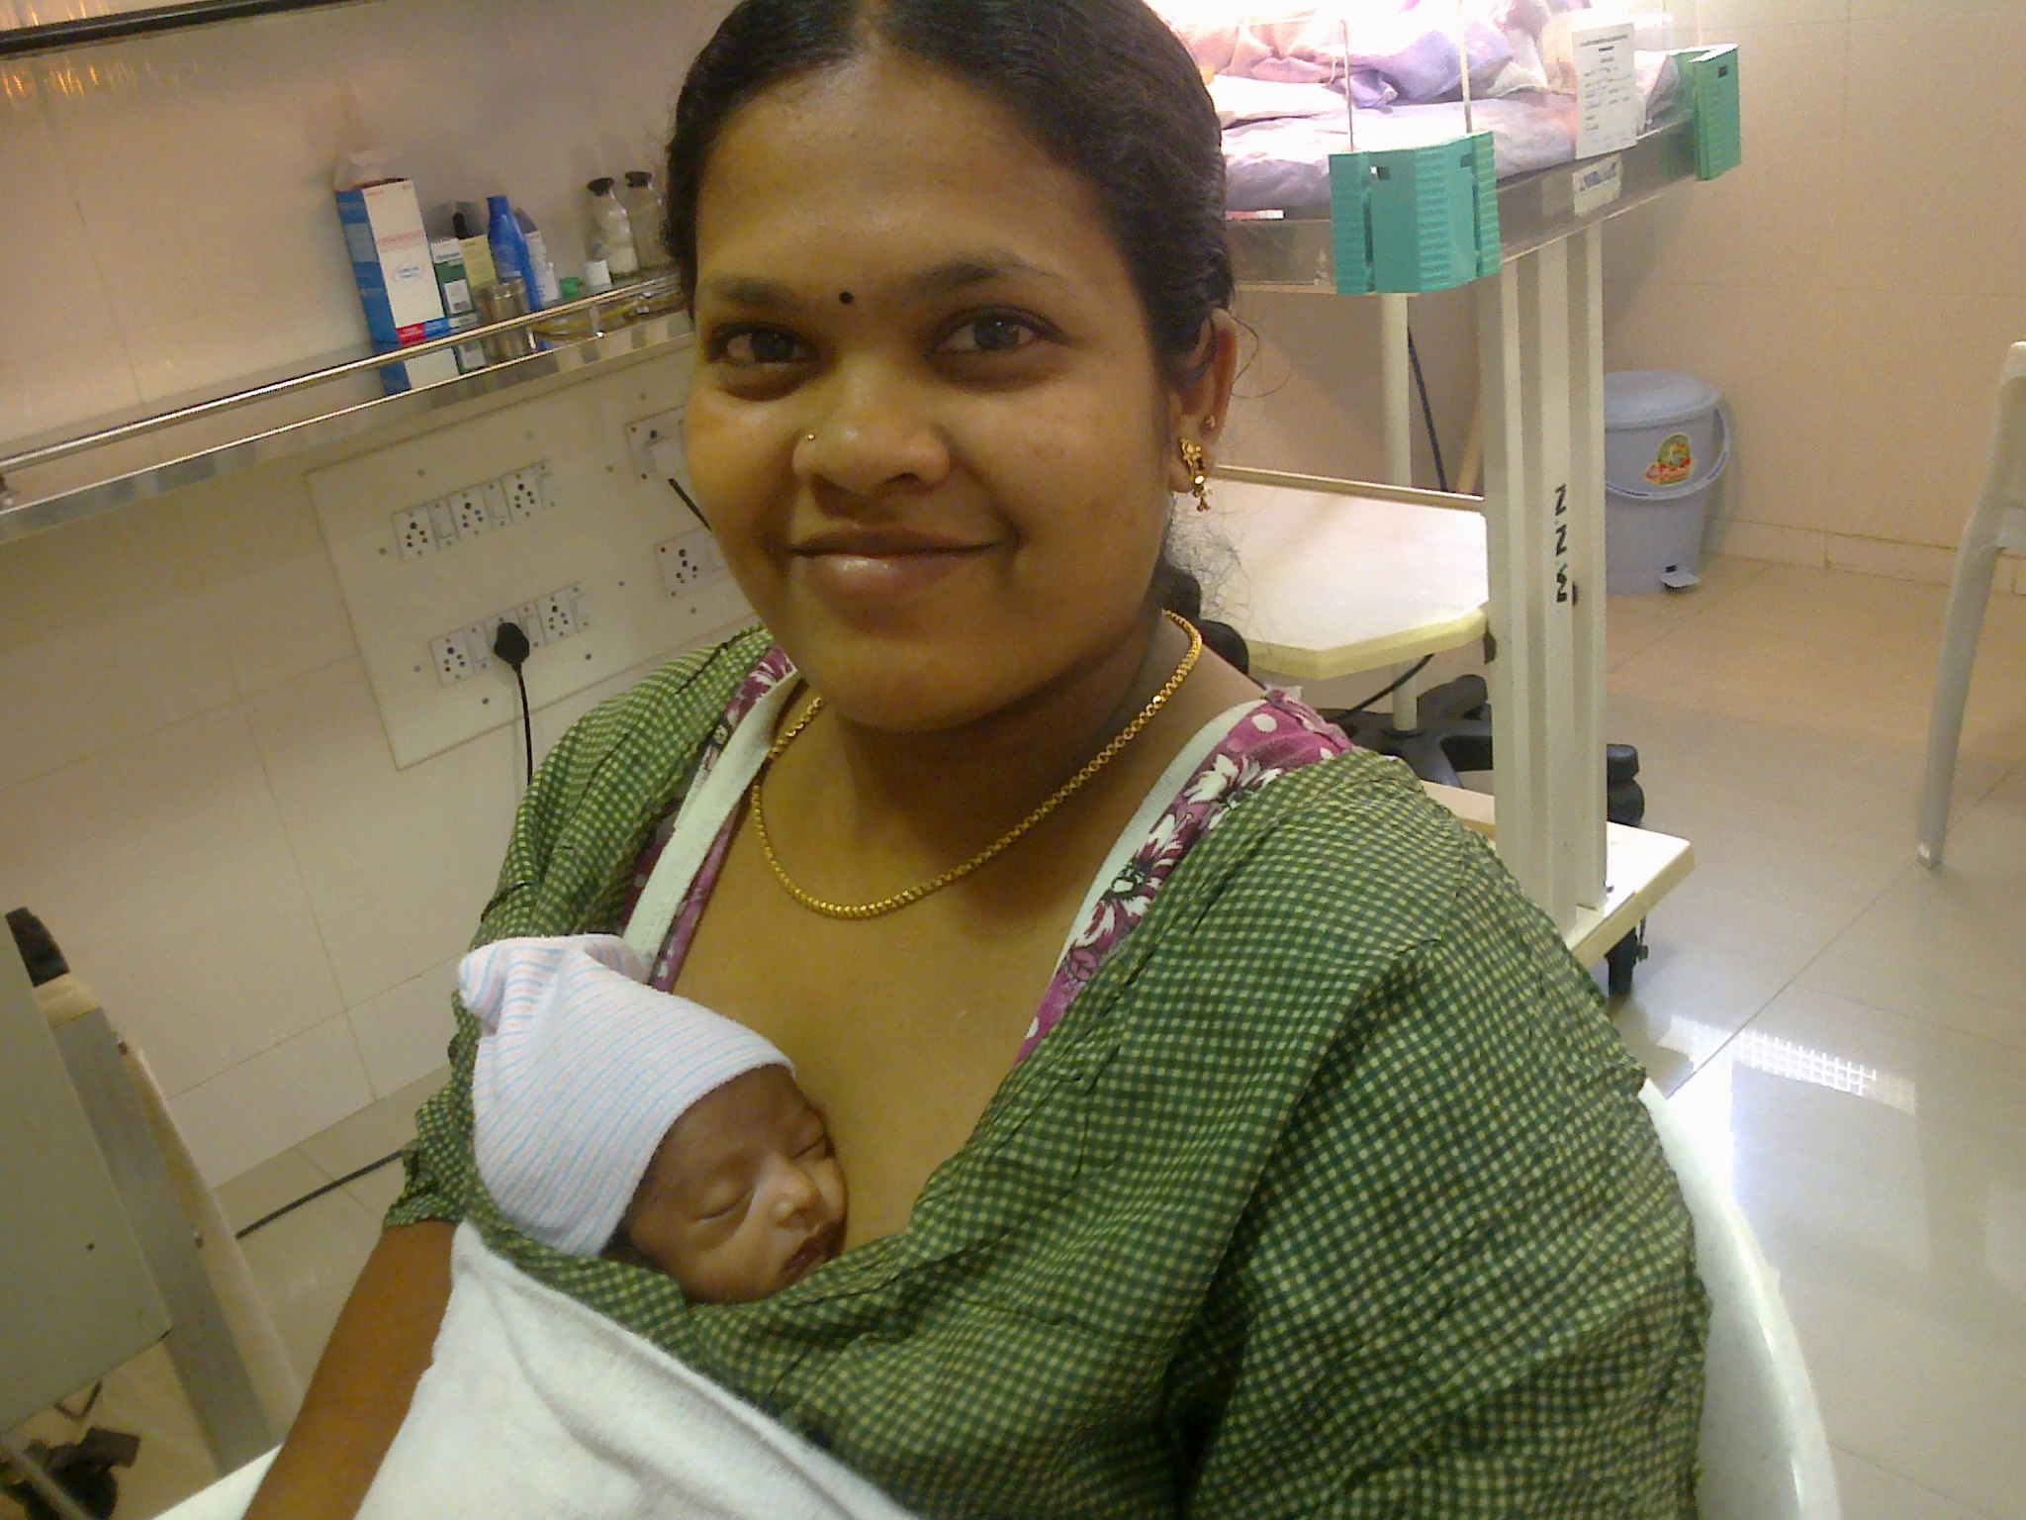
Mother – BEST for Infection prevention
KMC
Breastfeeding
Mother always welcome

Slide 14
Infection Prevention
Avoid overcrowding.
Avoid a cohort of infected babies.
Ensure hand hygiene of visitors.
NO person with infection should enter NICU.

Slide 15
Antibiotic Stewardship
Every SNCU should have its antibiotic policy based on local cultures.
Avoid unnecessary antibiotics.
DO NOT use higher antibiotics such as cephalosporins as first line – reserve for meningitis.
Stop antibiotics appropriately.

Slide 16
Case study
B/o Rajkumari is a 32 weeks preterm baby with birth weight of 1.3kg under radiant warmer. The baby is 2 days old now. Baby is not sucking at the breast, able to swallow. Mother wants to express the milk and feed the baby.
What infection control measures would you take for this baby?

Slide 17
Answer
Perform hand hygiene for 1mt using soap and water before and after handling the baby.
Create clean surroundings for the baby.
Support continuous skin-to-skin care at birth.
Place only one baby in an incubator or warmer.
Clean equipment and surfaces of the room.
Provide clean coverings for the baby.
Avoid contact with sick people.
Dispose waste properly.
Use personal protective equipment, like gown, cap or mask if necessary.
Follow the guideline for entry inside the SNCU.
Teach the mother about hand washing and cleaning the breast before expression of milk and before breast feeding.

Slide 18
Thank you

