Slide 1
Counselling - KMC
SJRI
SJNAHS
Bangalore

Slide 2
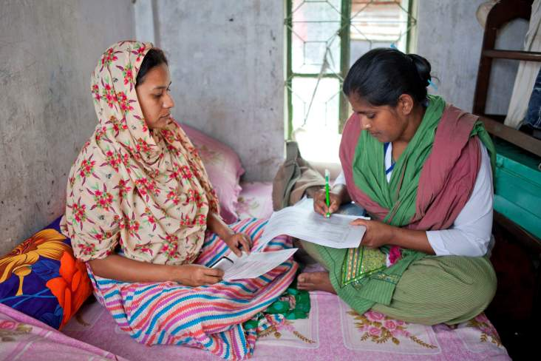
Steps used in Counselling for KMC
Build Rapport
  Ask name
  Introduce self
  Be attentive
    Sit facing mother
    Open posture
    Lean forward
    Eye contact
    Relaxed
Ask:
  E.g. How are you feeling today?
  E.g. How do you think your baby is doing?

Slide 3
Steps used in Counselling for KMC
Listen - Mother says “My baby is so small, I wonder whether I can hold the baby”
  Paraphrase: “You were saying that your baby is small and delicate and whether you could hold him”
  Clarifying: “’Did you say you were scared about how small your baby was? About carrying your baby?’’
  Reflection of feeling: “It seems like you are worried about your baby, am I right’

Slide 4
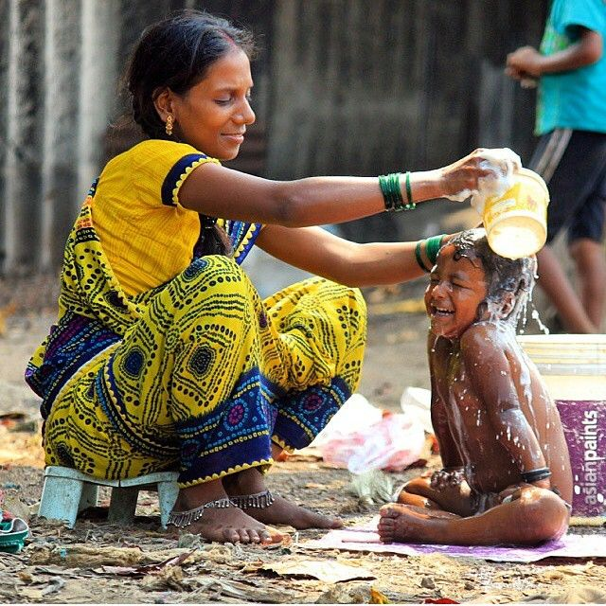
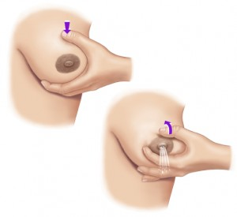
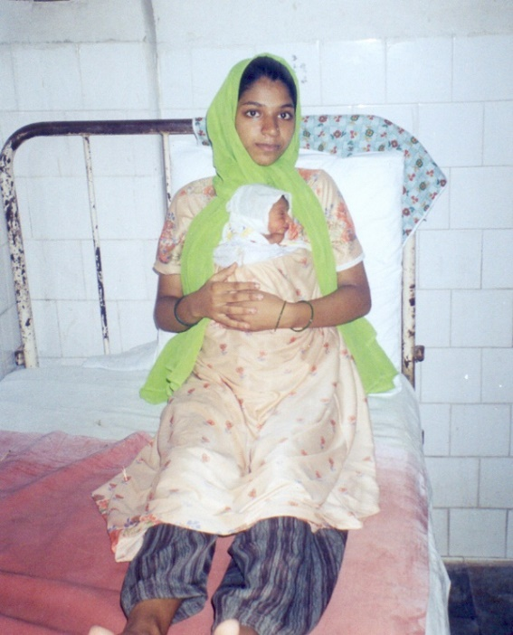
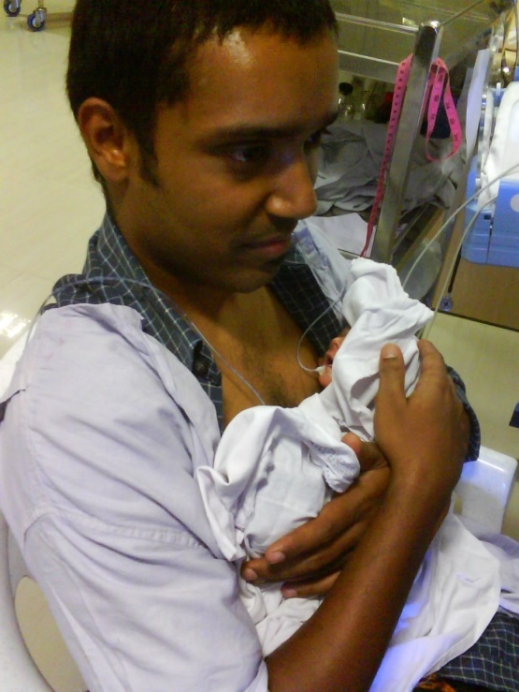
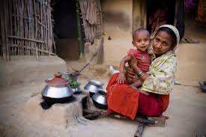
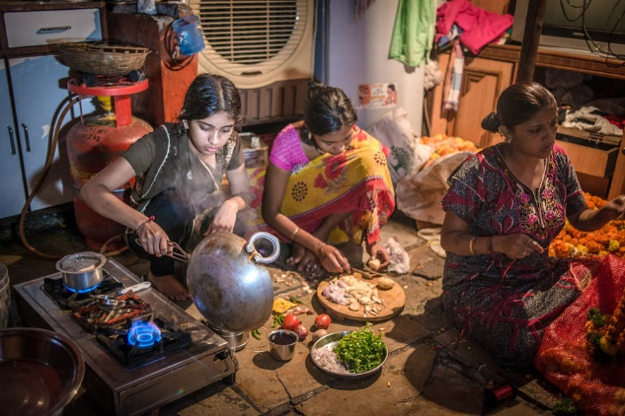
Listen – Barriers

Slide 5
Barriers for KMC – Mother
Tired
To express breast milk
Does not have support at home for other work and to provide KMC
Unaware of KMC
Positioning issues, even during sleeping
Issues with clothing
Fear / anxiety of hurting the baby
Medical issues
Attitude of health care personnel

Slide 6
Steps used in Counselling for KMC
Praise: Mother says, “I carried him today and was able to feed him also with the pallada”
  E.g. “Good, so you are also learning to feed him!”

Slide 7


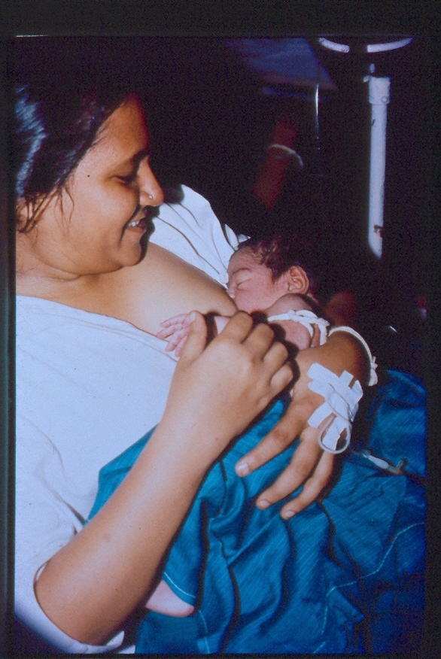
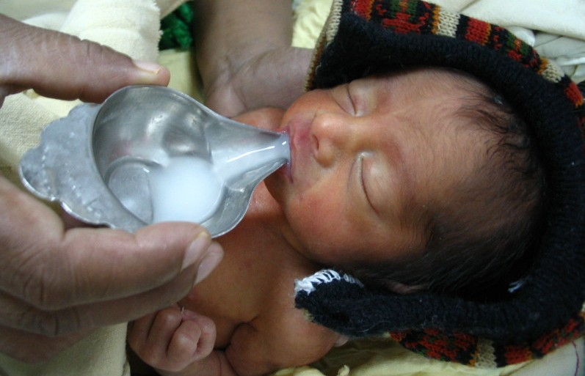
Steps used in Counselling for KMC
Advice
  E.g. About KMC- what, why, how, when, where
  E.g. Expressed Breast Feeding
  E.g. Breast Feeding

Slide 8
Steps used in Counselling for KMC
Confirm whether she has understood
  Summarise: E.g. “Can you tell me what all we discussed today”

Slide 9
Demonstration of Role Play
Rani gives birth to a 34 week 1500gms baby. This is her first baby. Baby is stable. Motivate and counsel the mother for KMC.
All participants will record the feedback in the ALPAC format
  Ask
  Listen
  Praise
  Advice
  Confirm understanding

Slide 10
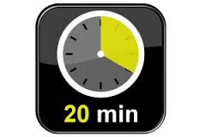
Practice of Counselling for Motivating the Mother to Provide KMC - Pairs
Same case study- each pair to take

Slide 11
What will help in implementation of KMC?
Facility:
  Training – ease of teaching KMC
  Support from staff
  Positive elements of the facility
Mothers
  Understanding efficacy
  Bonding mother and infant
  Better feeding
  Feelings of confidence
  Easy to practice
  Support from family and friends
  Early discharge

Slide 12
Role Play – Addressing enablers
Case Scenario: Suma has delivered a preterm 30 weeks 1800 gms baby. She has been giving KMC for 5 days in the hospital and is ready to be discharged.
  A: what she knows about KMC
  L: listen to what she knows, her fears or anxieties
  P: praise her for her desire to continue KMC
  A: Check how she is doing KMC- position, duration and reinforce benefits
  C: confirm understanding and get assurance of who will support her

Slide 13
Role Play Practice – Addressing Barriers
Case Scenario: Vani has delivered a term 1900gms baby. Baby is stable. She has been refusing to practice KMC. Counsel her
    A: what are her barriers
    L: listen to what she is telling you (paraphrase, clarify, reflection of feeling)
    P:praise her for any small motivating factor – she wants her baby to be well and healthy
    A: advise on how to overcome barrier, talk to other mothers
    C: confirm understanding by summarising and getting a commitment

Slide 14
Key points
Mothers can be counselled to
  Reinforce enablers to practicing KMC
  Overcome barriers to practicing KMC
A simple format to use when counselling is ALPAC
  Ask
  Listen
  Praise
  Advice
  Confirm understanding

