Slide 1
Care of Sick Newborn: Sepsis
Identification of Danger Signs;
Management of Hypoglycemia; Respiratory Distress; Seizures; and Jaundice

Slide 2
Learning Objectives
By the end of this session participants will be able to
List and identify the danger signs
Discuss on early and further management of danger signs
List babies that require urgent transport

Slide 3
I. Triage a Newborn-
Danger Signs

Slide 4
Triage Sick or At Risk Newborns
Hypothermia (<36⁰C)
Apnea/Gasping
Severe respiratory distress (RR>70, chest retractions, grunt)
Central cyanosis
Shock (cold periphery, CFT>3secs, weak /fast pulse)
Coma, convulsions, encephalopathy
Cold Stress (36.4-36⁰C)
Respiratory distress (RR>60)
Irritable/restless/jittery
Abdominal distension
Severe jaundice
Sever pallor
Bleeding from any site
Major congenital problems
Weight < 1800gms or >4000gms
Transitional stools
Posseting
Minor birth trauma
Superficial infections
Minor malformations
Jaundice
Others
Emergency
Initiate Treatment
Priority
Assess and Act Rapidly
Non urgent
Assess and Counsel
Classify
Act
Manage in Special NB care unit (SNCU) OR Refer
Notes:
Facility Based Newborn Care_Operational Guidelines 2011

Slide 5
Assessment and Treatment of Newborns with Emergency Signs
Cold to touch (Abdomen)
Rapidly rewarm if severe (<32⁰C-35⁰C), then gradual rewarming
T
Not breathing/Gasping or Central cyanosis
Severe respiratory distress
RR>70/min
Severe lower chest indrawing
Apnoeic spells
Grunting
Unable to feed
Manage airway
Provide tactile stimulation
If still apnoeic provide BMV
Give oxygen
Keep warm
A
Give oxygen
Insert IV-20ml/kg NS in 30 mins
Do full assessment and treat
Keep warm
CRT > 3 secs and fast and weak pulse
C
Manage airway
Check and correct hypoglycaemia
Give anticonvulsant
Keep warm
Convulsions
C

Slide 6
For all Newborns with Emergency Signs
Call for help
Provide treatment
Draw blood for emergency investigations
  Glucose
  Calcium
  Sepsis screening
Refer if pediatrician not available or no SNCU

Slide 7
Criteria for Admission in SNCU
Birth weight <1800gms or GA <34wks
Large baby >4000gms
Perinatal asphyxia
Apnea or gasping
Refusal to feed
Respiratory distress (RR>60/min or grunt/retractions)
Jaundice (appears<24hrs/stains palms and soles/lasts >2wks)
Hypothermia<35.4⁰C or hyperthermia >37.5⁰C
Central cyanosis
Shock (cold peripheries with CFT>3sec and weak/fast pulse)
Coma and or convulsions
Abdominal distension; diarrhea or dysentery
Major malformations

Slide 8
Criteria for Transfer from SNCU to Newborn Stabilisation Unit (NBSU)
Babies whose respiratory distress is improving (with or without oxygen to maintain saturation) or those with RR 60-70/min without grunting or retractions
Babies who are otherwise stable (Vitals and CFT normal)
  LBW (<1800gm)
  Babies with jaundice requiring phototherapy
  Admitted for any other condition for observation or antibiotics or other medications
Notes:
FBNC

Slide 9
Neonatal Sepsis
Clinical syndrome of bacteremia with systemic signs and symptoms of infection in the first four weeks of life

Slide 10
Common Organisms Causing Sepsis
Klebsiella pneumoniae
Escherichia coli
Staphylococcus aureus
Pseudomonas

Slide 11
Early vs Late Onset Sepsis
 | Early | Late
Onset | Upto 72 hrs | After 72 hrs
Source | Maternal | Postnatal environment
Presentation | Rapid including most organs Pneumonia frequent | Slowly progressive,focal Meningitis frequent
Mortality | 15-50% | 10-20%

Slide 12
II. Management of Specific -
Danger Signs

Slide 13
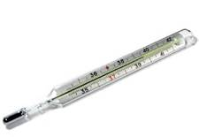
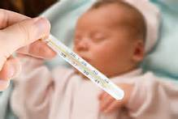
1. Hypothermia (< 36⁰C )

Slide 14
Definition & Degrees of Hypothermia
36.5-37.5ºC
Normal range
36.0 to 36.5ºC
Cold stress
Cause for concern
35.9-32.0ºC
Moderate hypothermia
Danger, warm baby
<32.0ºC
Severe hypothermia
Outlook grave, skilled
care urgently needed

Slide 15
Management of Hypothermia
Record body temperature
Severe hypothermia
  Radiant warmer
  Infuse 10% Dextrose @60ml/kg/day
  Provide oxygen
  Assess for sepsis
Mild to moderate
  Radiant warmer / KMC

Slide 16
Management: Severe Hypothermia (<32⁰C )
Provide extra heat preferably under radiant warmer
  - rapidly warm till 34⁰C, then slow re-warming
Take measures to reduce heat loss
IV fluids: 60ml/kg of 10% Dextrose
Oxygen, if needed
Inj. vitamin K 1 mg in term & 0.5 mg in preterm
If still hypothermic, consider antibiotics assuming sepsis
Admit in SNCU and monitor

Slide 17
Management: Moderate Hypothermia
Skin to skin contact
Warm room/bed
Take measures to reduce heat loss
Provide extra heat
  Room heater
  Radiant warmer
  Apply warm towels
Monitor temperature every 30 minutes

Slide 18
Management: Cold Stress
Cover adequately - remove cold clothes and replace with warm clothes
Warm room/bed
Take measures to reduce heat loss
Ensure skin-to-skin contact with mother
Or keep next to mother after fully covering the baby
Encourage breast feeding
Monitor axillary temperature every ½ hour till it reaches 36.5⁰ C, then hourly for next 4 hours, 2 hourly for 12 hours thereafter

Slide 19
Using Skin-to-Skin Contact
Re-warm a Cold Baby
Make sure the room is warm
Place baby in skin-to-skin contact in a pre-warmed shirt opening at the front, a nappy, cap and socks
Cover the baby on the mother’s chest with her clothes AND an additional warmed blanket
Check temperature every 30 minutes
Keep the baby with the mother until the temperature is in the normal range
NT-

Slide 20
2. Respiratory Distress
Fast breathing: > 60/min PLUS
  Retractions
  Grunting
  Nasal flaring
  Cyanosis

Slide 21
Assess Respiratory Distress Severity
Score | Upper Chest Retraction | Lower Chest Retraction | Xiphoid Retraction | Nasal Flaring | Grunt
0 | Synchronised | None | None | None | None
1 | Lag during inspiration | Just visible | Just visible | Minimal | Audible with stethoscope
2 | See-saw | Marked | Marked | Marked | Audible just with ears
Score 1-3 Score 4-6 Score >6 |  |  | Mild respiratory distress Moderate respiratory distress Impending respiratory failure

Slide 22
RDS
 | 0 | 1 | 2
RR | <60 | 60-80 | >80
Central cyanosis | None | None wih 40% O2 | Needs more than 40% 02
Retractions | None | Mild | Severe
Grunting | None | Minimal | Obvious
Air entry | Good | Decreased | Very poor

Slide 23
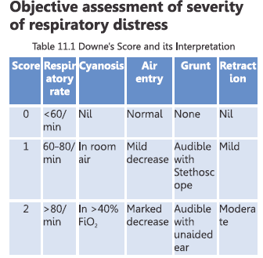
Interpretations
Score 1-6 = respiratory distress
Score >6 = impending respiratory failure
(may need CPAP or mechanical ventilation )

Slide 24
Assess Respiratory Distress
Baby has grunting, nasal flaring, RR 90/min, cyanosis of palms and feet and chest retractions
Baby has RR 60/min, upper chest retractions, no cyanosis, alert

Slide 25
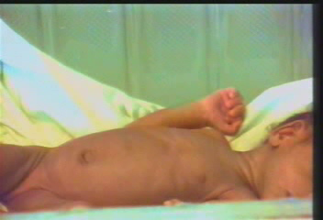
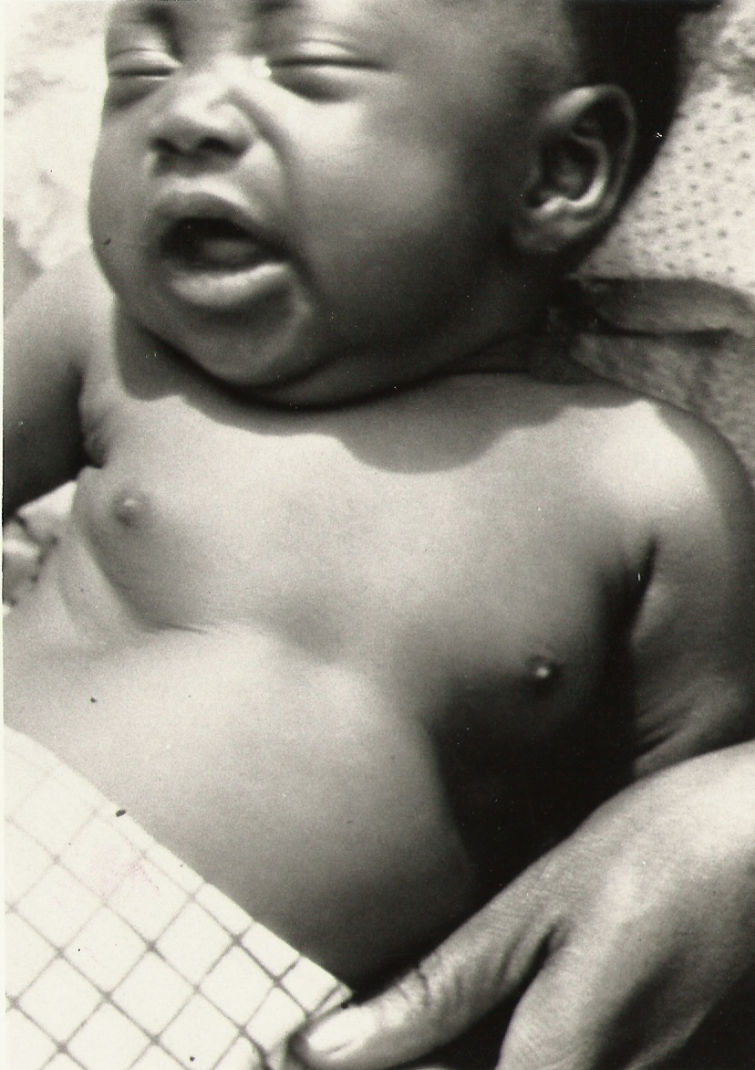
Respiratory Distress i. Chest Indrawing

Slide 26
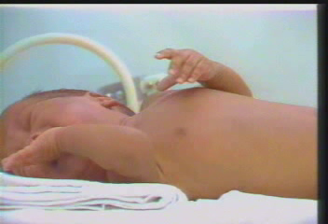
Respiratory Distress ii. Nasal flaring

Slide 27
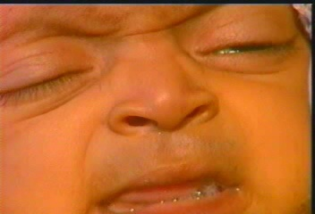
Respiratory Distress iii. Grunt

Slide 28
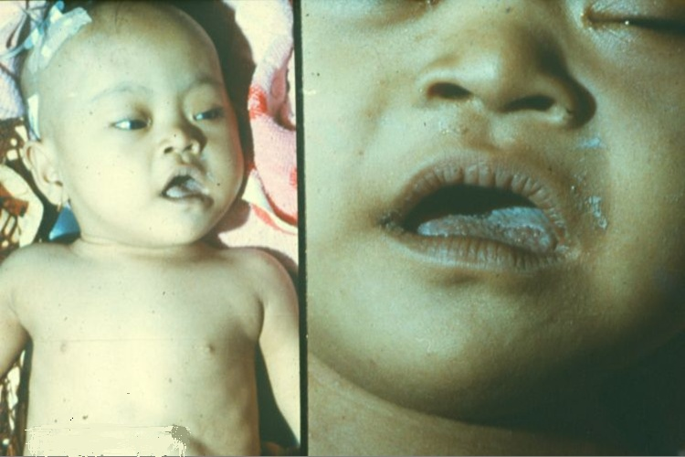
Respiratory Distress iv. Cyanosis

Slide 29
Monitoring of a Newborn with Respiratory Distress
RDS score
Oxygen saturation
  Maintain between 88-92% for preterm (PT)
  Maintain between 90-93% for term (T)
Give oxygen if breathing difficulty worsens or central cyanosis
  Nasal prong – 0.5-1L/min (PT) and 1-3L/min (T)
  Oxygen hood - >5L/min
  Nasal catheter (6-8Fr) – 0.5-1L/min

Slide 30

3. Convulsions / Seizures

Slide 31
Immediate Management of Seizures
Keep airway open
Start oxygen
Suction mouth if needed / wipe secretions
Insert IV line
Test blood for glucose, haematocrit, calcium, electrolytes, magnesium where possible
Glucose <45mg/dl, give 4-5ml of 10%dextrose
Continues – Inj Phenobarbitone 20mg/kg(20 mins)

Slide 32
Continued Management
Seizures
Repeats: Inj Phenobarbitone 10mg/kg till a total of 40mg/kg)
Continues: Give Inj Phenytoin 20mg/kg over 20 min
Initiate maintenance doses
Reassess for infections
  Bulging fontanelle
  Drowsy to coma
  REFER if continues to have seizures

Slide 33
Case Scenario 4
A term 2 kg baby is born to a primi mother who had rupture of membranes > 12 hours and fever during labour.
When the staff nurse checked with mother 1 hour after birth, whether the baby was feeding. The mother says that the baby is not feeding well. Later the baby is noticed to have a seizure by the staff nurse.

Slide 34
What you need to Learn?
Which babies are at risk?
How to differentiate between a seizure and jitteriness?
What medications to keep at hand?
What is the follow up and advice?

Slide 35
Risk Factors for Convulsions
Prolonged / obstructed labour
Birth injury
Birth asphyxia
Hypoglycemia
Preterm babies

Slide 36
Time of Onset of Seizures
Onset of Seizures
Within 24 hours
1-3 days
1-7 days
3-7 days
3-14 days
2 to later
Probable cause
Birth asphyxia & complicated delivery
Maternal diabetes, small or large baby
Small baby, sudden pallor (IV bleed)
Bilirubin encephalopathy
Unclean birth or application of substances on umbilicus
Meningitis

Slide 37
How can you Identify Seizures?
Eye deviation ( more in term babies)/ blinking with fixed stare (more in preterm babies)
Repetitive mouth and tongue movements
Apnea
Pedaling and tonic posturing
Sustained extension/flexion of upper and lower limb
Drowsy (+/-)

Slide 38
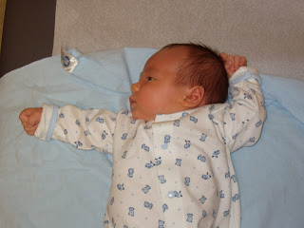
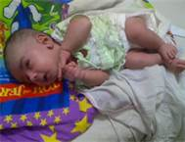

Newborns with seizures
Absence seizures
Multifocal clonic seizures (jerky movements)
Tonic seizures – hands flexed, legs extended
Notes:
http://www.bing.com/images/search?q=tonic+seizure+in+newborns+picture&qs=n&form=QBIR&pq=tonic+seizure+in+newborns+picture&sc=0-0&sp=-1&sk=

Slide 39
What must you check for?
Which parts are involved?
Was there a history of fetal distress, maternal infection
Is the baby hypoglycemic?
Is the baby hypothermic?
Is the baby conscious/unconscious?
Is the baby drowsy / alert?
Is the seizure triggered by stimuli?
Is it restricted with restraint?
Any pustules?
Any jaundice?
Notes:
Clonic seizures consist of rhythmic jerking movements of the arms and legs, sometimes on both sides of the body.
Tonic seizures are brief seizures (usually <60 seconds) consisting of the sudden onset of increased tone in the extensor muscles. are invariably longer and occasionally tonic seizures terminate with a clonic phase.

Slide 40
How to Differentiate Jitteriness and Seizures
CLINICAL FEATURE JITTERINESS SEIZURE
Abnormal gaze or eye O +
movement
Movements very stimulus + O
sensitive
Predominant movement Tremor Clonic jerking
Movements stop with passive + O
flexion
Autonomic changes O +
------------------------------------------------------------------------------------------------------------------

Slide 41
What must you keep Ready?
10% dextrose
Antibiotics first line – gentamycin, ampicillin and metrogyl
IV set, needles – vasofix/scalp vein
Anticonvulsants
  Phenobarbitone

Slide 42
Immediate Management of Seizures without Hypoglycemia
If hypoglycemia – treat it
No hypoglycemia- Anticonvulsants
  Phenobarbital:20mg/k IV loading dose slowly over 5 min or IM
  If convulsion does not stop within 30mins give one more dose:
    10mg/kg IV to a max of 40 mg/kg
    Repeat the dose once more after 30 mins if needed

Slide 43
CAUTION
DO NOT give diazepam
  Increase chance of circulatory collapse and respiratory failure
DO NOT give hydrocortisone

Slide 44
Initial Management of Seizures
Give oxygen if cyanosed or with breathing difficulty
Continue IV fluids if baby not able to feed
  D1 60ml/kg; D2 – 80ml/kg; D3 – 100ml/kg
  D4- 120ml/kg; D5 – 140ml/kg; D6 150ml/kg
Continue Phenobarbitone (5mg/kg) OD till baby has not had convulsions for 7 days
  Follow up for 3 days
Refer baby to higher center

Slide 45
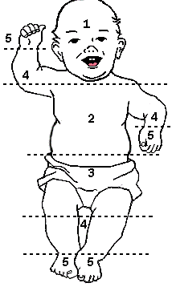
3. Jaundice
S. Bilirubin
Face: 6mg/dl
To trunk: 9mg/dl
To abdomen: 12mg/dl
To legs: 15mg/dl
To feet/hands: 18-20mg/dl

Slide 46
Jaundice

Slide 47
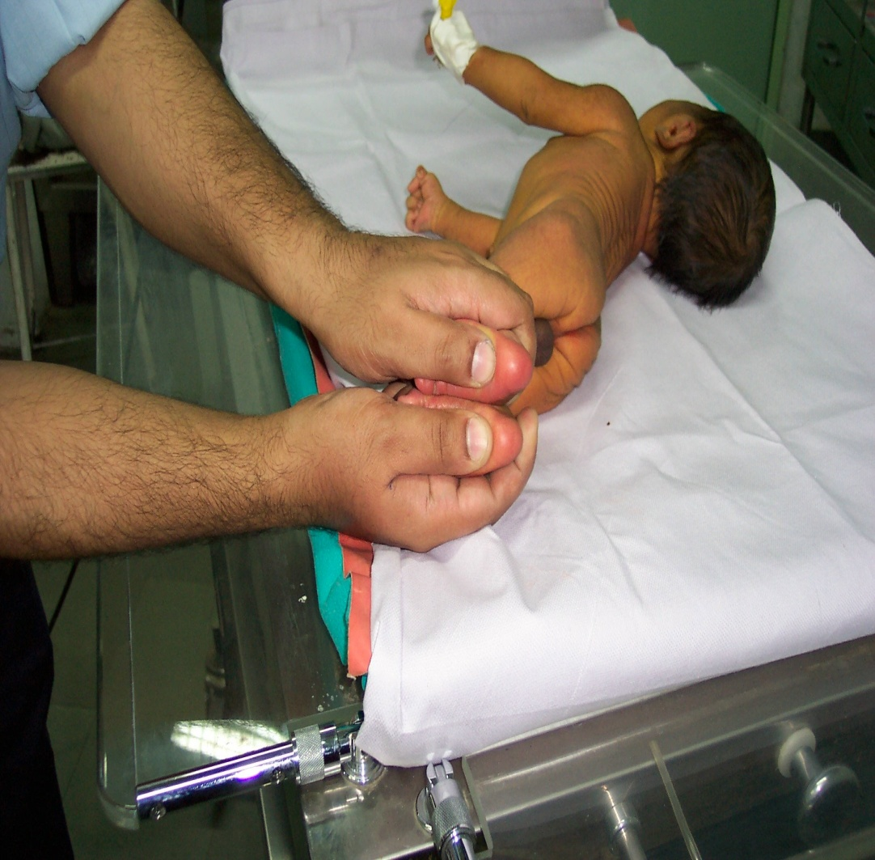
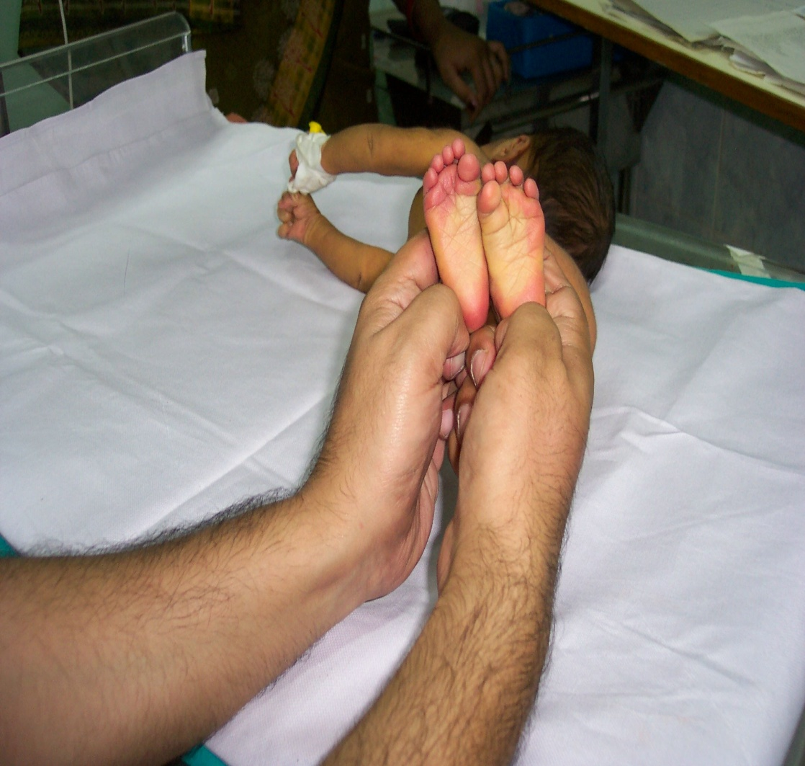
Severe Jaundice

Slide 48
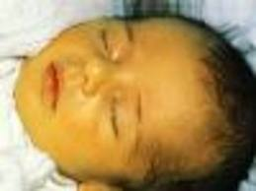
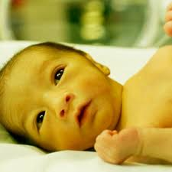
When must you be Alert
Jaundice within 24hrs
Total serum bilirubin (TSB) increasing by >5mg/dl/day
TSB>15mg/dl
Clinical jaundice lasting
  > 2 weeks FT
  > 3 weeks PT

Slide 49
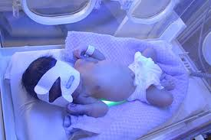
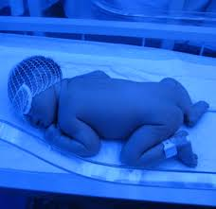
Management of hyperbilirubinemia
Phototherapy
  Naked but napkin (male)
  Eye shields
  More fluids
  Turn 2 hourly
  Watch I/O
When to REFER
How to feed?
Monitor

Slide 50
III. Other Signs of Sepsis

Slide 51
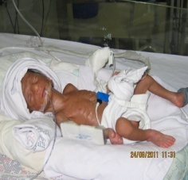
Poor Feeding
Preterm or sick baby
  Poor sucking
  Poor sucking swallowing coordination
  Respiratory problems
    Fast breathing

Slide 52
Sepsis

Slide 53
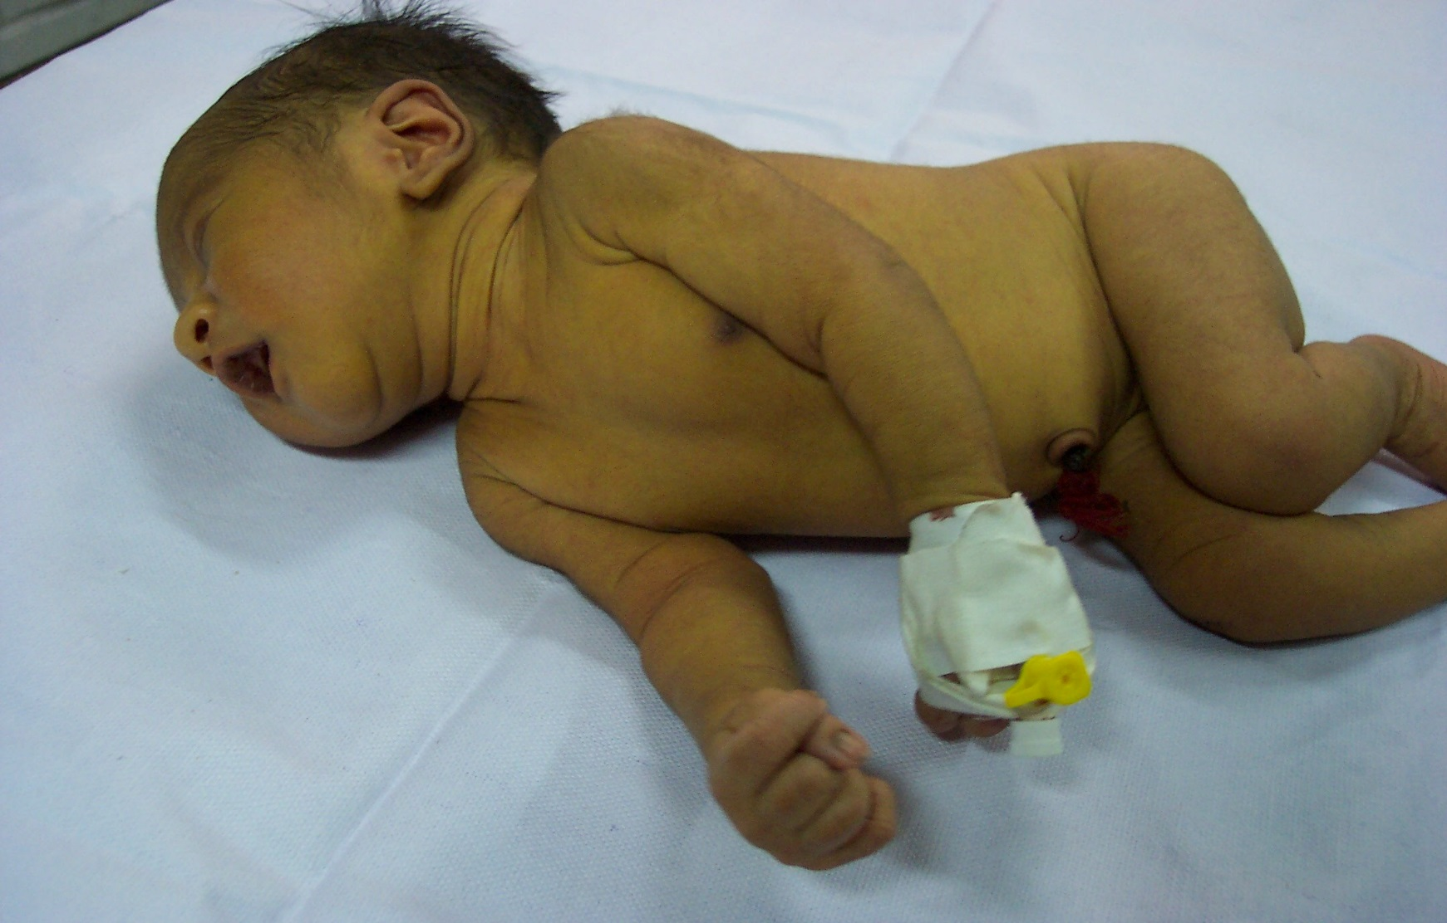
Stiff baby - Opisthotonus
Head and heels bent backward
Body arched forward
Extreme hyperxtension of the body with the head and heels bent backward and body arched forward

Slide 54
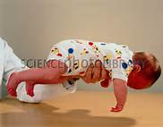
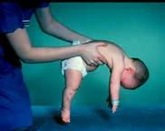
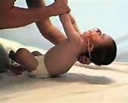
Floppy Baby
Floppy baby
Normal tone

Slide 55



Irritable or Lethargic / Unconscious / less than normal movements
Irritable baby – always crying
Normal - Active baby
Lethargic baby

Slide 56
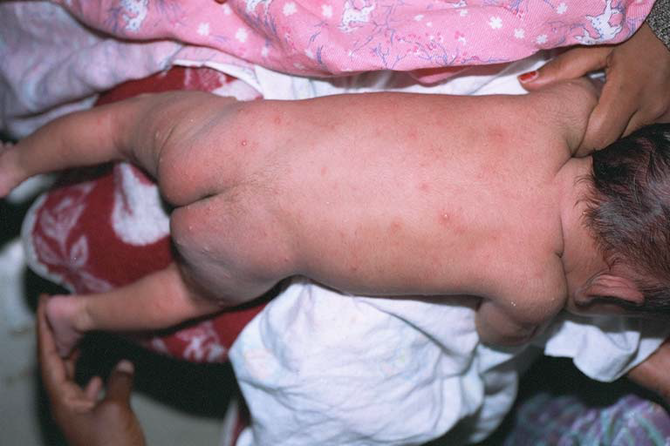
Skin Pustules / Boils
Single large boil
More than 10 pustules

Slide 57
Symptoms of Neonatal Sepsis
CNS
  Lethargy, refusal to suckle, limp, not arousable, poor or high pitched cry, irritable, seizures
CVS
  Pallor, cyanosis, cold clammy skin
Respiratory
  Tachypnea, apnea, grunt, retractions

Slide 58
Symptoms of Neonatal Sepsis
GIT
  Vomiting, diarrhea, abdominal distension
Hematological
  Bleeding, jaundice
Skin
  Rashes, purpura, pustules

Slide 59
Signs of Neonatal Sepsis
Cold to touch ( hypothermia )
Poor perfusion ( CRT )
Less or absent urine output - Renal failure
Sclerema
Bulging fontanels, neck stiffness
Poor weight gain*
*
Indicates low grade sepsis

Slide 60
IV. Management of Sepsis

Slide 61
Assessment of signs
Non-specific signs: Lethargy, refusal to suckle, ppor cry, not arousable, comatose
GI: Abdominal distension, dairrhea, vomiting, poor weight gain
CVS: Hypothermia, poor perfusion, shock, bleeding and sclerema
RS: Respiratory distress
CNS: Fever, seizures, high pitched cry, excessive cry, irritability, neck retraction, bulging fontanelle

Slide 62
Assessment of Sepsis
Is there shock? Treat immediately
Screen for sepsis
  Leukopenia (TLC<5000/cumm)
  Neutropenia (ANC<1800/cumm)
  Positive CRP
  Culture
    ---Negative ….Repeat >12hrs…Negative
    ….Positive…treat
  REFER if LP needed

Slide 63
Management of Sepsis
Treatment with antibiotics: Sepsis and Pneumonia
  Inj Ampicillin or Cloxacillin 50mg/kg/dose IV (7-10dys)
    < 7 days: 12 hourly
    >7 days: 8 hourly
  Inj Gentamicin (5mg/kg/dose) or Inj Amikacin (15mg/kg/dose) IV 24 hourly (7-10days)

Slide 64
Treatment for Meningitis
Inj Ampicillin 100mg/kg/dose IV x 21 days OR
Inj Cefotaxime 50mg/kg/dose x 21 days AND
In Gentamicin 2.5mg/kg/dose IV x 21 days

Slide 65
Supportive Care for Sepsis
Warmth
IV fluids
Inj Vitamin K 1mg IM
Start oxygen by hood if cyanosed and grunting
Gentle stimulation if apnoeic
BMV if breathing inadequate
Keep NPO
If condition worsens in 6 hours -REFER

Slide 66
Continue Management for Hypoglycemia
  Once 2 readings of blood glucose >45mg/dl
    Allow baby to breast feed or EBM-pallada/spoon
    Decrease volume of IV fluids slowly
  Continue measuring blood glucose Q12H till baby on IV fluids
  Once off IV fluids measure Q12 H twice.
    Blood glucose normal no need to check
Notes:
How long to continue anticonvulsants: One month after discharge
Neurological exam normal, D/C phenobarbital
Neurological exam is persistently abnormal, obtain EEG
No seizure activity on EEG, discontinue phenobarbital
What is the duration of follow up
Follow up:
Neuro
Developmental
Orthopedic /PMR
Education:
Prevention
Management

Slide 67
V. Case Scenario Discussion

Slide 68
Case Scenario 1
A term baby, cried soon after birth presents with low body temperature, lethargy on day 2. Mother says baby is refusing feeds and is irritable, noise coming from baby
What is the possible problem? What can you do?

Slide 69
Response
Possible infection – respiratory distress? Sepsis?
Check RDS
Administer first dose of antibiotics if indicated
Check if baby able to feed,
Keep NPO if RDS is >5
Start management for sepsis
Monitor baby- RDS, oxygen saturation, HR, CFT, jaundice, seizures, GRBS etc
Refer baby if baby does not improve and requires intensive care
Notes:
IV

Slide 70
Case Scenario 2
A term baby doing well on the first day presents with jaundice up to face and trunk, is active and alert.
What additional information will you need to collect? What is the possible problem? What can you do?

Slide 71
Responses
Maternal history, blood group and type, term/preterm?
Assess jaundice, send blood for S Bilirubin and Hb, sepsis study etc
Phototherapy
Monitor feeding, output, activity, sensorium, tone, GRBS
Check if vitals are normal or not-RR, HR, Temp, CFT?
Start antibiotics
Refer if baby is not improving (jaundice beyond chest level if baby requires exchange transfusion)

Slide 72
Case Scenario 3
A term baby 1700grams is lethargic, cold to touch and feeding poorly on day 1
What is the problem? What can you do?

Slide 73
Response
Possible infection –hypoglycaemia or sepsis
Encourage Kangaroo mother care or keep under radiant warmer
Check when last feed was given?
Check random blood sugar – if low <45mg/dl
Start IV line- Administer 2ml/kg 10% dextrose
Give IV fluid as maintenance
Monitor blood sugar (GRBS) 30 minutes later
  GRBS <25mg/dl another bolus
  GRBS 25-45mg/dl continue infusion
Check if baby is feeding, alert/active, sleeping well
Record if baby is lethargic/floppy; temperature is altered-hypothermic or fever; stiff; crying excessively
Start management for sepsis – antibiotics
Notes:
IV

Slide 74
Sepsis Management
Warmth
Airway
Fluids
Antibiotics
Manage jaundice
Manage hypoglycaemia
Manage convulsions

Slide 75
Take the baby to the nearest referral facility, by the shortest route, using the fastest possible mode of transport
IN UTERO Transport is the best

Slide 76
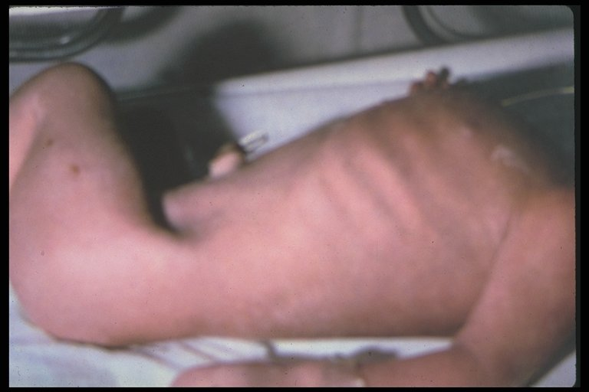
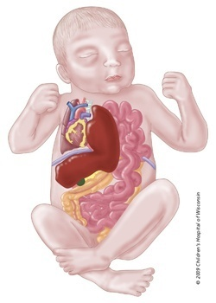
Congenital Anomalies – Diaphragmatic Hernia
-

Slide 77
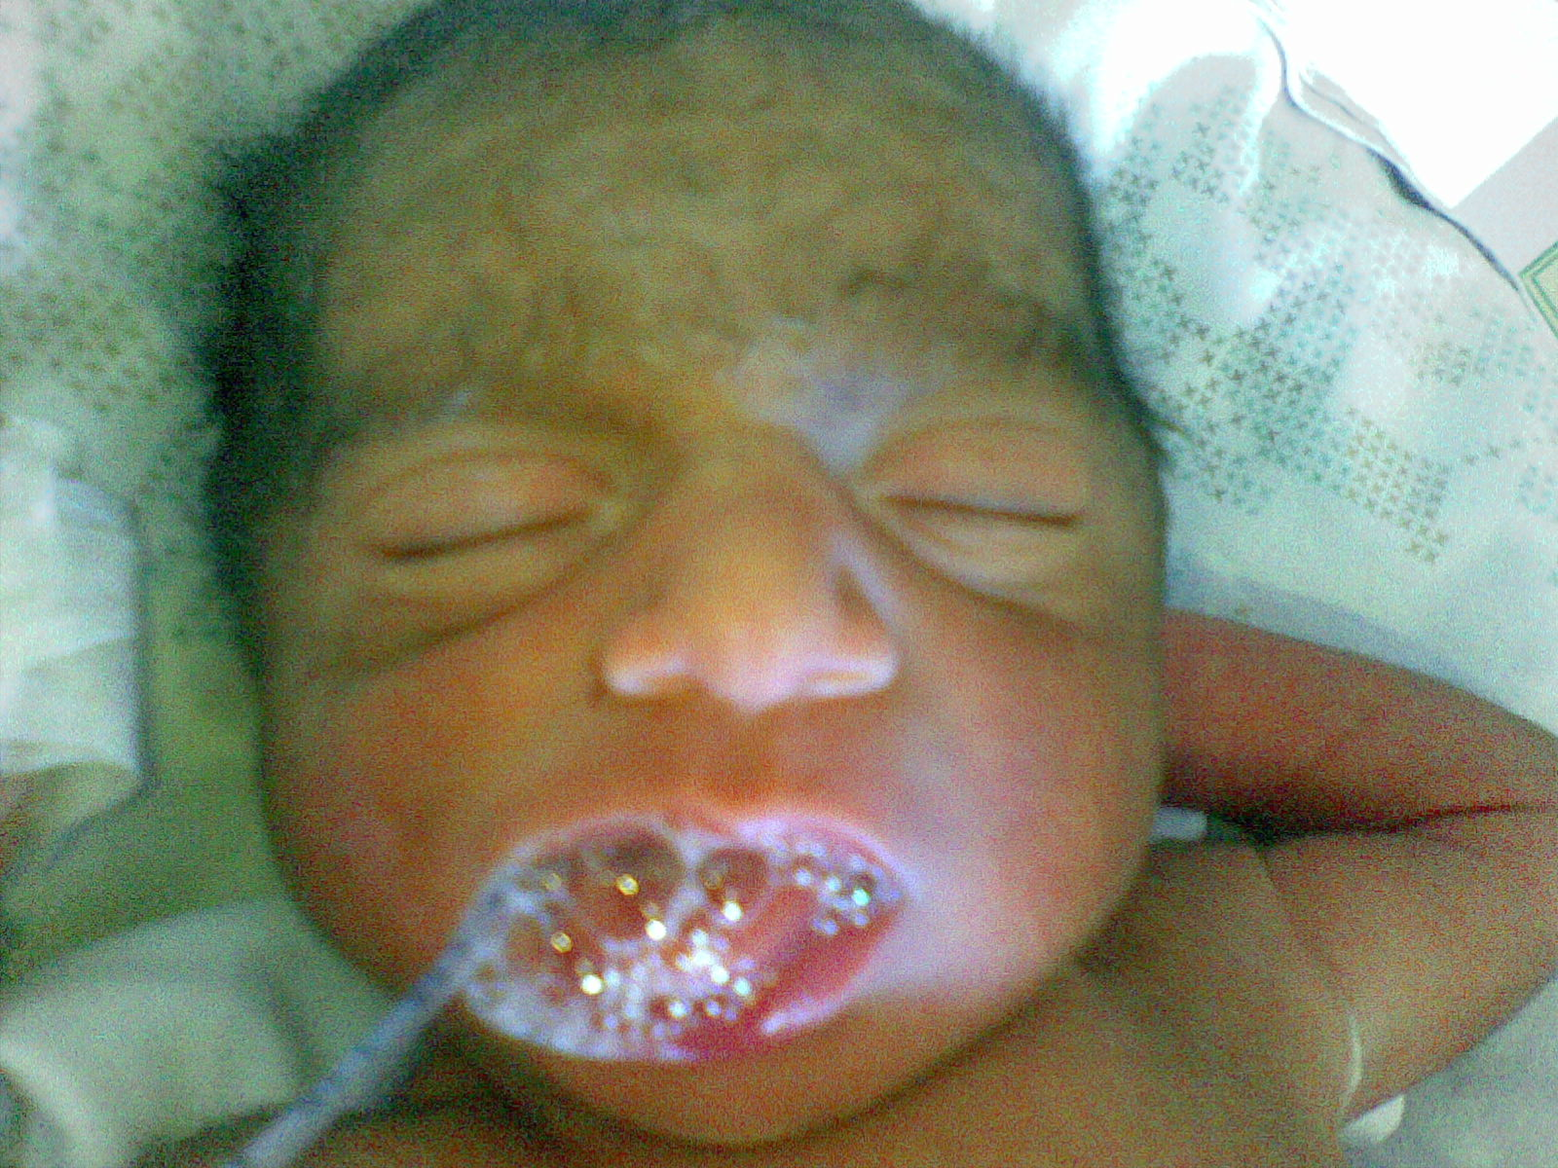
Congenital Anomalies- Trachea Esophageal Fistula
Breathing difficulty
Drooling of saliva
Choke with feed
Cyanosis

Slide 78
Any questions?
Thank you

