Slide 1
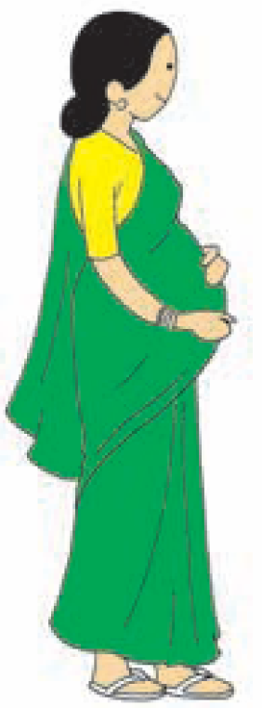
Antenatal care
Systematic examination of a women during pregnancy
History collection and examination
Advice given to the pregnant women.

Slide 2
Why ANC is important during pregnancy?
Most of the problems during pregnancy are not predictable.
For assessing growth of the baby and health of the mother, 3 ANCs are necessary for all pregnant women.

Slide 3
How many ANCs are necessary and why?
First visit is recommended as soon as the woman feels that she is pregnant - registration
of pregnancy.
Second visit -Between the fourth and sixth month
Third visit –Eighth month.
Additional visit – Ninth month, would help provide better care.

Slide 4
What things are checked and advised during ANC?

Slide 5
Essential components of antenatal care
Early registration
Regular weight check
Blood test for anaemia
Urine test for protein and sugar
Measure blood pressure
One tablet of IFA every day for three months to prevent anaemia
Treatment for anaemia
Two doses of Tetanus Toxoid (TT) vaccine
Nutrition counselling
Preparing for birth.

Slide 6
CONT....
Complete history collected about this pregnancy and previous pregnancies and past medical and surgical if any.
Checked for weight gain, uterus size, blood pressure, urine and haemoglobin.
2 TT injections given at one month interval, prevents the baby from Tetanus.
IFA tablets are given - helps in growth of the baby and prevents anaemia in mothers. A pregnant woman have to take at least 100 iron/IFA tablets.

Slide 7
Home care during pregnancy

Slide 8
What all types of foods are essential during pregnancy?

Slide 9
CONT...
Nutritious diet which is rich in iron, calcium and protein is required.
Pregnant women must consume all types of food -white (rice/roti), yellow (dal), green (vegetables) red (fish/meat/eggs) and liquids (milk, juice and water). Use Iodized salt only.
She should eat one more serving in each meal.
No food is prohibited during pregnancy.
Anemia in mother leads to small baby and increases risk of death in mother.
A pregnant woman should not fast. This deprives her and the growing baby inside the uterus of essential food.

Slide 10
Why rest is necessary for pregnant woman?/What type of work a pregnant woman must not do?

Slide 11
CONT...
Pregnant women need adequate rest for growth of the baby.
She must take rest for at least 2 hours during day time and whenever she feels tired.
Pregnant women can do light household work such as cooking, cleaning house etc.
Pregnant women must not do hard work or weight bearing activity such as grinding, drawing or carrying water or carrying load etc.
Hard and weight bearing work may lead to pregnancy loss, small baby and onset of labour before time

Slide 12
What are the common problems during pregnancy?

Slide 13
CONT...
The common problems during pregnancy are:
Bleeding before onset of labour pain
Convulsion/fits
High grade fever
Swelling of feet or hands
Pain abdomen before expected date of delivery
Severe pallor/anemia

Slide 14
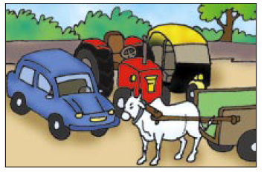
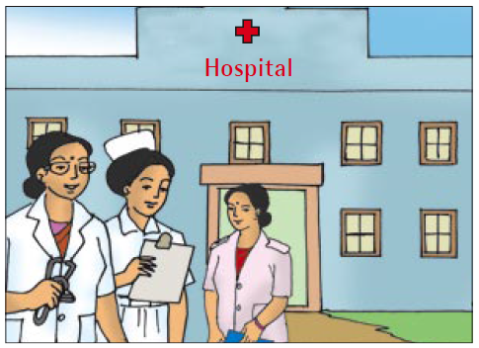
If a pregnant woman has any of the danger signs, where should she go for the delivery?
She must go to a hospital with adequate facilities (Block hospital or District hospital)for delivery.

Slide 15
Preterm labour
Labour before completion of 37 weeks of gestation is called preterm labour

Slide 16
Risk factor for preterm labour
Previous history of induced or spontaneous abortion or preterm delivery.
Pregnancy complication
Pre-eclampsia
Ante partum bleeding
Premature rupture of membrane
Polyhydramnios
Uterine anomalies
Medical and surgical illness
Infections
Multiple pregnancy
Placental abnormalities
Congenital malformation of foetus
Intrauterine death

Slide 17
Do always be alert for danger signs during pregnancy, labour and early postnatal period
Do counsel all women of danger signs

Slide 18
Arrange the items for the baby and mother; and transport for delivery

Slide 19
Cont...
Baby and mother both need adequate clothes after delivery. Arrange things beforehand which are necessary for the baby and mother immediately after delivery.
Delivering in a hospital is always safer for the baby and the mother. Government is promoting delivery at hospital under Janani Suraksha Yojana (JSY) free of charge.
The fastest possible modes of transport to hospital (either planned or in emergency) must be explored in advance.
Save money ready for use in emergency.
Support from relatives/friends/neighbours during the delivery and immediately after the delivery may be very useful.

Slide 20
Antenatal KMC Counselling
Counsel the mother about risk for preterm labour and chances of having a small baby.
Inform that small babies need increased special care compared to normal size babies.
There are simple, cost effective methods available to care for small babies.
Educate on what, how, when, and why for KMC.
Reinforce that wherever a mother delivers, she provide KMC once the baby is stable.

Slide 21
Case study 1
Mrs. Laxmi, who is 18 years old, says she did not get her periods this month.
How will you counsel her?

Slide 22
Answer
Inform her about nearest places for ANC services
AWC
Sub-Centre,
PHC
Community Health Centre (CHC)
District hospital.
Encourage her to inform ASHA or go to nearby ANC service place for pregnancy diagnosis.
Educate pregnant women about care in pregnancy, especially on the importance of increased nutrition, rest, and complete ANC services.
Help her to carry the BPL card to the institution.
Assist all pregnant women and families to prepare plans for birth.
Emphasis on institutional delivery.
Ensure that the Maternal Card is updated on weight gain, uterus size, blood pressure, urine and haemoglobin.
Educate her about the transport availability - whether funded by the state or other private means that is easily accessible and affordable and how to call on it when the need arises.

Slide 23
Case study 2
Mrs.Rekha, 35 years old multigravida mother 32 weeks of gestation. she visited twice the nearest PHC. She is not aware of ANC care.
HOW DO YOU COUNSEL HER?

Slide 24
Answer
Most of the pregnancies are smooth and uneventful. Some pregnant women may have
problems which indicate risk for the mother and the baby.
Educate her about the danger signs of pregnancy.
If she has any of the features of danger signs, must go to a hospital or contact the ANM URGENTLY.
She must go to a hospital with adequate facilities (Block hospital or District hospital) for delivery.
Arrange the items for the baby and mother; and transport for delivery.
Encourage her to save money for ready use in emergency.
Identify support from some relatives/friends/neighbours during the delivery and immediately after the delivery may be very useful.

Slide 25
Thank you

