Slide 1
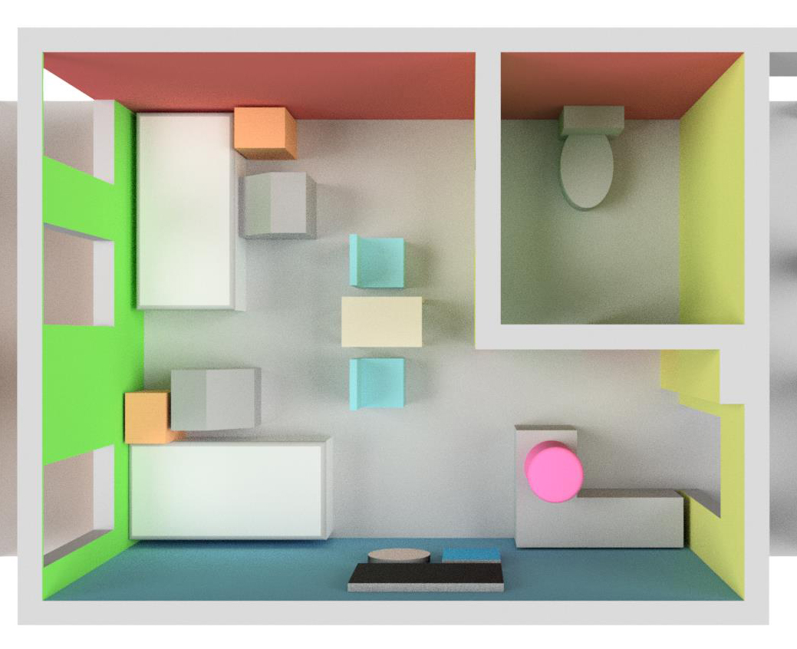
EARLY 3D CAD MODELLING EFFORTS

Slide 2
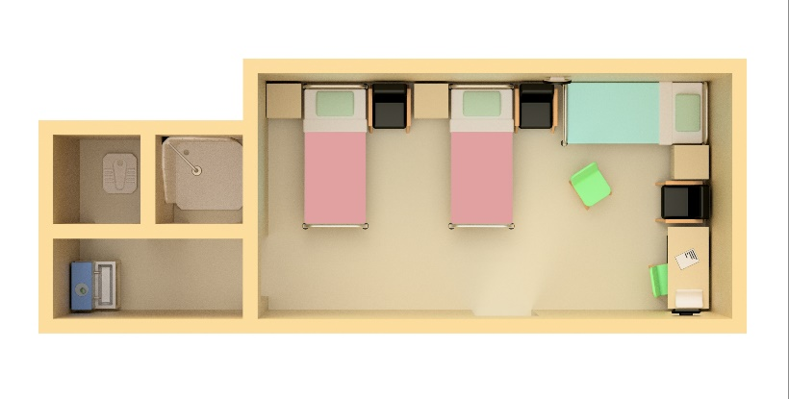
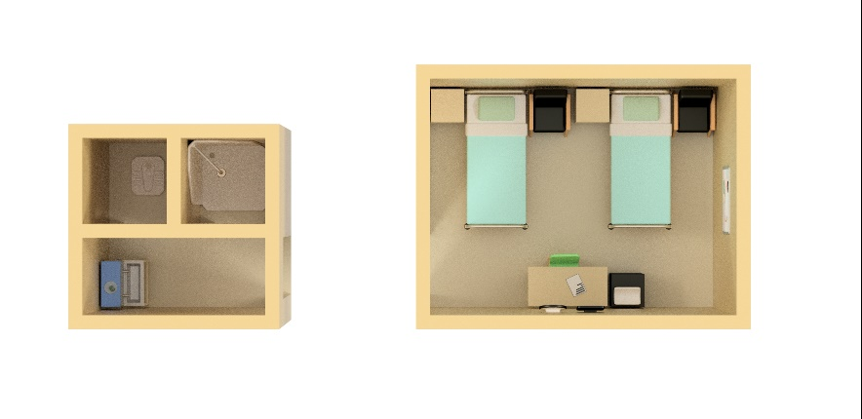
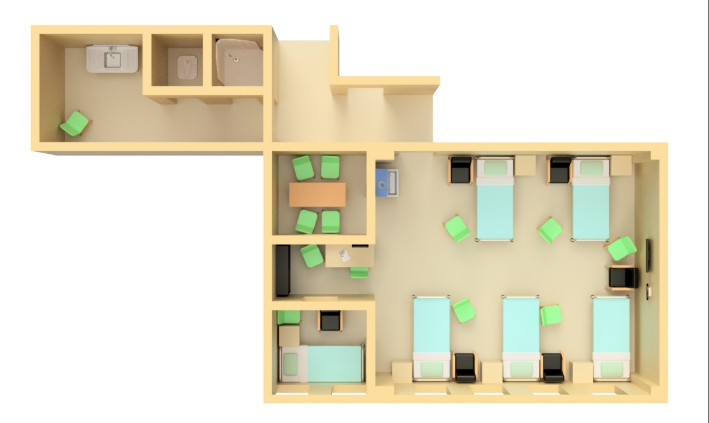
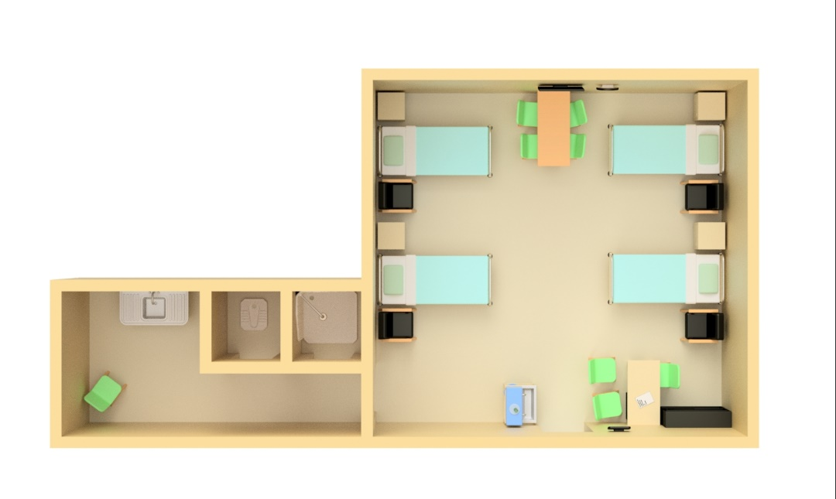
4 TYPES OF KMC ROOMS IN TIGRAY CATCHMENT
Health Care Center with shared KMC & Post Natal Room
Health Care Center with dedicated KMC room
1 KMC BED
1 - 2 KMC BEDS
Regional Hospital KMC Room
Referral Hospital KMC Room (i.e. Ayder Hospital)
2 - 4 KMC BEDS
6+ KMC BEDS

Slide 3
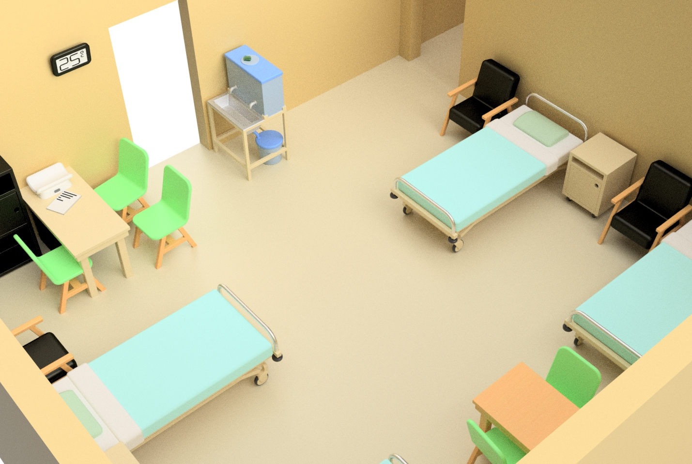
KMC ROOM 3D CAD MODELLING – PHYSICAL SPACE

Slide 4
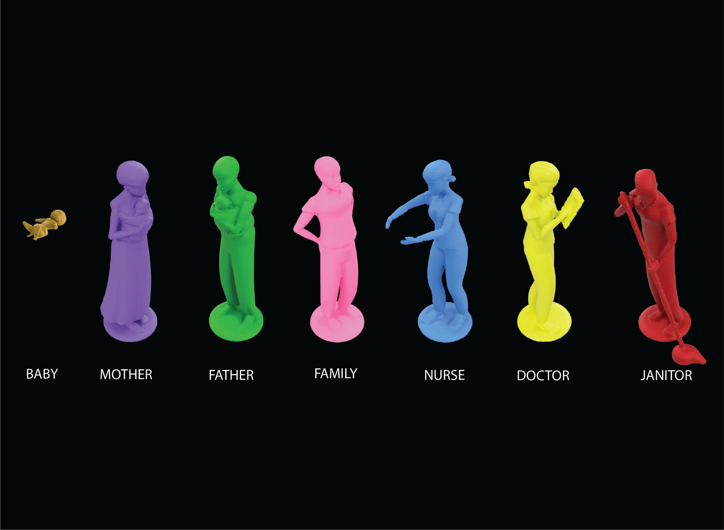
KMC ROOM 3D CAD MODELLING – PEOPLE!

Slide 5
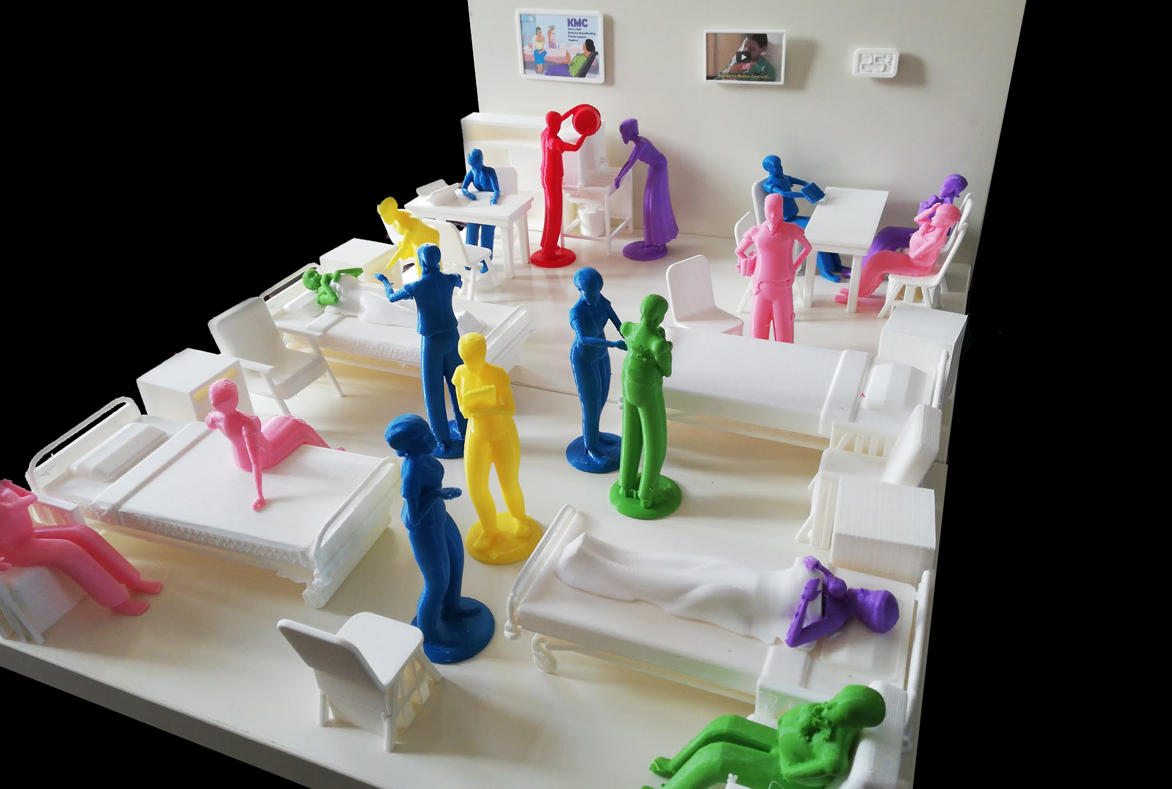
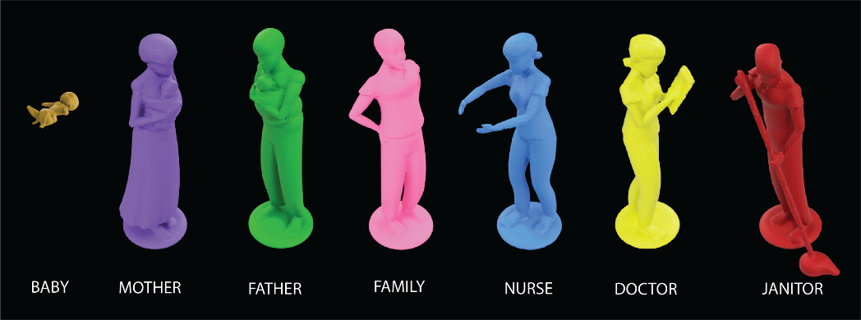
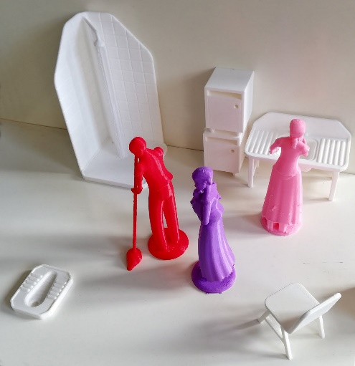
KMC ROOM 3D MAQUETTE

